Slide 1
Malignant peripheral nerve sheath tumors (MPNST)
An overview with emphasis on pathology,
imaging and management strategies.
Timothy Beer
Jefferson Medical College

Slide 2
OVERVIEW
DEFINITION
Any sarcoma with one of the following features:
arising from a peripheral nerve
arising from a pre-existing benign nerve sheath tumor
demonstrating Schwann cell differentiation on histologic examination
Any malignant spindled tumor in a patient with neurofibromatosis 1 (NF-1), unless proven otherwise
EPIDEMIOLOGY
Accounts for 5-10% of all soft tissue sarcomas
Incidence of 0.001% in the general population
Up to 50% occur in patients with NF-1, 10% are radiation-induced, 40% are sporadic
NF-1 associated MPNST
develops from existing plexiform neurofibromas, NOT superficial neurofibromas
lifetime risk of MPNST in NF-1 patients has been reported between 5-10%
tend to present earlier in life and with larger tumors than sporadic MPNSTs
Radiation-induced MPNST
mean latency between irradiation and MPNST presentation may be around 15.5 years (range: 2-26)
CLINICAL FEATURES
Most commonly presents as an enlarging mass +/- pain, paresthesias or neurologic deficits
Most commonly occurs in or near a nerve trunk (e.g. brachial plexus, sacral plexus, sciatic nerve)
Tend to recur locally and spread hematogenously, with lungs being the most common site of metastasis by far

Slide 3
PATHOGENESIS
A
B
D
Loss of remaining
functional NF-1 gene
↑Ras, cAMP, Ca²⁺
↓p53, p16^{INK4A}, p19^{ARF}, Rb
↑EGFR, Kit-L, TGFβ1
↑EGFR, ErbB2, c-KIT, c-MET
HGF, PDGF
C
E
(adapted by Timothy Beer from Carroll S, Acta Neuropathol, 2012)
Model for the pathogenesis of plexiform neurofibroma development and subsequent malignant transformation to malignant peripheral nerve sheath tumor (MPNST). The NF-1 gene encodes for the protein neurofibromin, which has been demonstrated to have tumor suppressor function. A Absence of the second functional NF-1 gene results in loss of neurofibromin function, leading to B de-regulation of several intracellular signaling cascades, including the Ras → Raf, MEK, ERK pathway, the cAMP → Protein kinase A pathway and calcium signaling pathways, all of which favor increased proliferative activity. Likewise, C EGF receptor (EGFR) accumulates because its expression is no longer inhibited by neurofibromin. These pro-growth alterations, together with substantial increases in secretion of the factors Kit ligand (Kit-L) and transforming growth factor beta (TGFβ1) are thought to contribute to the development of neurofibromas. Several additional molecular and genetic aberrations occur in those plexiform neurofibromas that undergo malignant transformation to MPNST. One such aberration is the D substantially decreased or absent expression of the key tumor suppressor proteins p53, p16^{INK4A}, p19^{ARF} and Rb (although p53 has actually been found to accumulate in the nuclei of cells in some MPNSTs). Another aberration is E further increased expression of several growth factors and their ligands, including EGFR, ErbB2, c-KIT, c-MET, HGF and PDGF.

Slide 4
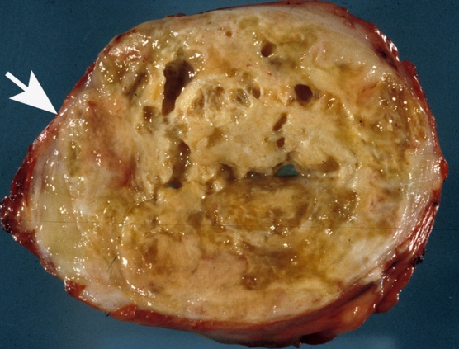
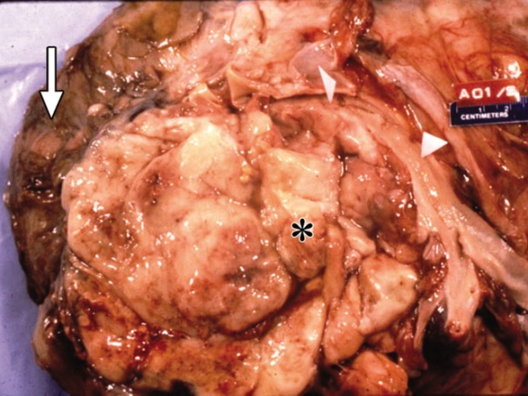
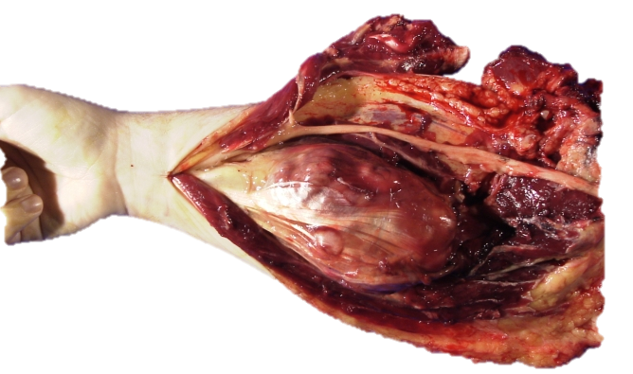
GROSS PATHOLOGY
FEATURES
Shape is globoid or fusiform (wide in the middle and tapers at both ends)
Mean size in most series is 10-15 cm in greatest dimension and infrequently less than 5 cm
Consistency is fleshy and firm to hard
Color is typically tan-gray on cut section, but may include a wide variety of colors
Necrosis is typically present, either focally or extensively
Areas of cyst formation are commonly present
May or may not be covered by a fibrous pseudocapsule
Gross invasion into surrounding soft tissues is a common finding
Entering and exiting nerve segments may be thickened due to spread along the epineurium and perineurium
May be surrounded by portions of plexiform neurofibroma which have not yet undergone malignant transformation
EXAMPLES
Retroperitoneal MPNST. Tan-gray with areas of necrosis and cyst formation. A thin pseudocapsule can be seen surrounding this tumor (arrow).
MPNST adherent to psoas muscle. Tan-yellow with some areas of hemorrhage. Adherent vessel (arrowheads) and portion of psoas muscle (arrow) can also be seen.
MPNST of the right arm. This image illustrates the typical “fusiform” (central enlargement with distal tapering) shape these tumors impart as they expand the involved nerve.

Slide 5
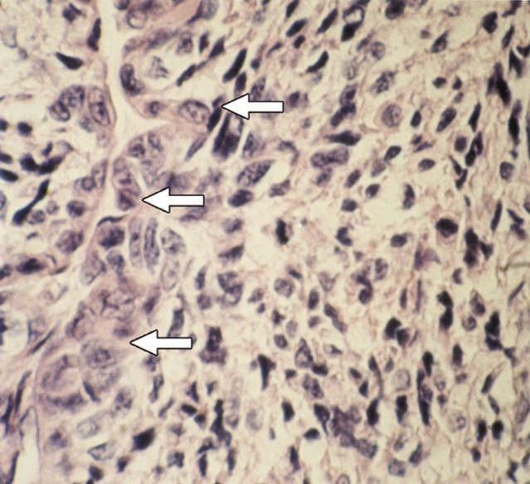
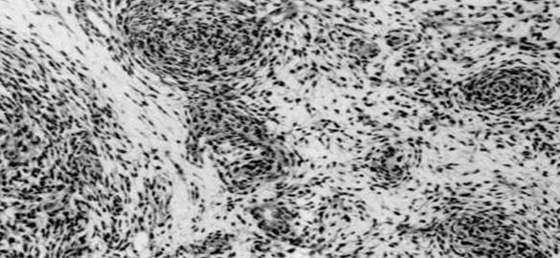
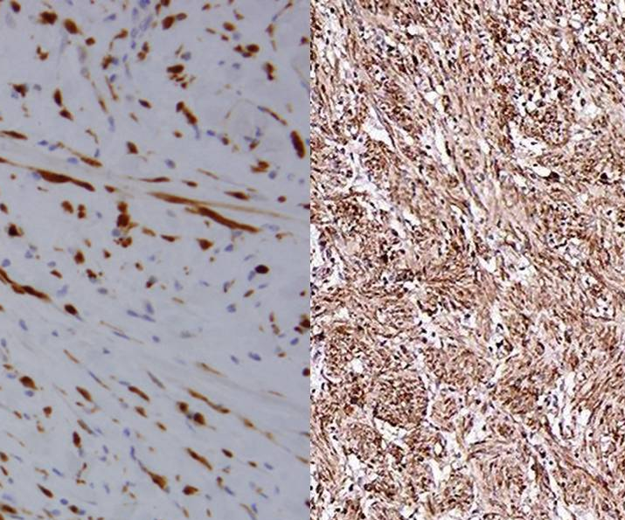
MICROSCOPIC PATHOLOGY
FEATURES
“Marbled” pattern of hypercellular fascicles of spindle cells interrupted by hypocellular myxoid areas
The spindle cells are relatively large, with long, hyperchromatic, wavy or “serpentine” nuclei
Perivascular hypercellularity, with indentation of cells into vascular lumens, is characteristic
High-grade tumors tend to have high mitotic activity and necrosis, while low-grade MPNSTs often lack these features
Minority of MPNSTs have variable differentiation (e.g. rhabdomyoblastic, epithelioid, glandular)
No specific immunohistochemical markers, although several are used to help differentiate from BPNST and melanoma
S100+ in 50-60% (but usually only focally), Leu-7+ in 50%, myelin basic protein+ in 50%, HMB45-, cytokeratin-
EXAMPLES
MPNST
Neurofibroma
Perivascular accentuation. Large spindle cells with irregular nuclei (arrows) encroach into vascular lumens, a histologic hallmark of MPNST.
“Marbled” appearance. Fascicles or bundles of tightly packed spindle cells alternate with relatively hypocellular myxoid zones, imparting a marbleized architecture.
S-100 staining. (left) MPNST stains S-100 positive only focally, whereas (right) benign neurofibroma stains S-100 positive strongly and diffusely.

Slide 6
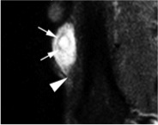
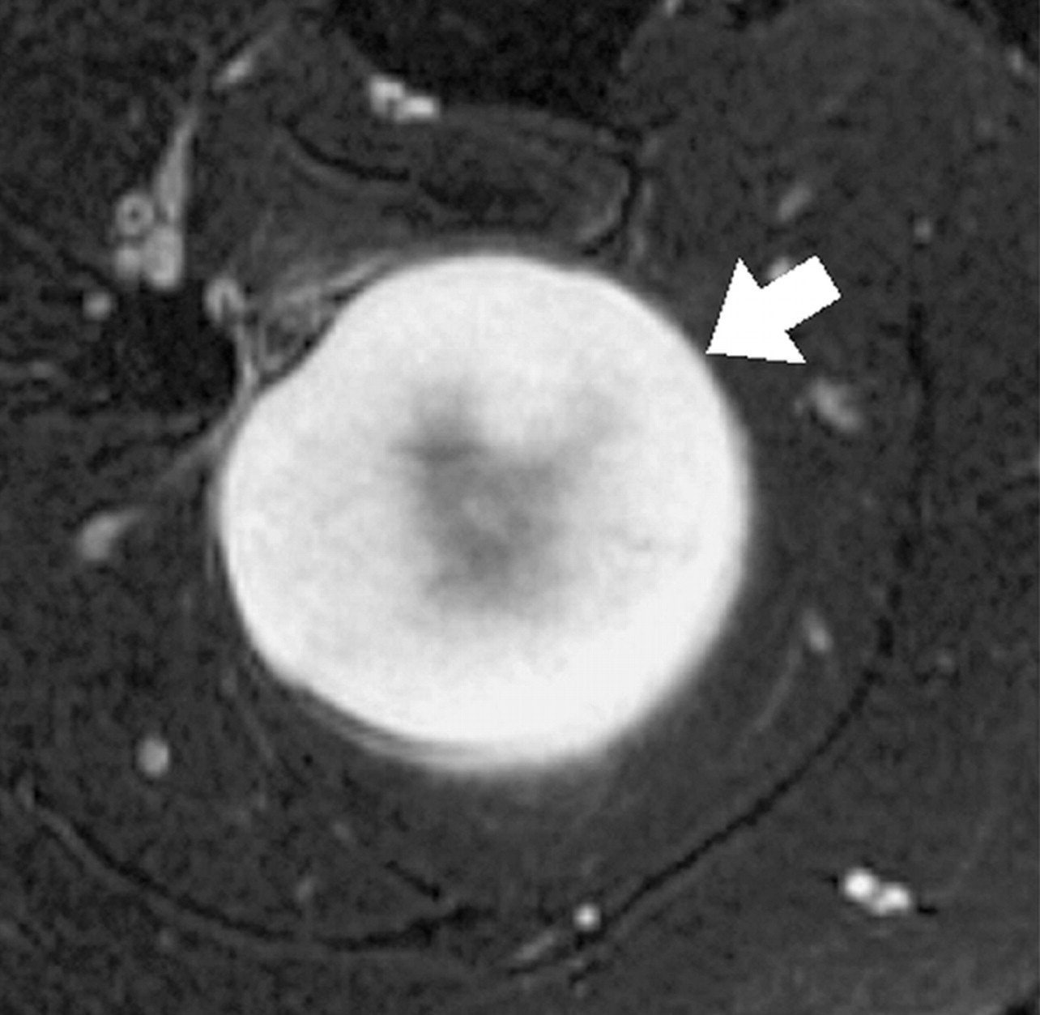
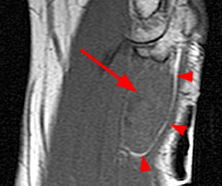
IMAGING
MRI (with and without contrast)
Imaging modality of choice for peripheral nerve sheath tumors
Cannot provide definitive diagnosis, but helps differentiate MPNST from benign plexiform neurofibromas (see table)
Fat suppression sequences may allow for better visualization of the nerve(s) involved
Magnetic resonance neurography (MRN) offers superior visualization and delineation of peripheral nerves from surrounding soft tissue and may be superior to MRI for evaluating MPNSTs, where the technology is available
MRI CHARACTERISTICS OF BENIGN AND MALIGNANT PERIPHERAL NERVE SHEATH TUMORS
CHARACTERISTIC | BPNST | MPNST
Fusiform shape with tapered ends | Present | Present
Oriented longitudinally along direction of peripheral nerve | Present | Present
Fascicular sign: multiple ring-like structures with peripheral hyperintensity on T2 weighted MR | Present | Absent
Target sign: hyperintense periphery surrounding a hypointense center on T2 weighted MR | Present | Absent
Split-fat sign: rim of fat surrounding the neurovascular bundle (and lesion) on T1 weighted MR | Present | Absent
Fascicular sign. (T2-MR) A hypointense ring (arrows) within an otherwise hyperintense benign plexiform neurofibroma.
Target sign. (T2-MR) A hypointense center with a hyperintense periphery in a benign plexiform neurofibroma of the tibial nerve.
Split-fat sign. (T1 MR) A rim of fat (arrow heads)
surrounds the neurovascular bundle in which a benign
Schwannoma (large arrow) has formed.

Slide 7
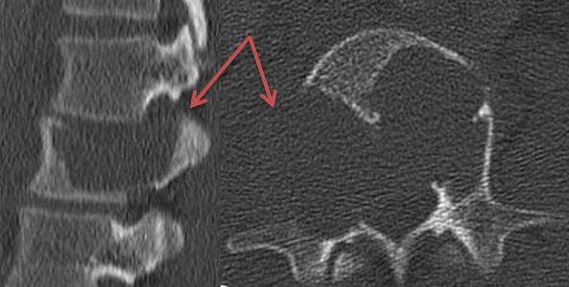
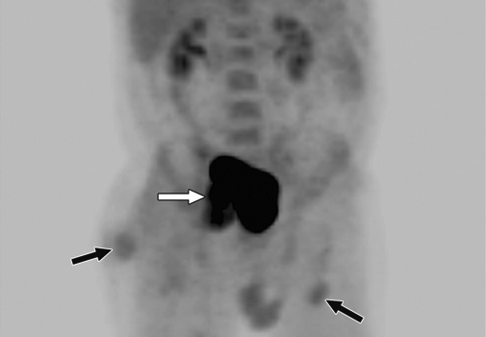
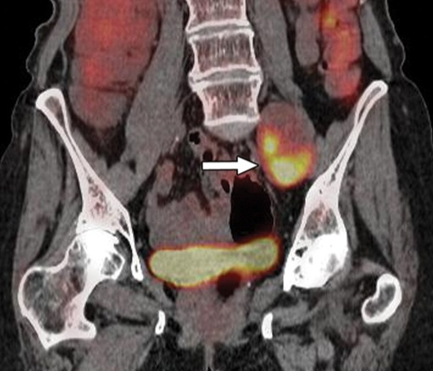
IMAGING
CT
Test of choice for detection of metastases following diagnosis of primary MPNST
All patients with MPNSTs should receive CT of the chest to assess for pulmonary metastases
FDG-PET & PET-CT
Shown in several series to be sensitive (89%) and specific (95%) for differentiating MPNST from benign neurofibroma in NF-1 patients. Average SUV of plexiform neurofibromas reportedly 1.54-2.49, average for MPNSTs reportedly 5.4-7.63.
SUV_{max} does not appear to correlate well with tumor grade
Some recommend using regular interval PET-CT to monitor NF-1 patients for malignant transformation of plexiform neurofibromas (specific intervals not yet defined)
GALLIUM-67 SCINTIGRAPHY
Rarely used, but increased gallium-67 uptake has been shown to be associated with malignant transformation to MPNST
CT spine with reconstruction algorithm. Destructive MPNST at L2 involving most of the
anterior vertebral body, both pedicles, and the right lamina while adjacent disc spaces
appear normal.
Whole-body FDG-PET. Mild FDG uptake in several benign
neurofibromas (black arrows), but intense uptake in an MPNST
along the right sciatic nerve (white arrow).
Fused FDG PET-CT. Increased uptake of FDG (SUV = 4.2) in an MPNST within the left iliopsoas muscle (arrow).

Slide 8
PROGNOSTIC FACTORS
FAVORABLE PROGNOSTIC FACTORS IDENTIFIED IN 11 REVIEWS OF MPNST
PUBLICATION | n | SIGNIFICANT RELATIVELY FAVORABLE POSTOPERATIVE PROGNOSTIC FACTORS*
Anghileri (2006) | 205 | smaller tumor size, lack of local recurrence, extremity location
Stucky (2012) | 175 | tumor size < 5 cm, lack of local recurrence, low histologic grade, extremity location
Zou (2009) | 140 | tumor size < 10 cm, low intensity p53 staining, positive S-100 staining
Wong (1999) | 134 | smaller tumor size, low histologic grade, perineural histologic subtype
Brekke (2009) | 64 | tumor size < 8 cm, complete surgical resection, lower intensity p53 staining
Okada (2006) | 56 | tumor size < 7 cm
Baehring (2003) | 54 | complete surgical resection, young age, radiation therapy, lack of chemotherapy
Gousias** (2010) | 43 | gross total resection
Kar (2006) | 25 | lower histologic grade, greater cellular differentiation
Romanathan (1999) | 23 | tumor size < 10 cm, low histologic grade
Zhu** (2012) | 16 | low histologic grade
* For studies that performed both univariate and multivariate analyses, only those risk factors found to be significant on multivariate analysis are included here. Metastasis at time of presentation is a uniformly poor prognostic factor and therefore was not evaluated in most studies ** Zhu series included only spinal tumors and Gousias series included only intracranial tumors
SUMMARY
Evidence overwhelmingly supports tumor size and local recurrence as important postoperative prognostic factors. By extension, because lack of local recurrence by definition requires complete surgical resection, complete surgical resection is likely also an important prognostic factor. This conclusion is also asserted in most of the included series.
Evidence is suggestive, but not conclusive, that tumor location (extremity vs. trunk, head and neck) and histologic grade are also important prognostic factors.
Further analysis is needed to determine whether factors such as p53 expression, radiation therapy, histologic subtype and S-100 staining are significant prognostic factors.

Slide 9
GENERAL MANAGEMENT
Complete surgical excision is required for cure
SURGICAL RESECTION
Often requires en-bloc resection of major nerves and acceptance of potentially significant functional loss
Complete resectability rates are determined primarily by neuroanatomic location
Reported to be around 95% for extremity lesions and 20% for paraspinal lesions
Most cases of extremity MPNST can be completely resected without amputation
RADIOTHERAPY (ADJUVANT OR NEOADJUVANT)
Found to improve local control and reduce local recurrence rates in many series
However, most series have found no benefit with respect to overall survival
CHEMOTHERAPY (ADJUVANT)
Has NOT been shown in any large studies to significantly improve survival
Often considered for patients with large tumor size (> 5 cm in most series), unresectability or metastatic disease
Difficult to assess efficacy of agents and schedules because of the rarity of MPNST
Most often involves ifosfamide and doxorubicin-based regimens (but no guidelines exist)
In one series, 2 patients with MPNST lung metastases, who had been unresponsive to ifosfamide-doxorubicin, were given carboplatin-etoposide. This put them into partial remission, allowing for the complete resection of their lung metastases. Both patients remained disease free for 20 and 28 months, respectively, at the time of publication
FOLLOW-UP
Follow-up guidelines have NOT been defined and vary widely
Lee et al (2010) reported successful management of several local recurrences using MRI imaging every 3 months

Slide 10
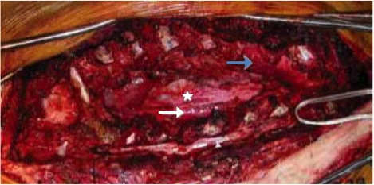
MANAGEMENT BY SITE
SPINAL
GENERAL
Paraspinal MPNSTs have a relatively dismal prognosis, largely due to their low rate of complete resectability, reported in some series to be as low as 20%
Most authors agree that paraspinal MPNSTs should be completely resected to achieve gross total resection, even if this requires an aggressive approach that severely destabilizes the spine and even in patients who have received prior radiation to the area
EXAMPLE McLaughlin et al. (Children’s Hospital of Philadelphia, 2011)
Patient: 14 year old female with left paraspinal MPNST extending to involve the intercostal muscles, aorta and neural foramina of T4-T10; previous surgeries, radiation and chemotherapy had failed
Intervention: performed gross total resection (GTR) using a costotransversectomy and multiple hemilaminotomies, then stabilized the patient using T1–12 pedicle screw fusion
Outcome: at time of publication, patient was 5 years post-op without any evidence of disease
UPDATE
She went on to be homecoming queen and as of June 2012, is finishing up as a cancer free premed undergrad!
Intraoperative “before” photo shows exposed spinal cord (yellow arrow), aorta (white arrow), pericardium (white star), and non-ventilated left lung (blue arrow).
Intraoperative “after” photo shows methyl methacrylate reconstruction and instrumented fusion. Due to prior thoracotomies, muscle flap was not possible.

Slide 11
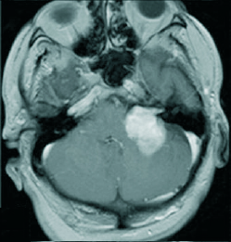
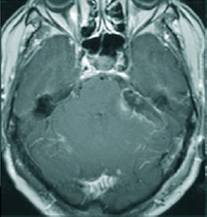
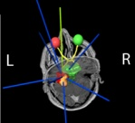
MANAGEMENT BY SITE
BRAIN
GENERAL
Over 40 cases of intracranial MPNST have been published and total gross resection has been shown to be essential for the achievement of extended survival
Adjuvant radiotherapy has been shown to be helpful in some cases but not others. Recently, a case report was published in which the use of adjuvant stereotactically-guided radiotherapy was associated with favorable outcome
EXAMPLE Gousias et al. (University Hospital of Bonn, 2010)
Patient: 64 year old male with 3 weeks of progressive headache, vertigo, nausea and ataxia. He had a 30 year history of left-sided hearing loss and 10 years ago a small benign appearing tumor at the left cerebellopontine angle had been detected on MRI. At the time of presentation, the mass was 3.5 x 4.0 cm and contrast enhancing
Intervention: gross total tumor resection (using neuromonitoring of motor tract and facial nerve function) followed 4 weeks later by stereotactic and image guided radiotherapy using single isocenter dose delivery
Outcome: follow-up clinical exam and MRI at 12 months showed no signs of tumor recurrence
UPDATE
Patient remained recurrence-free for at least 30 months, after which he was lost to follow-up
Pre-operative MRI. Strong enhancing mass in
CPA-IAC cistern with displacement of the MCP.
Post-operative MRI. No residual tumor seen.
Radiation plan MRI. Conformal arrangement of static beams. Tumor region is brown, CTV is blue, PTV is red.

Slide 12
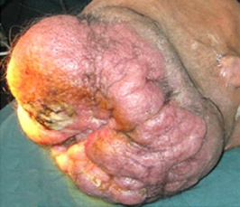
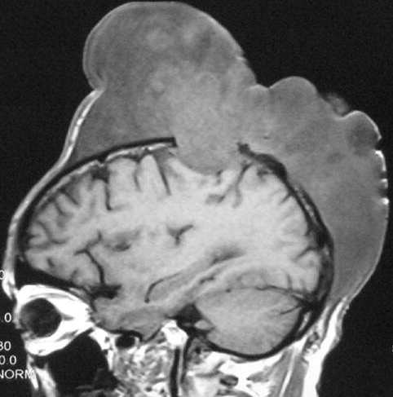
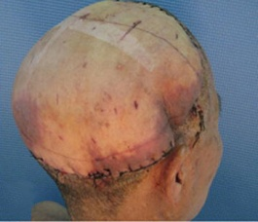
MANAGEMENT BY SITE
SCALP
GENERAL
Radical excision with wide margins (≥ 2 cm), histologic control of resection borders and adjuvant radiotherapy has been proposed as a standard of care therapy for scalp MPNST
In cases where tumor is found to have involvement of important intracranial structures or blood vessels, partial resection in combination with radiotherapy has been recommended
EXAMPLE Ge et al. (Jilin University, 2010)
Patient: 52 year old male with NF-1 with 22 x 18 cm multilobular, painless, non-mobile scalp mass with intracranial extension. The mass had been present for approximately 8.5 years, but progressively increased from the size of an egg over the past 2 years
Intervention: total excision of entire scalp mass and intracranial extension using repeated intra-operative margin assessment, followed by scalp repair using a skin ﬂap isolated from the lateral aspect of the left thigh
Outcome: no sign of tumor recurrence or metastasis at 6-month follow up
Pre-operative appearance. 22 × 18 cm diffuse multilobular scalp MPNST with focal areas of surface ulceration.
Pre-operative T1 MRI. Large heterogeneous hypointense lesion partially destructing the right parietal cranium.
Post-operative appearance. Scalp repaired with a skin flap isolated from the lateral aspect of the left thigh.

Slide 13
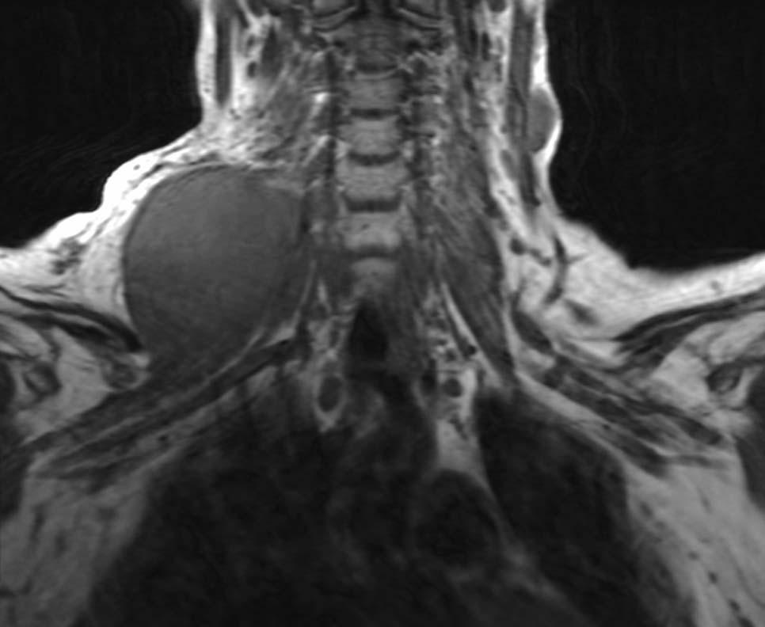
MANAGEMENT BY SITE
BRACHIAL PLEXUS
GENERAL
General consensus favors aggressive gross total resection, sacrificing as much of the brachial plexus, arm and shoulder as necessary
Neoadjuvant or adjuvant radiation are commonly employed for the purpose of decreasing local recurrence
Recently, there have been reports of successful brachial plexus reconstruction following MPNST excision
EXAMPLE Spiliopoulos K, Williams Z. (Massachusetts General Hospital, 2010)
Patient: 22 year old female with NF-1 with a rapidly enlarging, non-tender neck mass in the right supraclavicular fossa, encasing the upper trunk of the right brachial plexus. The mass had been biopsied 3 years prior and diagnosed as a benign plexiform neurofibroma, but it had since undergone malignant transformation to MPNST
Intervention: neoadjuvant external beam radiation followed by complete surgical excision of the tumor with negative margins, with subsequent reconstruction of the brachial plexus
Outcome: 19 months after excision of the tumor, no evidence of disease could be detected and the patient had regained function of all of the muscles in her right upper extremity, with some minor residual shoulder weakness
UPDATE
Patient is without recurrence and doing well as of June 2012
T2 weighted MRI. 6 cm lesion of heterogeneous
intensity encases upper trunk of the brachial plexus
Intraoperative photo. Fusiform tumor arising from the upper trunk of the brachial plexus

Slide 14
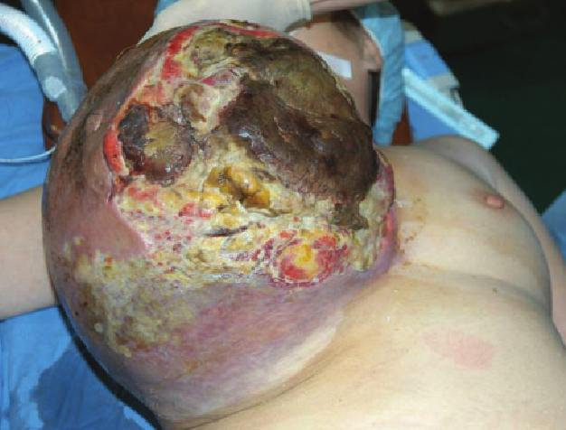
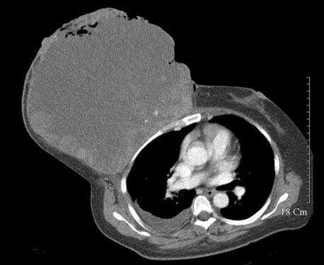
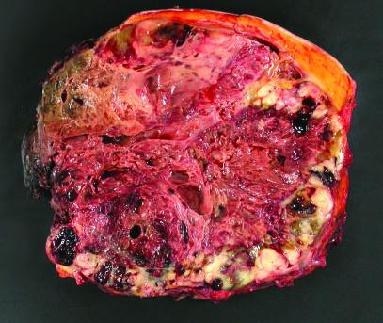
MANAGEMENT BY SITE
BREAST
GENERAL
MPNST of the breast is exceedingly rare (less than 10 total case reports published to date)
One case of MPNST of the male breast has been reported
Mastectomy (simple, radical or modified radical) ± radiation has been the treatment approach in all accounts
No long-term outcome data for breast MPNST has been reported
EXAMPLE Woo et al. (Korea University Hospital, 2007)
Patient: 56 year old female with breast mass, first noticed over 10 years ago, that had grown to 30 x 27 x 26 cm with extensive necrosis and hemorrhage
Intervention: modified radical mastectomy and axillary lymph node dissection with right anterior chest wall reconstruction using a pedicled latissimus dorsi muscle flap and a split thickness skin graft from the right thigh
Outcome: at time of publication was 6 months post-op without evidence of local recurrence or metastasis
Presenting appearance. Massive tumor of the right breast with extensive necrosis and inflammation.
Axial CT. Heterogeneous soft tissue mass with invasion
of the right anterior chest wall and substantial necrosis.
Mastectomy specimen. Heterogeneous solid mass has necrosis and hemorrhage with fleshy tan periphery.

Slide 15
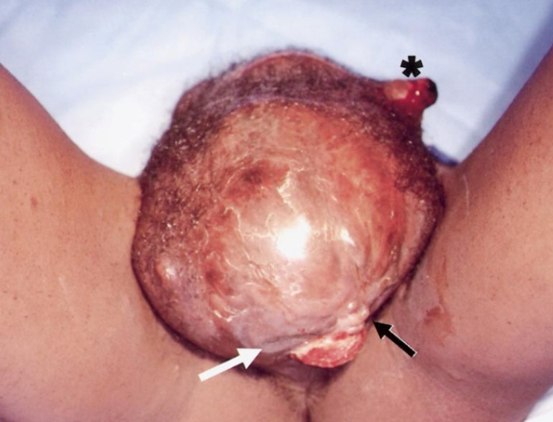
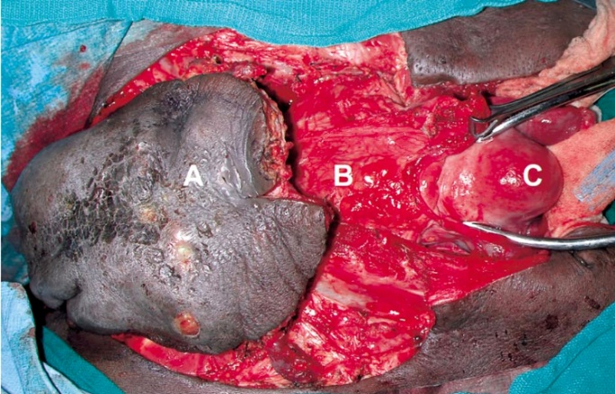
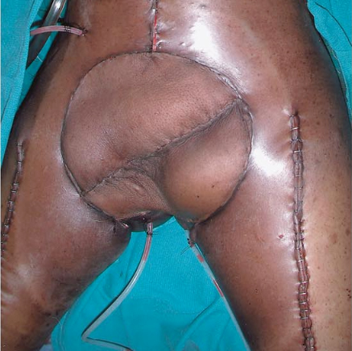
MANAGEMENT BY SITE
VULVA
GENERAL
There have been very few reported cases of MPNST of the vulva
Among the three case reports published, two were treated with surgical excision and were free of disease at 9 and 16 months, respectively. In the third case report, the patient had recurrent vulvar MPNST and was treated with neoadjuvant radiation, followed by margin-free excision and chemotherapy. She was disease free at 18 months
EXAMPLE Lambrou et al. (University of Miami Hospital, 2001)
Patient: 34 year old female with NF-1 had a rapidly enlarging recurrent pelvic MPNST (20 x 20 cm at presentation), pain, and difﬁculty ambulating. Only 6 weeks prior, she had undergone surgical removal of a 6 cm MPNST of the mons pelvis
Intervention: neoadjuvant external-beam radiation to shrink the mass, followed by anterior pelvic exenteration with intraoperative confirmation of negative margins and pelvic reconstruction and finally adjuvant chemotherapy
Outcome: No evidence of disease at 18 months after diagnosis
MPNST of vulva. Labeled are vaginal introitus (white arrow), urethral meatus (black arrow) and scar from previous incision (asterix).
En bloc resection of vulvar mass and adjacent structures. Labeled are vulvar tumor (A), 50% as large as it was prior to radiation therapy, bladder (B), uterus and adnexae (C).
Post-operative appearance. Reconstructed pelvis with rectus femoris myocutaneous ﬂaps.

Slide 16
MANAGEMENT EVIDENCE
Due to the rarity of MPNST, there have been no controlled trials, well designed cohort or case-control studies evaluating treatment. The body of evidence consists primarily of case reports, case series and literature reviews
Listed below are several of the articles from which evidence was derived for this presentation. They are graded by evidence level as defined by either the Oxford Center for Evidence-Based Medicine or the AHRQ guidelines
Article | Recommendation | Type | Evidence Level
Ferner et al. (2002) | All MPNST: postoperative radiotherapy as a uniform treatment policy | Expert group consensus | AHRQ: C
Kar et al. (2006) | All MPNST: radical surgical resection as treatment of choice | Case series | Oxford: 4
Kar et al. (2006) | All MPNST: postoperative radiotherapy has a definite role in both disease free and overall survival | Case series | Oxford: 4
Ducatman et al. (1986) | All MPNST: radical tumor excision with as wide of a margin of normal tissue as is feasible and the removal of all but the most vital structures, with amputation if necessary | Case series / 120 case review | Oxford: 4
Pengfei et al. (2010) | Scalp MPNST: intraoperative assessment of margins to ensure total tumor excision | Case report | Oxford: 4
Kumar et al. (2007) | Scalp MPNST: partial resection in combination with radiotherapy for cases with involvement of important intracranial structures or blood vessels | Case report | Oxford: 4
Voth et al. (2011) | Scalp MPNST: radical excision with wide margins (≥ 2 cm), histologic control of resection borders and adjuvant radiotherapy | Case report Systematic review | Oxford: 4
Woo et al. (2007) | Breast MPNST: modified radical mastectomy and axillary lymph node dissection for massive cases | Case report | Oxford: 4
Zhu et al. (2012) | Spinal MPNSTs: en bloc surgical resection if at all possible | Case series | Oxford: 4
Gousias et al. (2010) | Spinal MPNST: maximal surgical resection feasible with preservation of neurological function, followed by adjuvant stereotactically guided radiotherapy | Case report Literature review | Oxford: 4
Lambrou et al. (2001) | Vulva MPNST: complete surgical resection with adjuvant radiation +/- chemotherapy | Case report | Oxford: 4
Spiliopoulos et al. (2011) | Brachial plexus MPNST: reconstruction as an adjunct to surgical excision in patients in whom surgical morbidity is a necessary outcome of achieving gross total resection | Case report | Oxford: 4
Minovi et al. (2006) | Head and neck MPNST: complete tumor excision plus adjuvant radiotherapy | Case series Literature review | Oxford: 4
Chen et al. (2007) | Intracranial MPNST: complete surgical resection with radiotherapy for local control | Case report | Oxford: 4

Slide 17
SUMMARY
MPNSTs are rare malignancies that are classically associated with pre-existing plexiform neurofibromas in neurofibromatosis type 1 (NF-1) patients, but also occur in association with radiation as well as sporadically in patients with no known risk factors
The typical presentation of sporadic MPNST is a new painless enlarging mass. The typical presentation of MPNST in an NF-1 patient is rapid enlargement or new onset of pain associated with a pre-existing plexiform neurofibroma
Although both MPNST and benign neurofibromas share in common the absence of neurofibromin function due to loss of both NF-1 alleles, malignant transformation to MPNST requires several additional aberrations, most notably constituent activity of the proliferative Ras-GTPase pathway, increased expression of growth factor receptors such as EGFR and decreased activity in additional tumor suppressors such as p53, p16^{INK4A} and p19^{ARF}
Grossly, MPNSTs typically appear "fusiform" (wide in the middle with tapering at both ends), larger than 5 cm and tan-gray on cut section. Necrosis, cyst formation and a "pseudocapsule" are frequently, but not always, present features. They may or may not be surrounded by portions of a pre-existing neurofibroma which have not undergone malignant transformation
The histologic features of MPNSTs show considerable variation and they overlap greatly with benign neurofibromas. However, several features argue in favor of MPNST, including perivascular hypercellularity, hyperchromatic wavy nuclei, high mitotic activity, necrosis and only focal or no areas of S-100 positivity
MRI is the imaging modality of choice for evaluating MPNSTs. It can be useful for differentiating MPNST from benign neurofibroma based on the absence of the fascicular sign, target sign and split-fat sign. CT is most useful for detecting metastases and chest CT should be ordered for all newly diagnosed patients due to the high incidence of pulmonary metastases. PET-CT has an evolving role, especially with regards to differentiating neurofibroma from MPNST based on SUV
Prognostic factors for MPNST include tumor size, local recurrence and completeness of surgical resection. There is some evidence to suggest that tumor location (extremity vs. trunk, head and neck), histologic grade, p53 expression, S-100 expression, radiation therapy and histologic subtype may also be important prognostic factors
Complete surgical removal of an MPNST provides the only hope for cure. There are some cases where neoadjuvant radiation and/or chemotherapy have allowed for complete surgical removal and thereby enabled cure. There is considerable evidence to suggest that adjuvant radiation, but not adjuvant chemotherapy, is helpful in preventing local recurrence of MPNST
Postoperative follow-up strategies for MPNST varies greatly across practitioners. No formal guidelines for follow-up have been proposed, however one author has demonstrated that regular, frequent re-evaluation with MRI can allow for timely excision of local recurrences, thereby prolonging overall survival and extending the potential for cure

Slide 18
REFERENCES
1. Hajdu SI. Peripheral nerve sheath tumors. Histogenesis, classification, and prognosis. Cancer. Dec 15 1993;72(12):3549-3552.
2. Lee CS, Huh JS, Chang JW, Park JK. The early detection of recurrence of malignant peripheral nerve sheath tumor by frequent magnetic resonance imaging. Journal of Korean Neurosurgical Society. Jan 2010;47(1):51-54.
3. Foley KM, Woodruff JM, Ellis FT, Posner JB. Radiation-induced malignant and atypical peripheral nerve sheath tumors. Annals of neurology. Apr 1980;7(4):311-318.
4. Ducatman BS, Scheithauer BW. Postirradiation neurofibrosarcoma. Cancer. Mar 15 1983;51(6):1028-1033.
5. Eric Legiur HD, Rina Wu, Bryan K. Hall,. TP53 Mutations Are Frequent in Malignant NFI Tumors. Genes Chromosom Cancer. 1994;10:250-255.
6. Li CS, Huang GS, Wu HD, et al. Differentiation of soft tissue benign and malignant peripheral nerve sheath tumors with magnetic resonance imaging. Clinical imaging. Mar-Apr 2008;32(2):121-127.
7. Klijanienko J, Caillaud JM, Lagace R, Vielh P. Cytohistologic correlations of 24 malignant peripheral nerve sheath tumor (MPNST) in 17 patients: the Institut Curie experience. Diagnostic cytopathology. Aug 2002;27(2):103-108.
8. Gonzalez-Martinez T, Perez-Pinera P, Diaz-Esnal B, Vega JA. S-100 proteins in the human peripheral nervous system. Microscopy research and technique. Apr 15 2003;60(6):633-638.
9. Smith TA, Machen SK, Fisher C, Goldblum JR. Usefulness of cytokeratin subsets for distinguishing monophasic synovial sarcoma from malignant peripheral nerve sheath tumor. American journal of clinical pathology. Nov 1999;112(5):641-648.
10. Bhargava R, Parham DM, Lasater OE, Chari RS, Chen G, Fletcher BD. MR imaging differentiation of benign and malignant peripheral nerve sheath tumors: use of the target sign. Pediatric radiology. Feb 1997;27(2):124-129.
11. Banks KP. The target sign: extremity. Radiology. Mar 2005;234(3):899-900.
12. Pilavaki M, Chourmouzi D, Kiziridou A, Skordalaki A, Zarampoukas T, Drevelengas A. Imaging of peripheral nerve sheath tumors with pathologic correlation: pictorial review. European journal of radiology. Dec 2004;52(3):229-239.
13. Murphey MD, Smith WS, Smith SE, Kransdorf MJ, Temple HT. From the archives of the AFIP. Imaging of musculoskeletal neurogenic tumors: radiologic-pathologic correlation. Radiographics : a review publication of the Radiological Society of North America, Inc. Sep-Oct 1999;19(5):1253-1280.
14. Chhabra A, Soldatos T, Durand DJ, Carrino JA, McCarthy EF, Belzberg AJ. The role of magnetic resonance imaging in the diagnostic evaluation of malignant peripheral nerve sheath tumors. Indian journal of cancer. Jul-Sep 2011;48(3):328-334.
15. Maniker AH. Diagnostic steps, imaging, and electrophysiology. Neurosurgery clinics of North America. Apr 2004;15(2):133-144
16. Bensaid B, Giammarile F, Mognetti T, et al. [Utility of 18 FDG positon emission tomography in detection of sarcomatous transformation in neurofibromatosis type 1]. Annales de dermatologie et de venereologie. Oct 2007;134(10 Pt 1):735-741.
17. Basu S, Nair N. Potential clinical role of FDG-PET in detecting sarcomatous transformation in von Recklinghausen's disease: a case study and review of the literature. Journal of neuro-oncology. Oct 2006;80(1):91-95.
18. Benz MR, Czernin J, Dry SM, et al. Quantitative F18-fluorodeoxyglucose positron emission tomography accurately characterizes peripheral nerve sheath tumors as malignant or benign. Cancer. Jan 15 2010;116(2):451-458.
19. Cardona S, Schwarzbach M, Hinz U, et al. Evaluation of F18-deoxyglucose positron emission tomography (FDG-PET) to assess the nature of neurogenic tumours. European journal of surgical oncology : the journal of the European Society of Surgical Oncology and the British Association of Surgical Oncology. Aug 2003;29(6):536-541.
20. Brenner W, Friedrich RE, Gawad KA, et al. Prognostic relevance of FDG PET in patients with neurofibromatosis type-1 and malignant peripheral nerve sheath tumours. European journal of nuclear medicine and molecular imaging. Apr 2006;33(4):428-432.
21. Karabatsou K, Kiehl TR, Wilson DM, Hendler A, Guha A. Potential role of 18fluorodeoxyglucose-positron emission tomography/computed tomography in differentiating benign neurofibroma from malignant peripheral nerve sheath tumor associated with neurofibromatosis 1. Neurosurgery. Oct 2009;65(4 Suppl):A160-170.
22. Tsai LL, Drubach L, Fahey F, Irons M, Voss S, Ullrich NJ. [18F]-Fluorodeoxyglucose positron emission tomography in children with neurofibromatosis type 1 and plexiform neurofibromas: correlation with malignant transformation. Journal of neuro-oncology. Mar 11 2012.

Slide 19
REFERENCES
23. Ferner RE, Lucas JD, O'Doherty MJ, et al. Evaluation of (18)fluorodeoxyglucose positron emission tomography ((18)FDG PET) in the detection of malignant peripheral nerve sheath tumours arising from within plexiform neurofibromas in neurofibromatosis 1. Journal of neurology, neurosurgery, and psychiatry. Mar 2000;68(3):353-357.
24. Ferner RE, Golding JF, Smith M, et al. [18F]2-fluoro-2-deoxy-D-glucose positron emission tomography (FDG PET) as a diagnostic tool for neurofibromatosis 1 (NF1) associated malignant peripheral nerve sheath tumours (MPNSTs): a long-term clinical study. Annals of oncology : official journal of the European Society for Medical Oncology / ESMO. Feb 2008;19(2):390-394.
25. Levine E, Huntrakoon M, Wetzel LH. Malignant nerve-sheath neoplasms in neurofibromatosis: distinction from benign tumors by using imaging techniques. AJR. American journal of roentgenology. Nov 1987;149(5):1059-1064.
26. Longhi A, Errani C, Magagnoli G, et al. High grade malignant peripheral nerve sheath tumors: outcome of 62 patients with localized disease and review of the literature. J Chemother. Dec 2010;22(6):413-418.
27. Baehring JM, Betensky RA, Batchelor TT. Malignant peripheral nerve sheath tumor: the clinical spectrum and outcome of treatment. Neurology. Sep 9 2003;61(5):696-698.
28. Demir HA, Varan A, Yalcn B, Akyuz C, Kutluk T, Buyukpamukcu M. Malignant peripheral nerve sheath tumors in childhood: 13 cases from a single center. Journal of pediatric hematology/oncology. Apr 2012;34(3):204-207.
29. Moharir M, London K, Howman-Giles R, North K. Utility of positron emission tomography for tumour surveillance in children with neurofibromatosis type 1. European journal of nuclear medicine and molecular imaging. Jul 2010;37(7):1309-1317.
30. Tucker T, Wolkenstein P, Revuz J, Zeller J, Friedman JM. Association between benign and malignant peripheral nerve sheath tumors in NF1. Neurology. Jul 26 2005;65(2):205-211.
31. Gousias K, Bostrom J, Kovacs A, Niehusmann P, Wagner I, Kristof R. Factors of influence upon overall survival in the treatment of intracranial MPNSTs. Review of the literature and report of a case. Radiat Oncol. 2010;5:114.
32. van den Munckhof P, Germans MR, Schouten-van Meeteren AY, Oldenburger F, Troost D, Vandertop WP. Recurring intracranial malignant peripheral nerve sheath tumor: case report and systematic review of the literature. Neurosurgery. Apr 2011;68(4):E1152-1158; discussion E1159.
33. Gupta G, Maniker A. Malignant peripheral nerve sheath tumors. Neurosurgical focus. 2007;22(6):E12.
34. Spiliopoulos K, Williams Z. Brachial plexus reconstruction following resection of a malignant peripheral nerve sheath tumor: case report. Neurosurgery. Jul 2011;69(1):E245-250; discussion E250.
35. McLaughlin EJ, Heuer GG, Whitmore RG, et al. Treatment of a malignant peripheral nerve sheath tumor and its complications through a multidisciplinary approach. Journal of neurosurgery. Pediatrics. May 2011;7(5):543-548.
36. Kim KT, Park YS, Kwon JT, Kim YB. Primary paraspinal malignant peripheral nerve sheath tumor. Journal of Korean Neurosurgical Society. Aug 2008;44(2):91-94.
37. Xu Q, Xing B, Huang X, Wang R, Li Y, Yang Z. Primary malignant peripheral nerve sheath tumor of the cauda equina with metastasis to the brain in a child: case report and literature review. The spine journal : official journal of the North American Spine Society. Apr 2012;12(4):e7-e13.
38. Rames RA, Smith MT. Malignant peripheral nerve sheath tumor of the prostate: a rare manifestion of neurofibromatosis type 1. The Journal of urology. Jul 1999;162(1):165-166.
39. Garg A, Gupta V, Gaikwad SB, et al. Scalp malignant peripheral nerve sheath tumor (MPNST) with bony involvement and new bone formation: case report. Clinical neurology and neurosurgery. Sep 2004;106(4):340-344.
40. Ge P, Fu S, Lu L, Zhong Y, Qi B, Luo Y. Diffuse scalp malignant peripheral nerve sheath tumor with intracranial extension in a patient with neurofibromatosis type 1. Journal of clinical neuroscience : official journal of the Neurosurgical Society of Australasia. Nov 2010;17(11):1443-1444.
41. Voth H, Nakai N, Wardelmann E, et al. Malignant peripheral nerve sheath tumor of the scalp: case report and review of the literature. Dermatologic surgery : official publication for American Society for Dermatologic Surgery [et al.]. Nov 2011;37(11):1684-1688.

Slide 20
REFERENCES
42. Fukushima S, Kageshita T, Wakasugi S, et al. Giant malignant peripheral nerve sheath tumor of the scalp. The Journal of dermatology. Dec 2006;33(12):865-868.
43. Woo OH, Yong HS, Lee JB, Kim A, Koo BH, Kang EY. A giant malignant peripheral nerve sheath tumour of the breast: CT and pathological findings. The British journal of radiology. Feb 2007;80(950):e44-47.
44. Fangfang L, Danhua S, Songlin L, Yanfeng Z. An unusual breast malignant peripheral nerve sheath tumour and review of the literature. Journal of clinical pathology. Jul 2010;63(7):663-664.
45. Thanapaisal C, Koonmee S, Siritunyaporn S. Malignant peripheral nerve sheath tumor of breast in patient without Von Recklinghausen's neurofibromatosis: a case report. Journal of the Medical Association of Thailand = Chotmaihet thangphaet. Mar 2006;89(3):377-379.
46. Dhingra KK, Mandal S, Roy S, Khurana N. Malignant peripheral nerve sheath tumor of the breast: case report. World journal of surgical oncology. 2007;5:142.
47. Berrada R, Chahtane A, Lakhdar A, et al. [Malignant schwannoma of the breast. A case report]. Journal de gynecologie, obstetrique et biologie de la reproduction. Jun 1998;27(4):441-444.
48. Besznyak I, Dubecz S, Peter I. [Malignant schwannoma of the breast]. Orvosi hetilap. Jan 18 1998;139(3):137-139.
49. Hauser H, Beham A, Steindorfer P, Schmidt F, Smola MG. Malignant schwannoma of the breast. Langenbecks Archiv fur Chirurgie. 1995;380(6):350-353.
50. Catania S, Pacifico E, Zurrida S, Cusumano F. Malignant schwannoma of the breast. European journal of surgical oncology : the journal of the European Society of Surgical Oncology and the British Association of Surgical Oncology. Feb 1992;18(1):80-81.
51. Catania S, Vittorelli C, Pacifico E, Cusumano F, Sarti L. [Malignant schwannoma of the breast. Contribution to diagnosis and therapy]. Minerva chirurgica. Oct 15 1983;38(19):1589-1590.
52. Heslin MJ, Cordon-Cardo C, Lewis JJ, Woodruff JM, Brennan MF. Ki-67 detected by MIB-1 predicts distant metastasis and tumor mortality in primary, high grade extremity soft tissue sarcoma. Cancer. Aug 1 1998;83(3):490-497.
53. Brekke HR, Kolberg M, Skotheim RI, et al. Identification of p53 as a strong predictor of survival for patients with malignant peripheral nerve sheath tumors. Neuro-oncology. Oct 2009;11(5):514-528.
54. Halling KC, Scheithauer BW, Halling AC, et al. p53 expression in neurofibroma and malignant peripheral nerve sheath tumor. An immunohistochemical study of sporadic and NF1-associated tumors. American journal of clinical pathology. Sep 1996;106(3):282-288.
55. Collin C, Godbold J, Hajdu S, Brennan M. Localized extremity soft tissue sarcoma: an analysis of factors affecting survival. Journal of clinical oncology : official journal of the American Society of Clinical Oncology. Apr 1987;5(4):601-612.
56. Stucky CC, Johnson KN, Gray RJ, et al. Malignant peripheral nerve sheath tumors (MPNST): the Mayo Clinic experience. Annals of surgical oncology. Mar 2012;19(3):878-885.
57. Ducatman BS, Scheithauer BW, Piepgras DG, Reiman HM, Ilstrup DM. Malignant peripheral nerve sheath tumors. A clinicopathologic study of 120 cases. Cancer. May 15 1986;57(10):2006-2021.
58. Wong WW, Hirose T, Scheithauer BW, Schild SE, Gunderson LL. Malignant peripheral nerve sheath tumor: analysis of treatment outcome. International journal of radiation oncology, biology, physics. Sep 1 1998;42(2):351-360.
59. Kourea HP, Bilsky MH, Leung DH, Lewis JJ, Woodruff JM. Subdiaphragmatic and intrathoracic paraspinal malignant peripheral nerve sheath tumors: a clinicopathologic study of 25 patients and 26 tumors. Cancer. Jun 1 1998;82(11):2191-2203.

