Slide 1

The Decision Counseling Program© and
Shared Decision Making
Ronald E. Myers, PhD
Professor and Director, Division of Population Science
Department of Medical Oncology, Kimmel Cancer Center, Thomas Jefferson University

Slide 2
Patient-Centered Care
Patient-centered care is “care that is respectful of and responsive to individual patient preferences, needs, and values (and ensures) that patient values guide all clinical decisions.”
  (Crossing the Quality Chasm, IOM, 2001)
“the most important attribute of patient-centered
care is the active engagement of patients when
fateful health care decisions must be made –
when an individual patient arrives at a crossroads
of medical options, where the diverging paths
have different and important consequences with
lasting implications.”
  (Barry and Edgman-Levitan, NEJM, 2012)

Slide 3
Before Decision Counseling and Shared Decision Making
Patients & Families
Outcomes
Quality & Safety
Patient Experience
Provider Satisfaction
Clinical Outcomes
Use of Resources
Clinical
Encounter
Health Care Providers
Health Care Organizations
Environment

Slide 4
Receptivity to Shared Decision Making
Most patients want to be involved in decisions about their health care, but do not wish to make autonomous decisions or take on what they perceive to be the provider’s role.
Most providers support patient participation, but view the value of patient input as limited by understanding their clinical situation and options.
  (Deber et al., 2007; Hamann et al., 2007; Legare et al., 2008)

Slide 5
Decision Aids (DAs)
Print materials (pamphlets, brochures, booklets)
Oral, scripted presentations
Audiovisual or digital recordings
Computer-based or online software applications

Slide 6
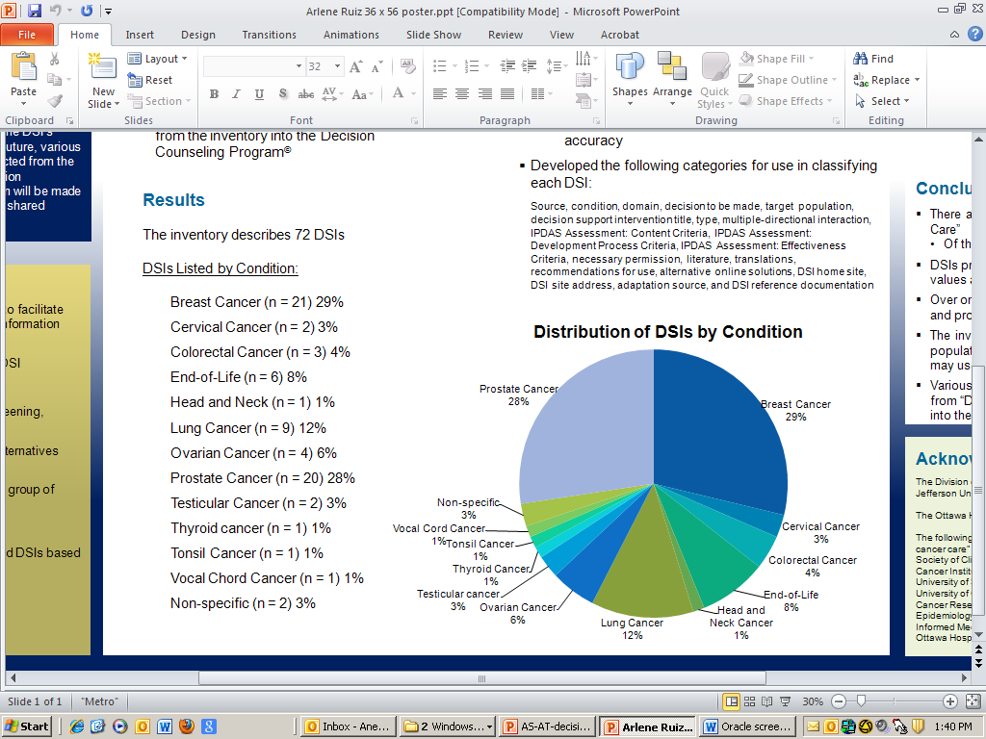
Inventory of DAs in Cancer Care

Slide 7
Implementing DAs: Are We There Yet?
Population-based survey mailed to 878 physicians: surgeons, medical oncologists, & radiation oncologists
69% of respondents aware of decision aids, and 46% were aware of decision aids relevant to their practice
24% were currently using decision aids
Main barriers to the use of decision aids in practice
  Lack of awareness
  Limited resources/time
(J Clin Oncol., 2010;28:2286-2292))

Slide 8


Slide 9
DAs Decision Support Interventions (DSIs)
“Decision support interventions help people think about choices they face; they describe where and why choice exists; (and) they provide information about options, including where reasonable, the option of taking no action.”
Decision support interventions (DSIs) can be used for one-way delivery of information to patients (non-mediated) or in the context of a two-way interaction between a patient and a health care provider (mediated)
(Elwyn et al., 2010))

Slide 10
Decision Counseling – A Mediated DSI
(Physician, Nurse, Social Worker, Health Educator)
    Specify decision to be made and alternatives (options)
    Provide education about decision options
    Clarify patient preference related to available options and create 1-page summary of results
    Make summary report available for use in shared decision making
    Follow-up to assess decision making, planning, performance, and experience

Slide 11

Decision Counseling and Shared Decision Making
Decision Counseling
Program©
Patients & Families
Outcomes
Quality & Safety
Patient Experience
Provider Satisfaction
Clinical Outcomes
Use of Resources
SDM in the Clinical
Encounter
Health Care Providers
Health Care Organizations
Environment

Slide 12
Decision Counseling Program©
Counseling Component
  Education, counseling, and shared decision making
Administration
  Creation of counseling sessions tailored to defined health decisions
Training and Support
  In-person and distance learning
  Database development and results reporting

Slide 13
Case Study: Active Surveillance vs Active Treatment among Men with Low-Risk Prostate Cancer
Active surveillance (AS) is a reasonable treatment option for men with low-risk prostate cancer vs active treatment (AT)
  Life expectancy < 10-15 years; cancer not felt on DRE and/or small stage T1c or T2a; PSA < 10ng/ml; Gleason score < 6 with no Gleason pattern 4 or 5 on a 12 core biopsy
Prostate Cancer Intervention Versus Observation Trial (PIVOT). Wilt et al. N Engl J Med 2012; 367:203-213, July 19, 2012.
At 10 years, mortality did not differ among men who had radical prostatectomy and men who had observation
  10% of men with low-risk prostate cancer have AS

Slide 14
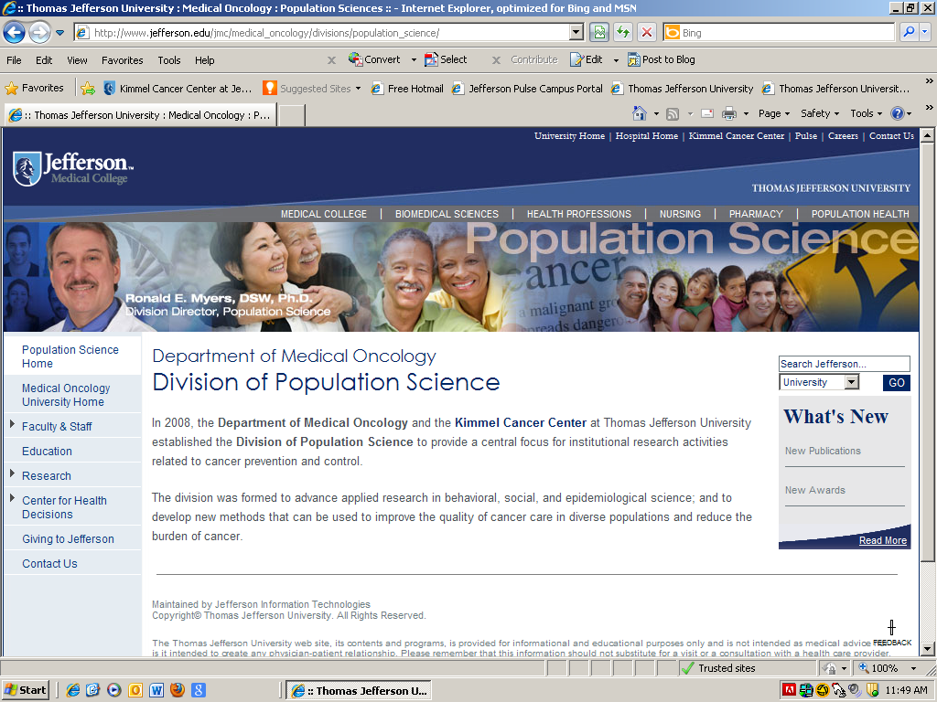
Division of Population Science Home Page

Slide 15
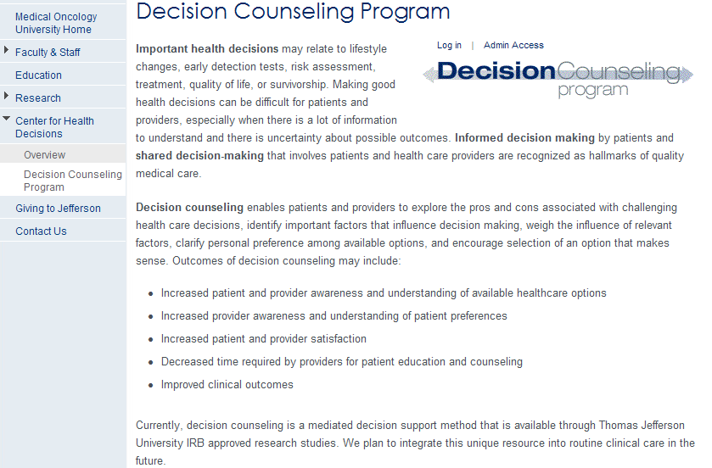
DCP Login

Slide 16
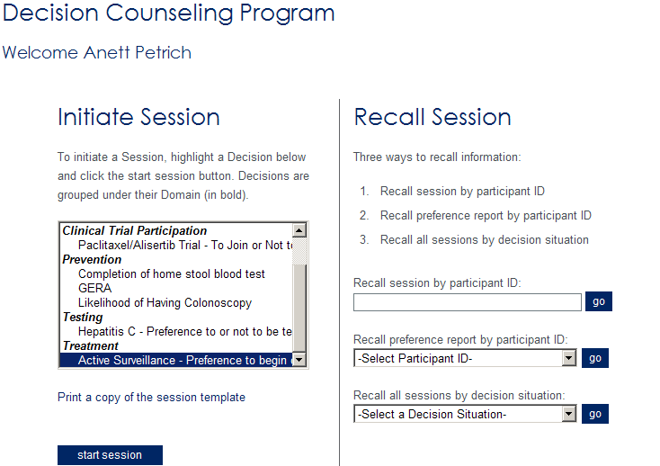
DCP Session Selection
[Decision Counselor]

Slide 17
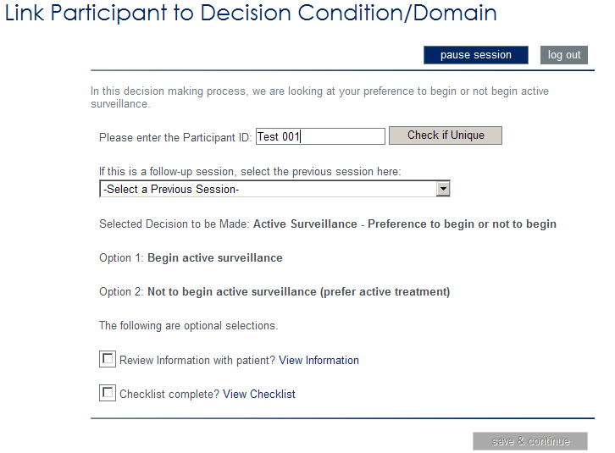
DCP Session Initiation
P
DCP© Library:
AS v AT Option Grid

Slide 18
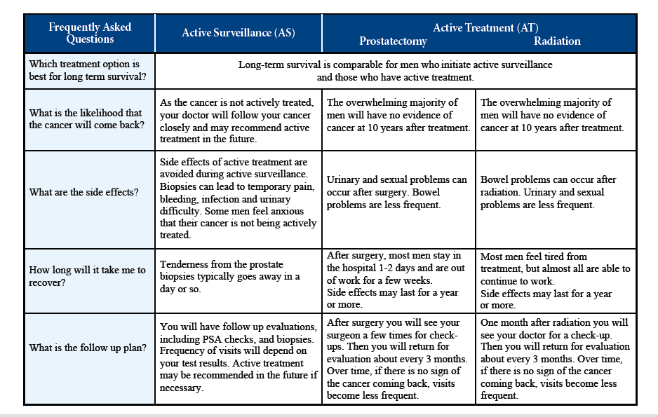
DCP Decision Aid
Active Surveillance
Active Treatment
_{Periodic PSA/Annual Biopsy}

Slide 19
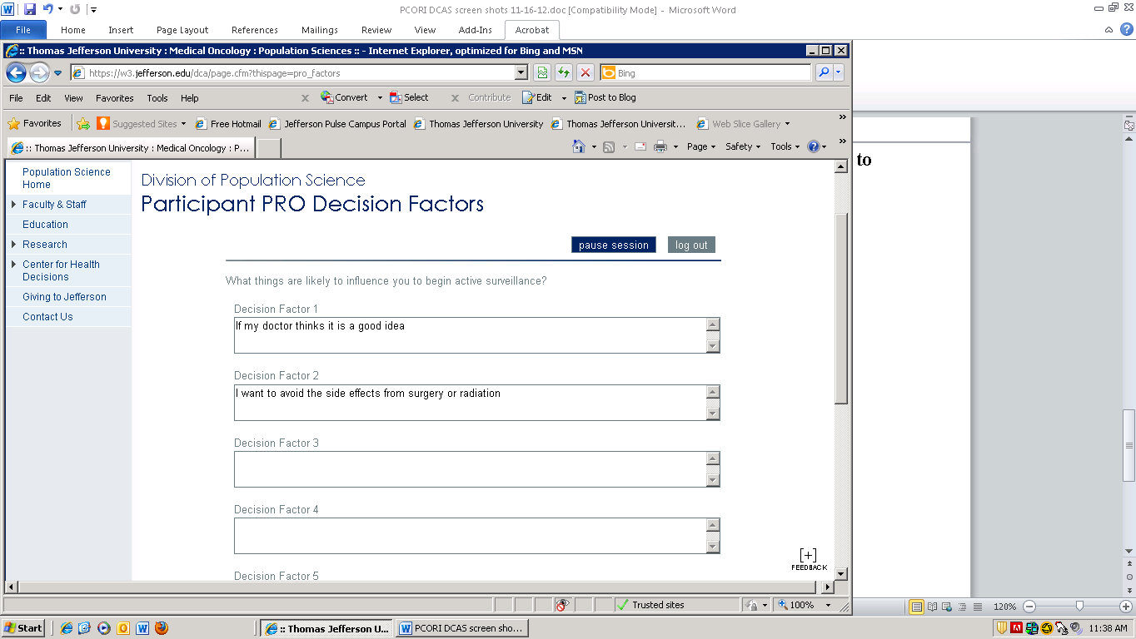
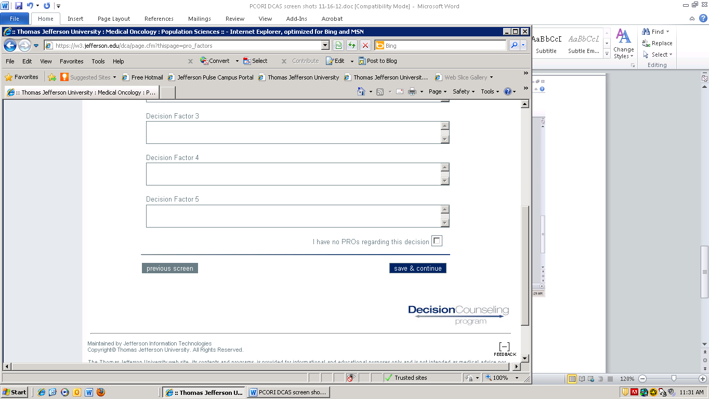
DCP Pro Factors Identification
AS makes sense, because I…

Slide 20
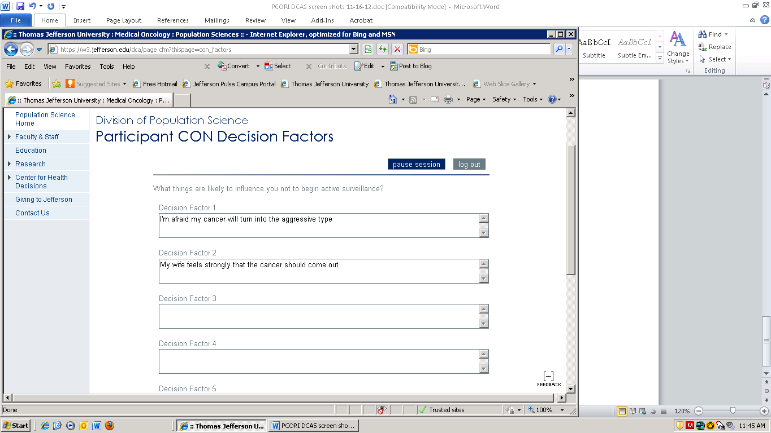
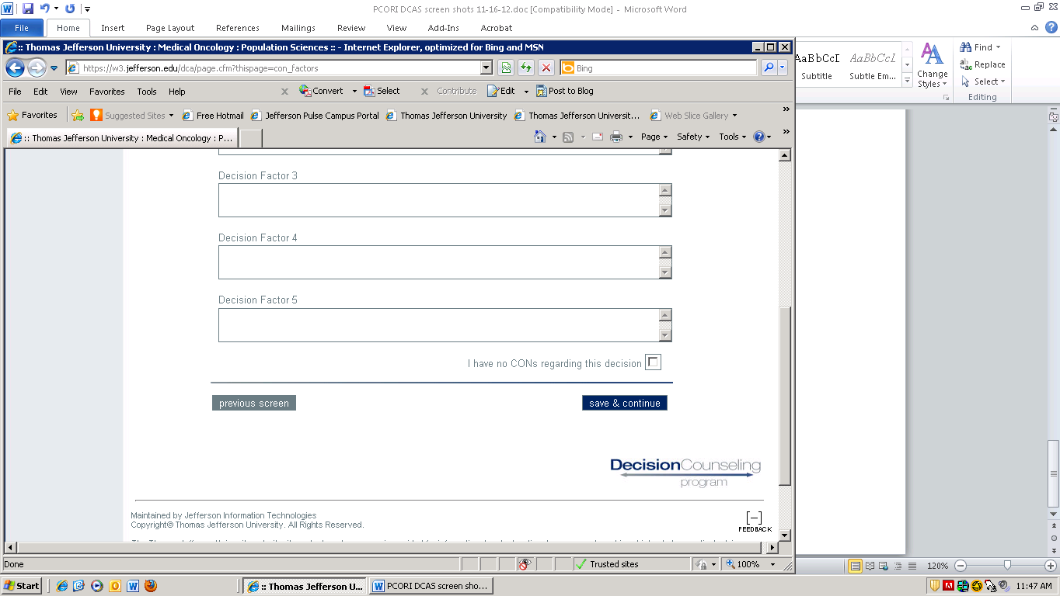
DCP Con Factors Identification
AS doesn’t make sense, because I…

Slide 21
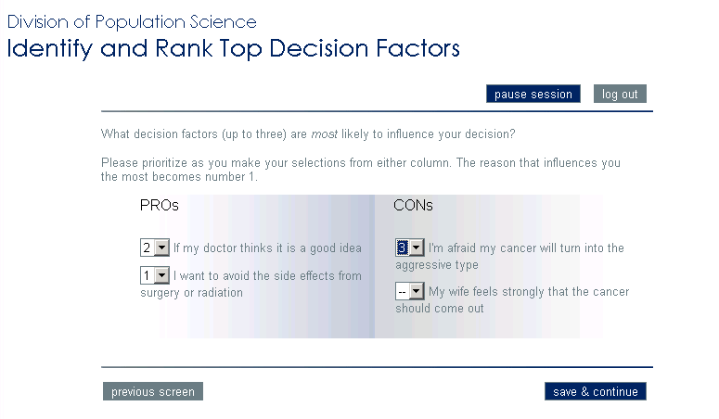
DCP Decision Factor Ranking

Slide 22
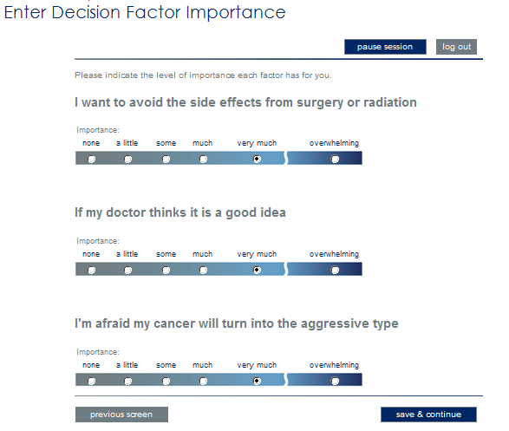
DCP Decision Factor Importance

Slide 23
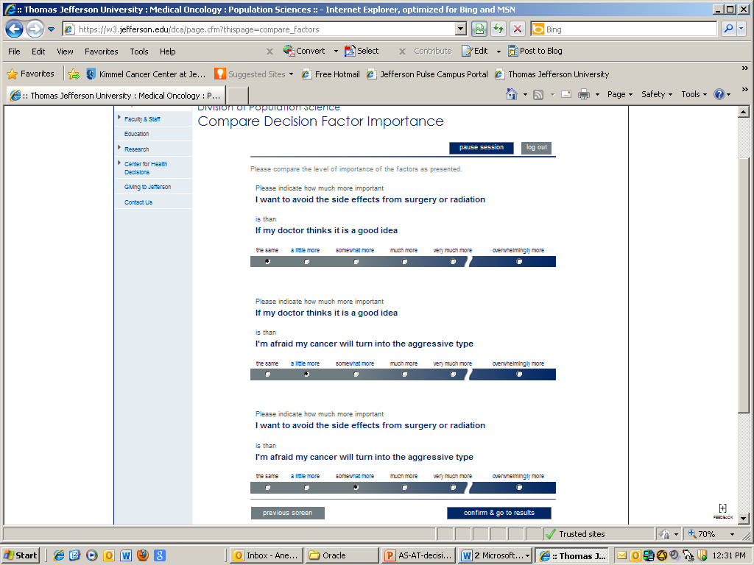
DCP Decision Factor Relative Importance

Slide 24
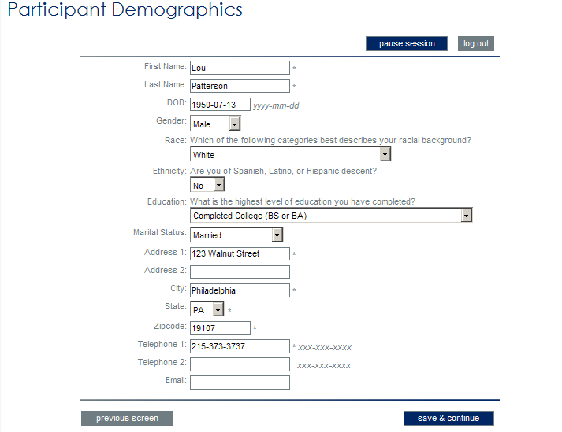
Patient Background Data

Slide 25
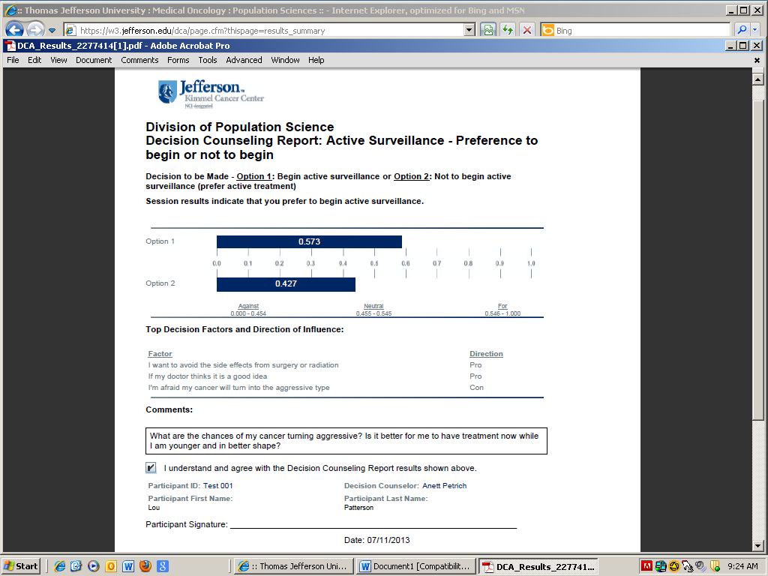
DCP Summary Page

Slide 26
Demographic Characteristics (N=21)
Characteristic |  | Frequency | Percent
Race
 | White | 14 | 66.7
 | Black | 6 | 28.6
 | Asian | 1 | 4.8
Education
 | < HS | 4 | 19.0
 | > HS | 17 | 81.0
Marital Status
 | Single/Divorced | 4 | 19.0
 | Married/Living Together | 17 | 81.0

Slide 27
Decision Factors: AS Pros and Cons
Pro Factors
“I want to avoid the side effects of radiation and treatment.”
“I’m not ready to jump into having surgery or radiation.”
“If my doctor thinks active surveillance is a good idea.”
Con Factors
“I’m afraid my cancer will turn out to be
the aggressive type.”
“I just want the cancer out.”
“Having treatment at a younger age might be better than when
I’m older.”
Pros: 42%
Cons: 58%

Slide 28
Treatment Preference at Baseline
Preference | N (%)
Prefer AS | 5 (23.9)
Equal Preference | 10 (47.6)
Prefer AT | 6 (28.5)
Total | 21 (100.0)

Slide 29
Treatment Decision at 5 Days and 30 Days
 | Decision at 30 Days
Decision at 5 Days | Have AS n (%) | Have AT n (%) | Total N (%)
Have AS | 17 (81.0) | 0 (0.0) | 17 (81.0)
Have AT | 0 (0.0) | 4 (19.0) | 4 (19.0)
Total | 17 (81.0) | 4 (81.0) | 21 (100.0)

Slide 30
Treatment Preference at Baseline and Treatment Decision at 30 Days
 | Decision
Preference | Total N (%) | Have AS n (%) | Have AT n (%)
Prefer AT | 6 (28.6) | 4 (19.1) | 2 (9.4)
Equal Preference | 10 (47.6) | 9 (42.8) | 1 (4.8)
Prefer AS | 5 (23.8) | 4 (19.1) | 1 (4.8)
Total | 21 (100.0) | 17 (81.0) | 4 (19.0)

Slide 31
Change in Knowledge & Decisional Conflict from Baseline to 30 Days
Scale | Baseline | 30-Days | Difference
Knowledge | 73.8% | 86.9% | +13.1%
Decisional Conflict* | 1.80 | 0.72 | -1.08
Uncertain | 2.16 | 0.90 | -1.26
Uninformed | 1.92 | 0.57 | -1.35
Unclear | 1.87 | 0.78 | -1.09
Unsupported | 2.16 | 0.90 | -1.26
*12 out of 16 questions from scale

Slide 32
Summary
In response to decision counseling and shared decision making,
Knowledge increased
Decisional conflict decreased
Patients tended to decide in favor of AS, especially if they had an equal preference for AS and AT, or if they favored AS
Treatment decisions remained stable at 5 and 30 days

Slide 33
DCP Administrator Access

Slide 34
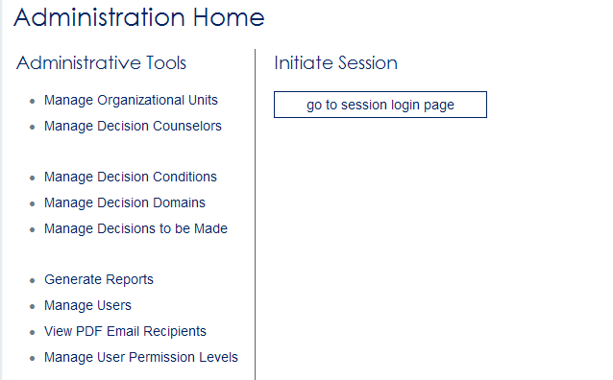
DCP Administrative Tools

Slide 35
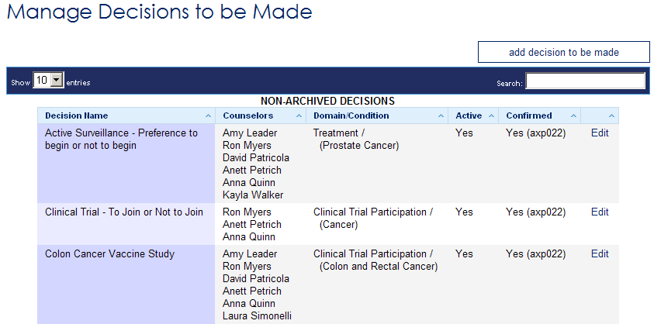
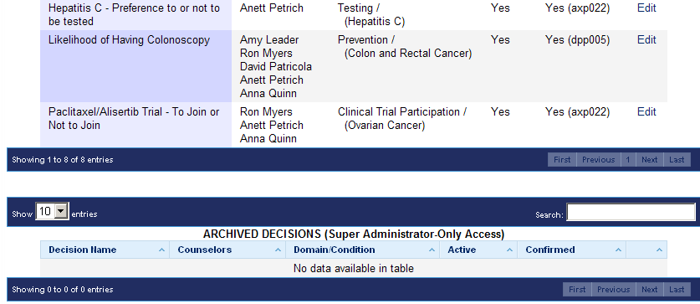
DCP Decision Context

Slide 36
DCP Counselors

Slide 37
DCP Decision Situation

Slide 38
DCP Activation Status

Slide 39
DCP Edit Function

Slide 40
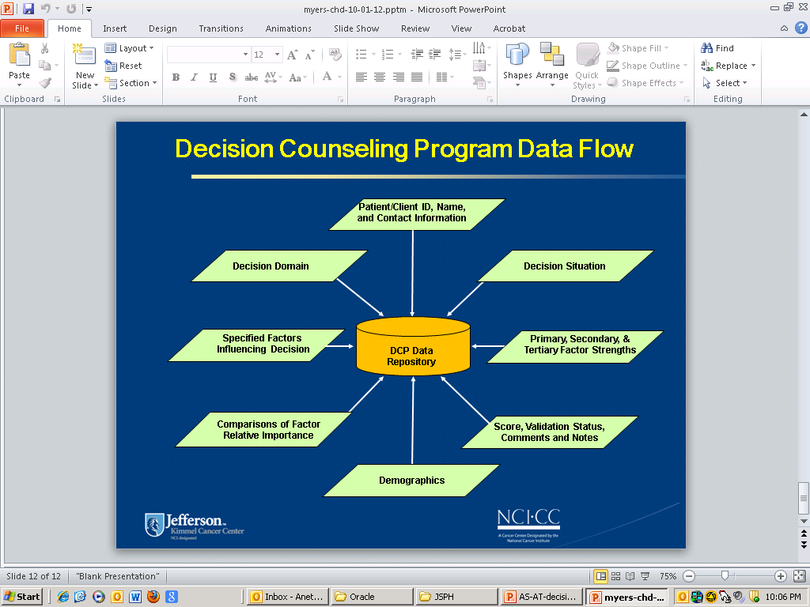
DCP Data Repository

Slide 41
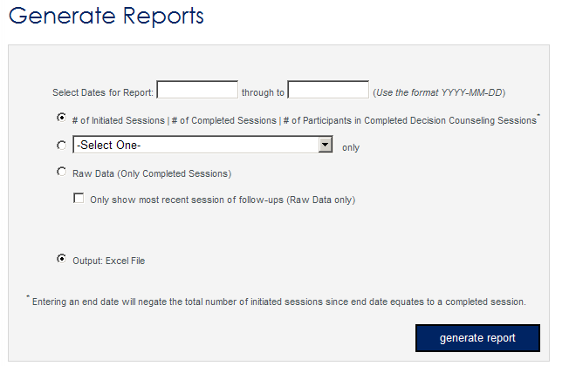
DCP Reporting Functions

Slide 42
DCP Training and Support
Patient Counseling
  In-person or telephone counseling
Counselor Training
  2-day training course with follow-up
Reporting
  Individual, aggregate data

Slide 43
Acknowledgements
  Department of Medical Oncology
  Amy Leader, PhD, Jean Hoffman-Censits, MD, Anett Petrich, MSN, RN, Anna Quinn, MPH, James Cocroft, MA
  Department of Urology
    Edouard Trabulsi, MD, Leonard Gomella, MD
    Department of Radiation Oncology
    Robert Den, MD, Mark Hurwitz, MD, Adam Dicker, MD
  Department of Pharmacology and Experimental Therapeutics
  Constantine Daskalakis, DSc
  Jefferson Information Technology
  David Patricola

Slide 44




DCP + SDM Better Outcomes
Decision
Counseling
Shared
Decision Making
Better Outcomes

Slide 45


