Slide 1
A Scoping Review of Microwave Ablation versus Partial Nephrectomy for Treatment of Renal Cell Carcinoma
Benjamin Odumah, MBBS, MPH
MS in Applied Health Economics and Outcomes Research
Capstone Chair: Vittorio Maio, PharmD, MS, MSPH

Slide 2
Agenda
Introduction
Objectives
Methods
Articles
Outcomes/Results
Summary
Limitations
Conclusion
Acknowledgement

Slide 3
Introduction
Renal cell carcinomas originate within renal cortex and make up 80 to 85 percent of primary renal neoplasms.
Classified as localized disease (stage I, II, and III) or as advanced disease (tumor invading beyond Gerota's fascia or extending into the ipsilateral adrenal gland (T4) and metastatic disease (M1), stage IV RCC)
Surgery is definitive and preferred treatment for localized RCC.
Radical nephrectomy, or partial nephrectomy are surgical options with PN the preferred method for appropriately selected patients.
Extent of disease, location, age and comorbidity impact choice of surgical procedure.

Slide 4
Introduction (Cont’d)
Over 90% of RCC low grade and slow growing, with low probability of metastasis
More than half of RCC detected incidentally due to imaging technology advances in last two decades.
Percutaneous image-guided interventions changed management of urologic diseases.
Stage 1a and 1b, earlier treated surgically now effectively managed using minimally invasive image-guided techniques, on a day care basis using only local anesthesia or conscious sedation.
Applications of non-surgical techniques growing due to minimally invasive nature, lower procedure-related morbidity and reduced hospital stay.

Slide 5
Introduction- Cont’d
Increased use of thermal ablation for patients unsuitable for surgery
AUA and EAU guidelines endorse thermal ablation as alternative treatment option for clinical T1a (<3 cm) RCC, especially for poor surgical candidates.
Cost effectiveness and reduced hospitalization time makes the case of MWA more compelling.
Literature supports MWA with a high curative response, favorable safety profile, and renal preservation rates
MWA short and intermediate outcome data comparable to surgery, with clinical success of 90%-95% for tumors smaller than 3cm.

Slide 6
Objectives
The objective of this capstone is to conduct a scoping review (SR) on microwave ablation therapy versus PN regarding oncologic, perioperative, and functional outcomes in the treatment of renal cell carcinoma.

Slide 7
Methods
Scope Review Strategy
The Scope Review conducted per standard guidelines set by the latest PRISMA statement, methods and tools recommended by the Cochrane Handbook and NICE guidelines
Pre-specified PICOS criteria (Population, Intervention, Comparator, Outcome, Study design) used to identify studies relevant for inclusion in review.
For selected articles: collected general study information, study characteristics, population
Key baseline characteristics (e.g., age, gender, weight), definitions of outcome measures, results, assessment of risk of bias by outcome, and study limitations collected

Slide 8
Methods-Cont’d
Search strategy
Database search using Embase, Ovid MEDLINE®, and the Cochrane Central Register of Controlled Trials was utilized for clinical studies on Microwave ablation and partial nephrectomy in kidney cancer for the period 2000 – 2020.

Slide 9
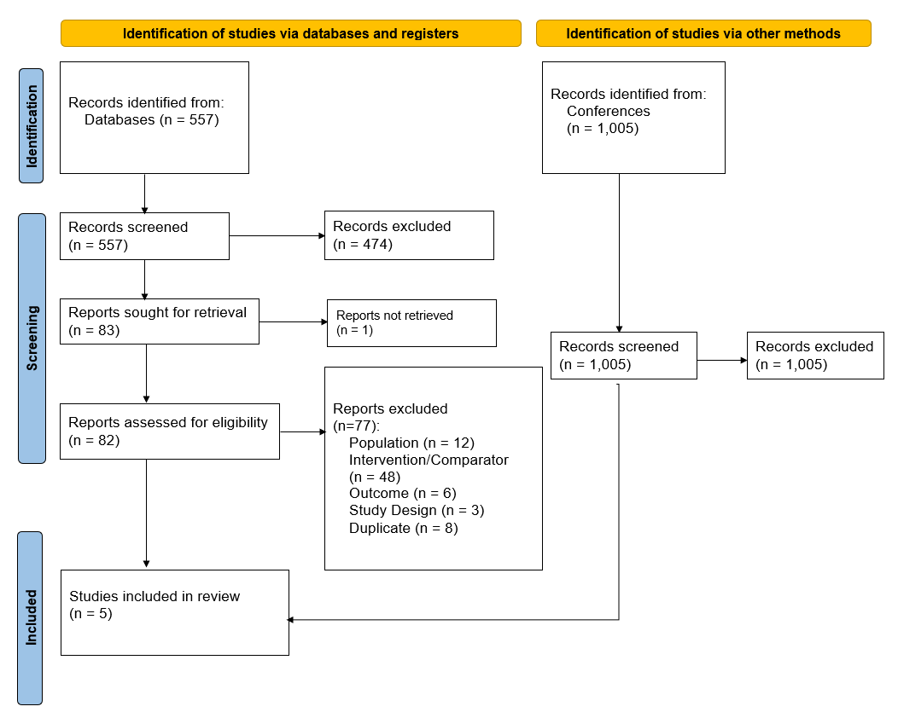

Slide 10
Articles
First Author | Pub Year | Country | Title | Study Design | Setting | Number of patients
Anglickis | 2019 | Lithuania | Microwave Thermal Ablation versus Open Partial Nephrectomy for the Treatment of Small Renal Tumors in Patients Over 70 Years Old | Retrospective | Single center | 33
Guan | 2012 | China | Microwave Ablation Versus Partial Nephrectomy for Small Renal Tumors: Intermediate-Term Results | Prospective | Single center | 66
Hou | 2020 | China | Acute kidney injury after nephron sparing surgery and microwave ablation: focus on incidence, survival impact and prediction | Retrospective | Single center | 1477
Shapiro | 2020 | USA | Comparing Outcomes for Patients with Clinical T1b Renal Cell Carcinoma Treated With Either Percutaneous Microwave Ablation or Surgery | Retrospective | Single center | 114
Yu | 2020 | China | Percutaneous Microwave Ablation versus Laparoscopic Partial Nephrectomy for cT1a Renal Cell Carcinoma: A Propensity-matched Cohort Study of 1955 Patients | Retrospective | Single center | 1955

Slide 11
Oncologic
 | Local recurrence (1 year) % with range | Metastatic recurrence % with range | Overall survival (3years) % with range | Overall survival (5years) % with range
Partial nephrectomy | 1.1 (0.0-1.4) | 4.3 (0.0-8.0) | 97.9 (97.6-98.2) | 93.4 (91.9-94.9)
Microwave ablation | 3.6 (0.0-5.0) | 4.3 (0.0-8.0) | 95.2 (94.0-96.3) | 87.2 (86.3-88.1)

Slide 12
Functional outcome
 | Pre-eGFR (Mean with range) | Post- eGFR (Mean with range) | Mean % difference post op
Partial nephrectomy | 46.2 (42.7-65.8) | 43.45(38.3-65.0) | -2.06
Microwave ablation | 59.9 (49.5-73.8) | 56.45(46.6-71.9) | -2.34

Slide 13
Perioperative outcomes
 | Procedure time (min) | Hospitalization postop (Days) | Blood loss % | Complications rate % (All) | Complications rate % (Major)
Partial nephrectomy | 68 (55-90) | 6.5 (5.0-9.0) | 8.1 | 24.3 | 5.2
Microwave ablation | 26 (25-30 | 2 (1.5-2.0) | 2.5 | 17.5 | 6.1

Slide 14
Comparing outcomes for patients with T1 renal cell carcinoma treated with either percutaneous microwave ablation or partial nephrectomy
Perioperative:
Median length of hospitalization was shorter for MWA compared to PN patients (2 days - 6.5 days)
Perioperative blood loss was significantly less for the MWA group compared to the PN group (2 vs 8.1)
Lower overall complications rate for MWA compared to PN (17.5% vs 24.3%) but higher major complication rate (6.1% vs 5.2%)
Functional:
Post-treatment estimated glomerular filtration rate decreased by median 2.34 for MWA compared to 2.04 for PN .

Slide 15
Comparing outcomes for patients with T1 renal cell carcinoma treated with either percutaneous microwave ablation or partial nephrectomy –Cont’d
Oncological:
Estimated 5-year overall survival was 87.2% for MWA vs 93.4% for PN
No difference in 5-year metastasis-free survival was found among MW or PN.
No significant difference in cumulative Cancer Specific Survival (CSS) between the percutaneous MWA and LPN groups)
MWA 3-year OS was 95.2 % while the 5-years OS was 87.2 vs PN 3-year 97.9 and 93.4%
The overall survival in the PN group (death from any cause- 7, death from RCC- 7) was better than that in the MWA group (death from any cause-19, death from RCC- 4)

Slide 16
Summary
MWA is safe and efficacious technique for the treatment of small- to medium-sized RCC
MWA provides favorable results compared to PN, though longer-term data needed.
Aspect of cost effectiveness of MWA well documented
MWA with excellent outcomes:reducing operative times, hospital stays, and estimated blood loss compared to PN.
Significantly better complication rates for MWA compared to PN
Preservation of renal function not significantly different between the two procedures.
Comparable oncologic outcomes between both treatment groups

Slide 17
Limitations
Only a handful of studies included, and most were conducted in a retrospective manner, increasing risk of bias and limiting study quality.
To obtain a more comprehensive review, need to include more trials that are prospective that provide a high level of detail
Like other surgical trials, major challenge in conducting an RCT for microwave ablation vs partial nephrectomy is ethical considerations in randomizing to cohorts
Patients treated with MWA were older with higher Charlson comorbidity indices compared to PN patients, propensity matching to match comparisons

Slide 18
Conclusion
Microwave ablation seems to be an intervention that could represent a valid alternative to surgical treatment in selected patients with renal cancer
Further evaluation of microwave ablation technique against surgical therapies (PN or RN) or other ablation techniques in a comparative randomized mode is warranted.
Longer follow-up required to further define the role of MWA in the management of T1 renal cell carcinomas.

Slide 19
Bibliography
1. Das CJ, Baliyan V, Sharma S. Image-guided urological interventions: What the urologists must know. Indian J Urol. 2015;31(3):202-208. doi:10.4103/0970-1591.156919
2. Pandey J, Syed W. Renal Cancer. [Updated 2022 Aug 8]. In: StatPearls [Internet]. Treasure Island (FL): StatPearls Publishing; 2022 Jan-. Available from: https://www.ncbi.nlm.nih.gov/books/NBK558975/
3. Michael B Atkins, MD. Overview of the treatment of renal cell carcinoma. Uptodate. Nov2022
Overview of the treatment of renal cell carcinoma - UpToDate
4. Max Padgett, MD, and Kari J. Nelson, MD. Thermal Ablation for Renal Cell Carcinoma: Current Guidelines and Supporting Evidence. Intervention oncology. Oct2018 https://assets.bmctoday.net/evtoday/pdfs/et1018_F5_Nelson.pdf
5. Talenfeld AD, Gennarelli RL, Elkin EB, et al. Percutaneous ablation versus partial and radical nephrectomy for T1a renal cancer: a population-based analysis. Ann Intern Med. 2018;169:69-77.
6. Uhlig J, Strauss A, Rücker G, Seif Amir Hosseini A, Lotz J, Trojan L, Kim HS, Uhlig A. Partial nephrectomy versus ablative techniques for small renal masses: a systematic review and network meta-analysis. Eur Radiol. 2019 Mar;29(3):1293-1307. doi: 10.1007/s00330-018-5660-3. Epub 2018 Sep 25. PMID: 30255245.
7. Hui GC, Tuncali K, Tatli S, Morrison PR, Silverman SG. Comparison of percutaneous and surgical approaches to renal tumor ablation: Metaanalysis of effectiveness and complication rates. J Vasc Interv Radiol. 2008;19:1311–20.
8. Littrup PJ, Ahmed A, Aoun HD, Noujaim DL, Harb T, Nakat S, et al. CT-guided percutaneous cryotherapy of renal masses. J Vasc Interv Radiol. 2007;18:383–92.
9. Anglickis M, Anglickienė G, Andreikaitė G, Skrebūnas A. Microwave Thermal Ablation versus Open Partial Nephrectomy for the Treatment of Small Renal Tumors in Patients Over 70 Years Old. Medicina (Kaunas). 2019;55(10):664. Published 2019 Oct 1. doi:10.3390/medicina55100664
10. Wei Guan MD, Jian Bai MD. Microwave ablation versus partial nephrectomy for small renal tumors: Intermediate-term results. Journal of Surgical Oncology, volume 106, Issue 3. https://doi.org/10.1002/jso.23071
11. Shapiro DD, Wells SA, Best SL, et al. Comparing Outcomes for Patients with Clinical T1b Renal Cell Carcinoma Treated With Either Percutaneous Microwave Ablation or Surgery. Urology. 2020;135:88-94. doi:10.1016/j.urology.2019.09.024

Slide 20
Acknowledgement
My sincere thanks and gratitude to people who have helped me in completing this capstone project as without their help, completing this project would have been very difficult:
Capstone chair and advisor, Professor Vittorio Maio, for his support and guidance in completing this project.
Faculty at the college of population health
Uzo my darling wife and my children, Derek and Michelle for their immense support patience and help during this project.

