Slide 1
The Impact of Doulas on Birth Outcomes: A Rapid Systematic Review
Heather Higgins, MPH (c)
Mentors: Katie DiSantis, PhD, MPH & John McAna, PhD

Slide 2
Birth Outcomes
The maternal mortality rate in 2020 was 23.8 deaths per 100,000 live births in the U.S.
In the U.S. in 2020, 31.8% of deliveries were cesarean deliveries.

Slide 3
Birth Outcomes Continued
In 2021, about 1 of every 10 infants born in the U.S. were a preterm birth (10.5%).
In 2020, about 1 in 12 babies born in the U.S. were low-birth weight (8.24%).

Slide 4
Doulas
Definition Of Doula
Emotional Support
Physical Support
Informational Support
Education
Pain Relief
Advocate
Comfort
Positioning Suggestions

Slide 5
Methods
Consulted with librarians to develop a search strategy
PICO strategy and key terms
pregnant women, doulas, birth outcomes, and outcome measures, low-birth weight, post-partum depression, epidural, caesarian section, preterm birth
Screen for inclusion or exclusion criteria
Any study that looks at impact of doula care on pregnancy, labor, postpartum period. Reports on birth outcomes. Accept all countries. Exclude dates before 2012. Exclude lay doulas and death doulas.

Slide 6
Methods Continued
Database
PubMed
Methods of Review
Phase 1: Screened titles and abstracts
Phase 2: Read full text articles
Followed PRISMA guidelines
Data Extraction
Study description, patient demographics, relevant findings, and birth outcomes

Slide 7
Selection Process
Identification of studies via databases and registers
Records identified from*:
Databases (n = 108)
Registers (n = 0)
Records removed before screening:
Duplicate records removed (n = 2)
Records marked as ineligible by automation tools (n =0 )
Records removed for other reasons (n =0 )
Identification
Records screened
(n = 106 )
Records excluded**
(n =58)
Screening
Reports sought for retrieval
(n = 48 )
Reports not retrieved
(n = 25)
Reports assessed for eligibility
(n = 23 )
Reports excluded:
Reason 1 (n = 3 continuous support or lay doula)
Reason 2 (n = 13 does not include about majority of birth analysed )
Studies included in review
(n = 7 )
Reports of included studies
(n = 7)
Included

Slide 8
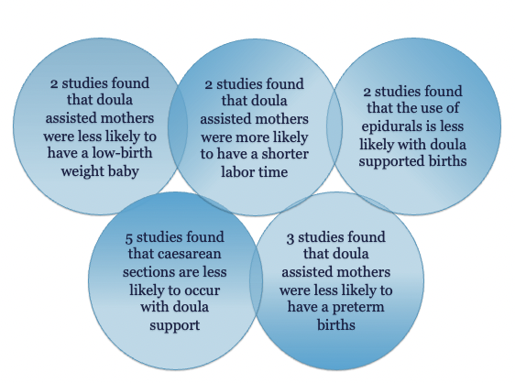
Relevant Findings from 7 Studies

Slide 9
Strengths and Limitations
Strengths:
Review needed-not much known on doulas; PICO and PRISMA strategy used.
Limitations:
One database, one reviewer.

Slide 10
Recommendations: Now What?
Future research in expanding the use of doulas to individuals who are most prone to poor outcomes is needed. Efforts to integrate doula care into usual care as an optional support could improve outcomes among these women and reduce health disparities.
Medicaid reimbursement for doula support will be key in wider use and evaluation.
The implementation of a doulas program in hospitals could be a cost-effective strategy to increase patient satisfaction and improve outcomes for pregnancy, birth, and labor.

Slide 11
Acknowledgements
Thank you!
Dr. Katie DiSantis
Dr. John McAna
Dr. Rosemary Frasso
Dr. Paul Hunter

Slide 12
Citations
Liu L, Oza S, Hogan D, Chu Y, Perin J, Zhu J, et al. Global, regional, and national causes of under-5 mortality in 2000-15: an updated systematic analysis with implications for the Sustainable Development Goals. Lancet. 2016;388(10063):3027-35
National Center for Health Statistics, final natality data. Retrieved August 26, 2022, from www.marchofdimes.org/peristats.
DONA. What is a Doula. (2018, December 05). Retrieved from https://www.dona.org/what-is-a-doula/
Campbell, D. A., Lake, M. F., Falk, M., & Backstrand, J. R. (2006). A randomized control trial of continuous support in labor by a lay doula. Journal of obstetric, gynecologic, and neonatal nursing : JOGNN, 35(4), 456–464. https://doi.org/10.1111/j.1552-6909.2006.00067.x
Vonderheid S. C., Kishi R., Norr K. F., & Klima C. (2011). Group prenatal care and doula care for pregnant women In Handler A., Kennelly J., & Peacock N. (Eds.), Reducing racial/ethnic disparities in reproductive and perinatal outcomes: The evidence from population-based interventions (pp. 369–399). 10.1007/978-1-4419-1499-6_15
Picture of America Reproductive Outcomes Fact Sheet. CDC. (n.d.). Retrieved from https://www.cdc.gov/pictureofamerica/pdfs/Picture_of_America_Reproductive_Outcomes.pdf
Centers for Disease Control and Prevention. (2022, February 23). Maternal mortality rates in the United States, 2020. Centers for Disease Control and Prevention. Retrieved from https://www.cdc.gov/nchs/data/hestat/maternal-mortality/2020/maternal-mortality-rates-2020.htm
Kozhimannil, K. B., Attanasio, L. B., Jou, J., Joarnt, L. K., Johnson, P. J., & Gjerdingen, D. K. (2014). Potential benefits of increased access to doula support during childbirth. The American journal of managed care, 20(8), e340–e352
Gruber, K. J., Cupito, S. H., & Dobson, C. F. (2013). Impact of doulas on healthy birth outcomes. The Journal of perinatal education, 22(1), 49–58. https://doi.org/10.1891/1058-1243.22.1.49
Kozhimannil. (2016). Modeling the Cost-Effectiveness of Doula Care Associated with Reductions in Preterm Birth and Cesarean Delivery. Birth, 43(1), 20–27.
Kozhimannil. (2013). Doula care, birth outcomes, and costs among Medicaid beneficiaries. American Journal of Public Health., 103(4), e113–21.
Paterno. (2012). Evaluation of a student-nurse doula program: an analysis of doula interventions and their impact on labor analgesia and cesarean birth. Journal of Midwifery & Women’s Health, 57(1), 28–34.
Phillips. (2014). Social work should embrace doulas. Health & Social Work., 39(2), 117–120.
Ricklan. (2021). Two decades of interventions in New York State to reduce maternal mortality: a systematic review. The Journal of Maternal-Fetal & Neonatal Medicine., 34(21), 3514–3523.

