Slide 1
A Rapid Systematic Review of the Significance of Parental Awareness of Children’s Oral Health on the Prevalence of Dental Caries in Saudi Arabia
Nasser Albishi MPH (c)
Mentor: Prof. Martha Romney

Slide 2
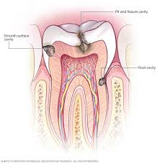
High Prevalence of Dental Caries in Children in Saudi Arabia
Dental Caries in Literature
One of the most common oral health problems in children in Saudi Arabia
Percentages are varied in different places in Saudi Arabia, as high as 89%.
Risk Factors:
Poor oral hygiene level of the children.
Parents need more involvement in hygiene practices.

Slide 3
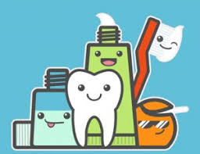
Parental Involvement in Children’s Oral Hygiene
Lack of parent's knowledge about maintaining children’s oral hygiene
Higher rates of dental caries at a young age
Limited awareness of
Using a toothbrush instead of finger brushing
Frequency of brushing
Supervision of children while brushing
Dentist visits
2. Effective interventions to increase Parental Supervised Brushing (PSB)

Slide 4
Conducting a Rapid Systematic Review
Research Question:
“To what extent does parental awareness of their children’s oral hygiene have an effect on the prevalence of dental caries in Saudi Arabia?”
Answering the question:
Synthesizing previous evidence from 6 published articles
Describing their findings using systematic review methods
Discuss possible solutions and future research opportunities

Slide 5
SELECTION PROCESS
Dataset
PubMed
Keywords: “parents”, “child”, “prevalence”, “dental caries”, “oral hygiene”, “Saudi Arabia”
Data Collection:
Using PECO and MeSH terms
Review Methods:
Screened title and an abstract
Screened full text
Data Extraction:
Find commonalities and differences among articles
Find the evidence from each article that supports a correlation between parental awareness and children’s dental caries.

Slide 6
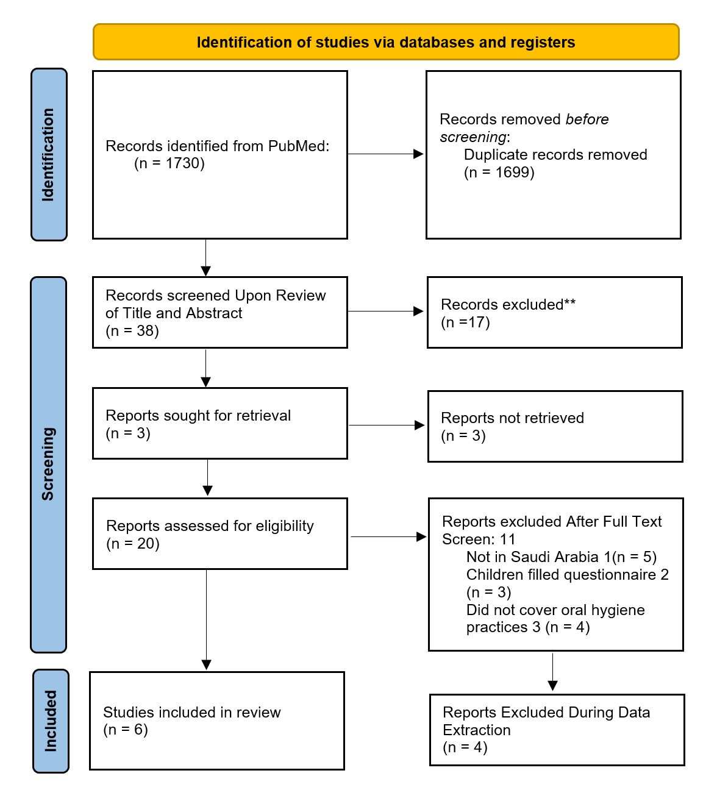
Figure 1: PRISMA Flow Diagram
Inclusion criteria:
- Studies on children and parents.
- Children with dental caries.
- Parent questionnaire.
- In Saudi Arabia

Slide 7
Findings:
High prevalence of dental caries in school-aged children in Saudi Arabia
High correlation between oral hygiene in children and levels of parental awareness on the matter
Low parental awareness levels of dental hygiene are a risk factor for caries in Saudi Arabia.
Parental supervised brushing contributes to lower rates of caries
Parents need to have good and easy access to knowledge and proper awareness to improve children’s dental health
Parental lack of awareness in the matters that could affect their children’s oral health, such as the age at which children start brushing their teeth, frequent dentist visits, and dietary habits.

Slide 8
Acknowledgments
Prof. Martha Romney
Prof. Colin Plover
Prof. John McAna
Dr. Paul Hunter

Slide 9
References
Al Agili, D. (2012). A systematic review of population-based dental caries
studies among children in Saudi Arabia. The Saudi Dental Journal, 25(1), 3-11. doi: 10.1016/j.sdentj.2012.10.002
Alshammari, F. S., Alshammari, R. A., Alshammari, M. H., Alshammari, M. F.,
Alibrahim, A. K., Al Sineedi, F. A., Alkurdi, K. A., & Alshammari, A. F. (2021). Parental Awareness and Knowledge toward their Children's Oral Health in the City of Dammam, Saudi Arabia. International journal of clinical pediatric dentistry, 14(1), 100–103. https://doi.org/10.5005/jp- journals-10005-1894
Alshammary, F., Aljohani, F., Alkhuwayr, F., & A Siddiqui, A. (2019).
Measurement of Parents’ Knowledge toward Oral Health of their Children: An Observational Study from Hail, Saudi Arabia. The Journal Of Contemporary Dental Practice, 20(7), 801-805. doi: 10.5005/jp-journals- 10024-2600

Slide 10
References
Gudipaneni, R. K., Patil, S. R., Assiry, A. A., Karobari, M. I., Bandela, V.,
Metta, K. K., & Almuhanna, R. (2021). Association of oral hygiene practices with the outcome of untreated dental caries and its clinical consequences in pre-and primary school children: A cross- sectional study in a northern province of Saudi Arabia. Clinical and experimental dental research, 7(6), 968–977. https://doi.org/10.1002/cre2.438
Kotha, S., Alabdulaali, R., Dahy, W., Alkhaibari, Y., Albaraki, A., &
Alghanim, A. (2018). The influence of oral health knowledge on parental practices among the Saudi parents of children aged 2–6 years in Riyadh City, Saudi Arabia. Journal Of International Society Of Preventive And Community Dentistry, 8(6), 565. doi: 10.4103/jispcd.jispcd_341_18

