Slide 1
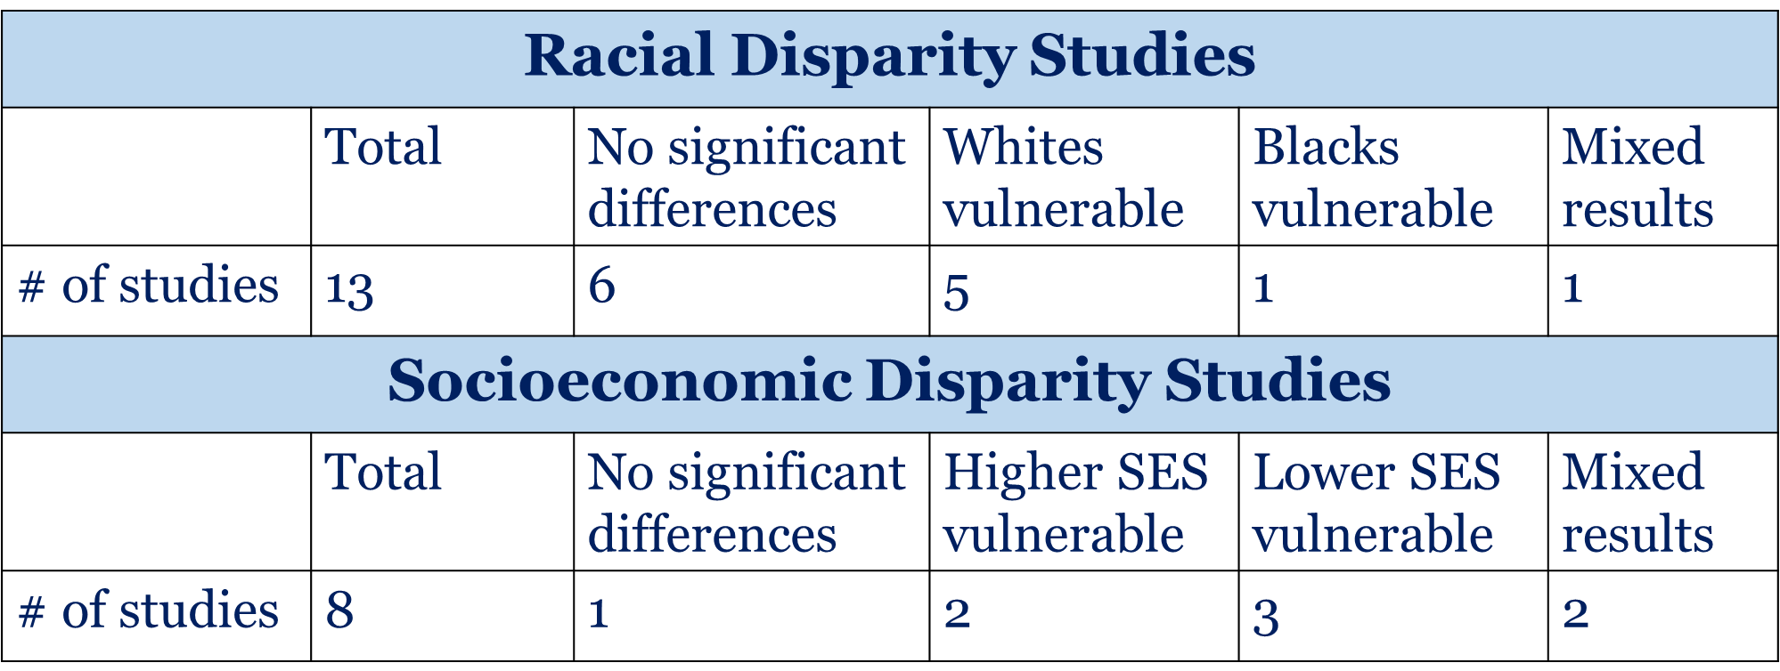
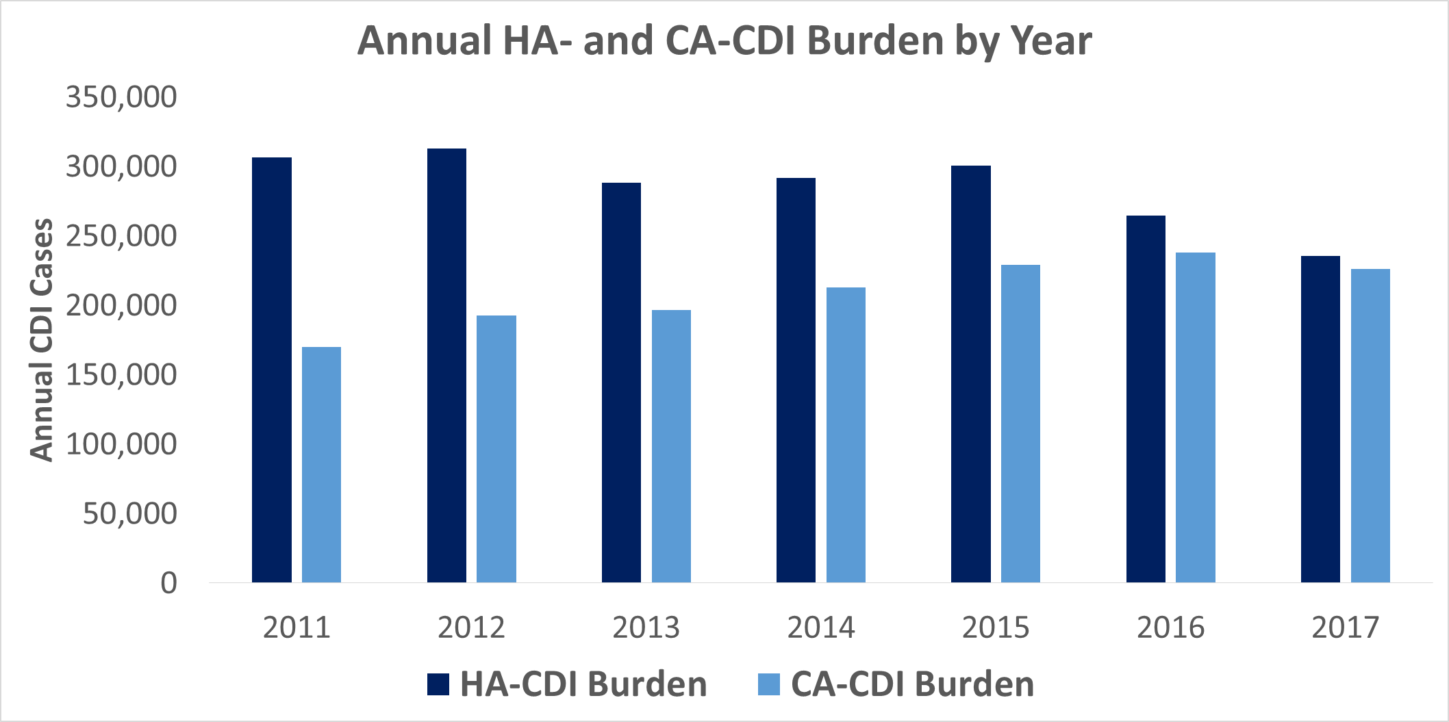
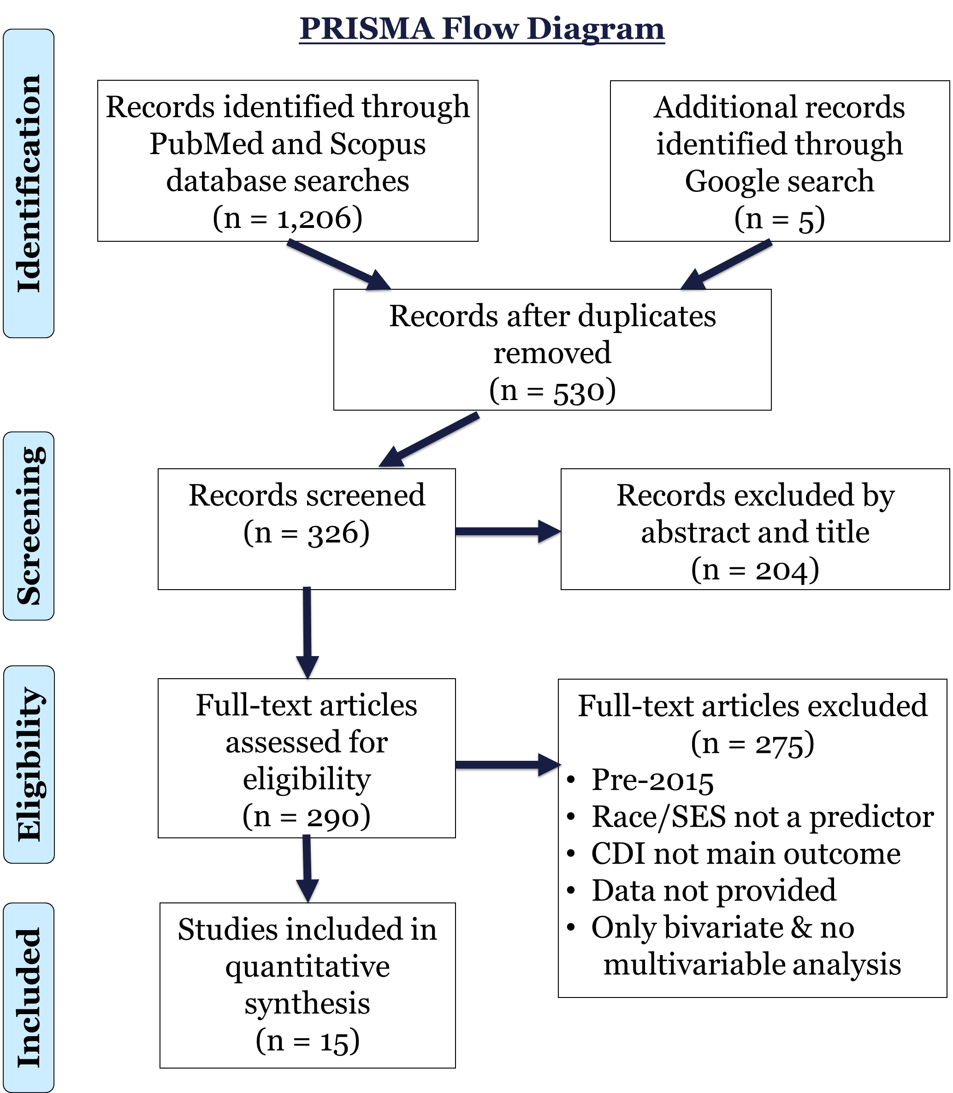
Racial and Socioeconomic Disparities in Healthcare- and Community-Associated Clostridium difficile Infection: A Rapid Review Rutvin Kyada Chair: Amy Leader, DrPH; Preceptor: Rosemary Frasso, PhD
BACKGROUND
METHODS
RESULTS
Clostridium difficile infection (CDI) involves bacterial infection of the large intestine, causing complications like colitis and diarrhea (CDC).
2 main settings:
Healthcare-Associated CDI (HA-CDI): infection in or due to healthcare settings
Community-Associated CDI (CA-CDI): infection outside of healthcare settings
Both HA-CDI and CA-CDI caused an estimated 462,000 infections nationwide in 2017 (Guh et al., 2020). CDI is classified by CDC as an “Urgent Threat”.
The most well-known risk factors for CDI include advanced age, medications like proton pump inhibitors and antibiotics, and hospitalization.
Disparities in some infectious disease complications like sepsis as well as in patient safety are well-documented.
While very little disparities research is done in the domain of healthcare-associated infections, a review of pre-2015 studies by Yang et al. (2016) found higher rates of HA-CDI in Whites and major literature gaps.
Data Sources
Two databases: PubMed and Scopus.
Representative Search Terms:
Inclusion Criteria
Published in last 5 years: May, 2015, to May, 2020
United States patient sample
Quantitative analysis using cohort, case-control, ecological, cross-sectional, or experimental study designs
Association between race and/or socioeconomic status as predictor and CDI incidence or related measures as outcomes measured through a multivariable regression model for which effect sizes or p values are provided.
Racial disparities:
Whites generally faced higher incidence for both HA- and CA-CDI in a variety of patient samples.
Argamany et al. (2016) showed in a large nationally representative sample that Blacks faced higher severity, mortality, and costs.
Socioeconomic disparities:
At the census tract level, lower socioeconomic status (as measured by poverty, education, unemployment, insurance type, public assistance, and home crowding) was associated with higher CA-CDI
At the individual level, results were mixed with higher income and government insurance were associated with higher HA- and CA-CDI rates.
Risk Factors | Nosocomial Infection | Clostridium difficile
Social Determinants | Healthcare-Associated Infection | Clostridioides difficile
Health Disparities | Cross Infection
Social Factors | Community-Associated Infection
DISCUSSION
Source: Adapted from Guh et al. (2020)
Importance to literature:
Strengthens previous evidence for White burden in HA-CDI and provides new evidence in CA-CDI burden; however, Blacks might face harsher CDI consequences.
There is new evidence for SES disparities, which differ based on census tract vs. individual levels.
Potential reasons for disparities:
Differential access to healthcare and medications: higher healthcare, antibiotic, and proton pump inhibitor use can predispose certain groups to higher CDI burden.
Differential access to nucleic acid amplification tests (NAAT): high-sensitivity tests like these may explain observed differences between sociodemographic groups.
Public health research implications:
Need to standardize race, SES, and CDI definitions.
Further research is needed in large national samples to determine extent to which disparities depend on access.
OBJECTIVES
Update the current status of racial disparities in HA-CDIs in last 5 years.
Explore racial disparities in CA-CDIs.
Explore socioeconomic disparities in HA- and CA-CDIs.

