Slide 1

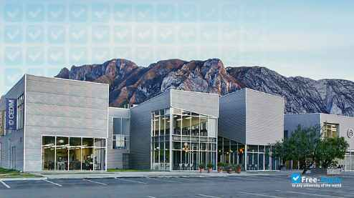
Monterrey Center for Higher Learning of Design
Sante Fe, Mexico City, Mexico

Slide 2

Analogous learning:
Lessons learned from aviation
How to deal with complexity
John Pourdehnad, Ph.D.
October 27, 2022

Slide 3
Monterrey Center for Higher Learning of Design
It was a pleasure and a lovely opportunity working with you for the Webinar, of which we are sincerely grateful and honored. On behalf of all of us at CEDIM Innovation Programs, I hereby attach a diploma in recognition for your participation as a Guest Speaker. Also, as promised, here's the Youtube link to the edited clip of the Webinar:
https://www.youtube.com/watch?v=zREbDBYI_mY

Slide 4
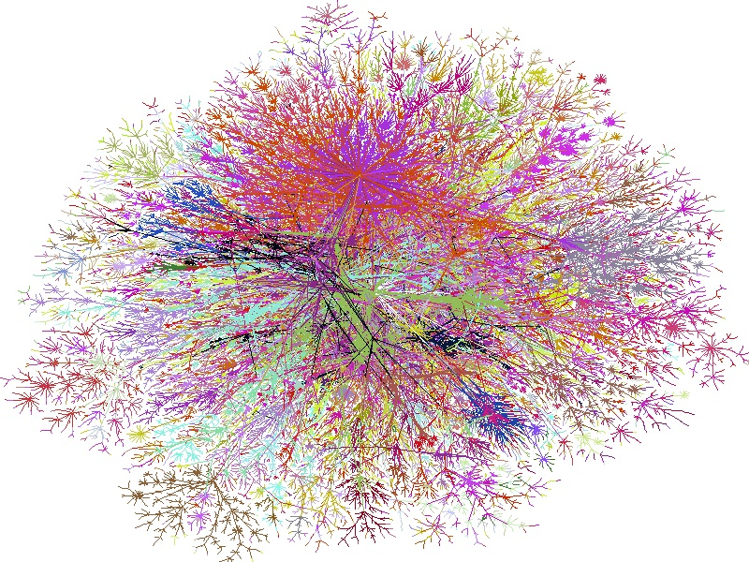
Rising Complexity
“What the hell is going on?”
“Managing a business today is fundamentally different than it was just 30 years ago. The most profound difference, we’ve come to believe, is the level of complexity people have to cope with.”
(Sargut & McGrath (2011) Harvard Business Review, Sept 2011)

Slide 5
Proficiency to make effective decisions for improved performance in dynamic complexity is lacking!
Like pilots on the flight deck, executives and managers are continuously making decisions. But unlike the pilots, they are rarely supported by systems that help them navigate the “permanent white water” in today’s environment.

Slide 6
Analogous Learning: Discovering commonalities in the most uncommon places
Analogous learning is, quite simply, learning from situations and people that are different from your own but share similar attributes.
It entails exploring uncommon places for best practices, finding new ways of looking at the paradoxes of management and, most importantly, reinvigorating leaders.
The boundaries of analogous learning are set only by the degree of one’s openness and curiosity.
Analogous Learning: Discovering Commonalities in the Most Uncommon Places: https://tinyurl.com/cj4n4efu

Slide 7

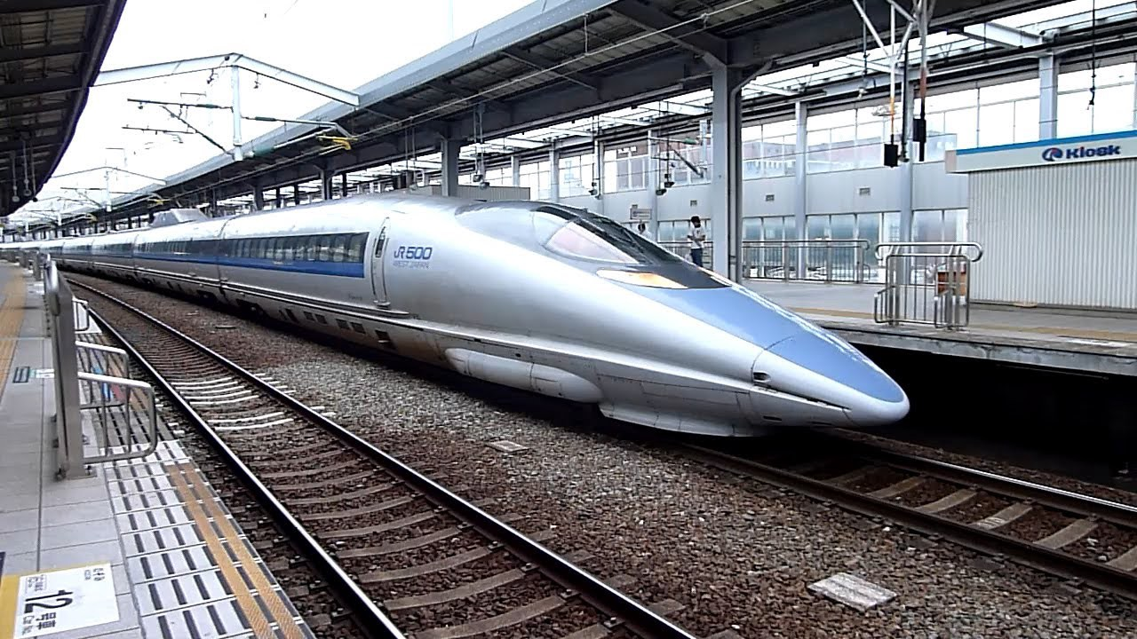
Lesson: Shinkansen bullet trains and the kingfisher bird
The Japanese Shinkansen bullet trains now move more passengers between metros than any rail in the world. But during development, their super speed caused them to exit the long, straight tunnels with a loud sonic boom. After several failed attempts at a solution, engineers knew they needed to think differently. So they looked to the kingfisher bird. Studying its long, narrow beak and smooth ability to transition from air to water, they were able to implement the same design to allow the trains to enter and exit the tunnels quietly, saving millions in build costs.
Analogous Learning: Discovering Commonalities in the Most Uncommon Places
https://tinyurl.com/cj4n4efu

Slide 8

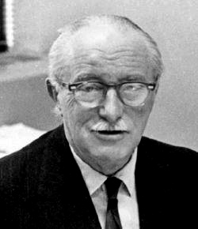
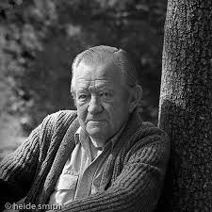
Causal Texture of Organizational Environments
Eric Trist
Fred Emery
Emery F. and Trist E. (1965). The Causal Texture of Organizational Environments. Human Relations, Vol 18 (1): 21-32.

Slide 9
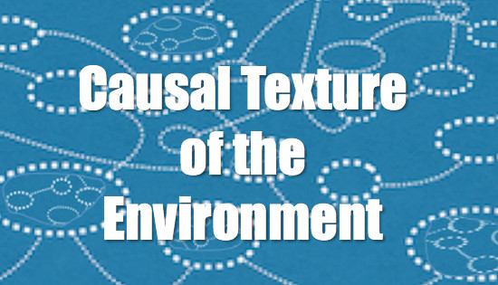
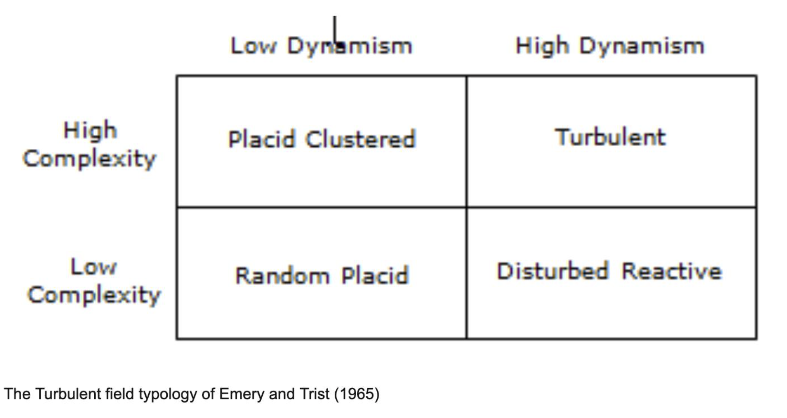
Causal Texture of Organizational Environments
A main problem in the study of organization change is that the environmental contexts in which organizations exists are themselves changing, at an increasing rate, and towards increasing complexity.
The characteristics of organizational environments demand consideration for their own sake, if there is to be an advancement of understanding in the behavioral sciences of a great deal that is taking place under the impact of technological change, especially at the present time.

Slide 10

Professor David Hawk’s Comment about Turbulence
David Hawk: Two points: Much of this concept came from Eric Trist when he hit on the idea of turbulence while on a plane ride from New York to London and (because) after turbulence was announced a passenger didn't believe it (yet) got injured from falling down. Eric wanted to add vortext to the list and have five types, in that he thought there was much worse contexts then turbulence. Fred Emery strongly disagreed, as he thought turbulence was too extreme of an idea.

Slide 11

Turbulence in organizations:
New metaphor for organizational research
How do environmental turbulence and complexity affect the appropriate formal design of organizations?

Slide 12
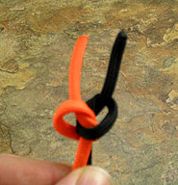
Two strands of thought are coming together that have one thing in common
COMPLEXITY

Slide 13


A Leader’s Framework for Decision Making
Harvard Business Review, 2007
by David J. Snowden and Mary E. Boone
From the Magazine (November 2007)

Slide 14

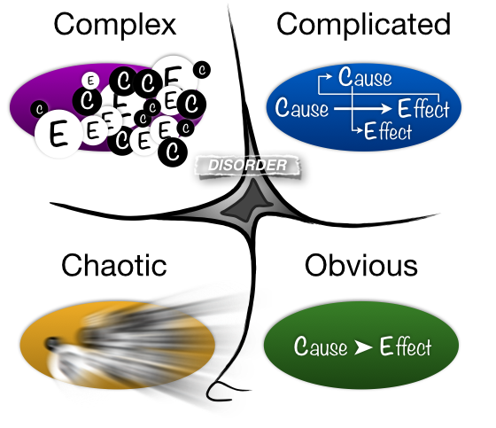
Experts: Good Practice
Emergence
Rapid Response
Best Practice
How to lead and make appropriate decisions

Slide 15

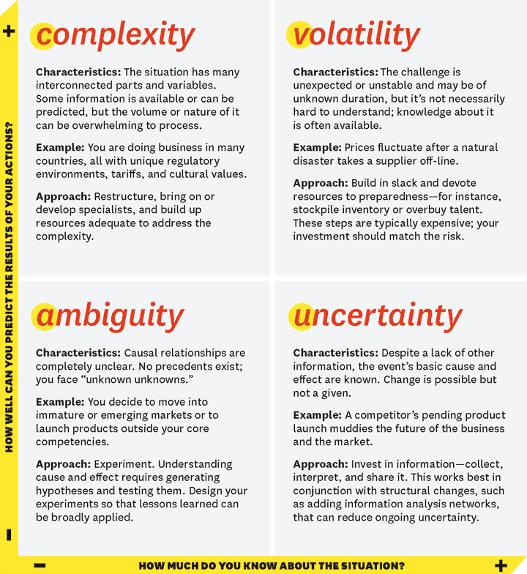
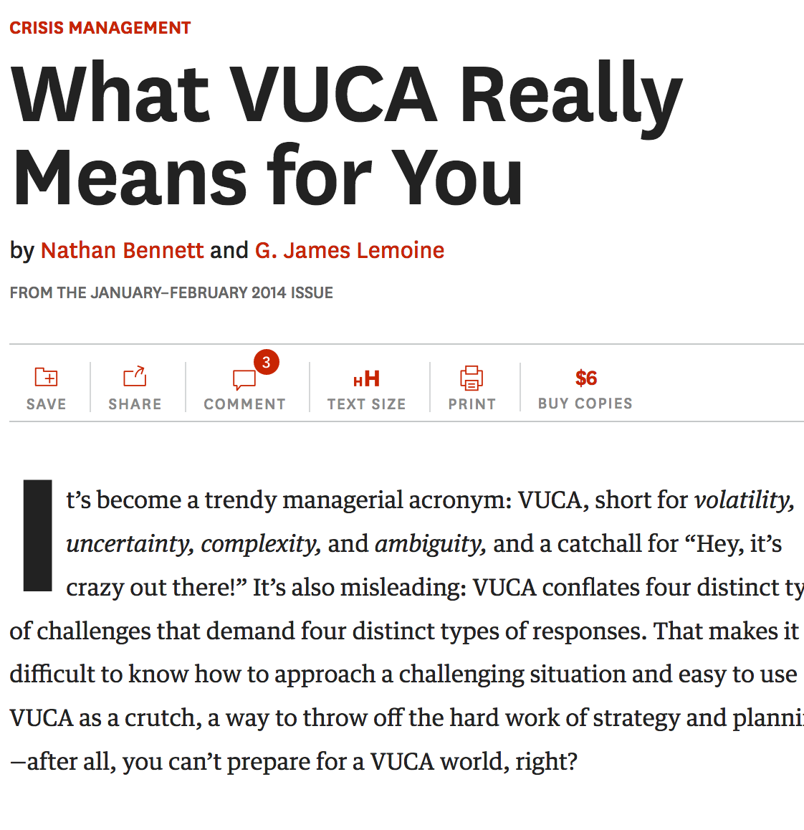
Harvard Business Review, January 2014

Slide 16

Need For Diverse Thinking
“Cynefin’s value as a sense-making framework lies in helping system decision makers understand approximately where their systems
lie among these domains, and by extension, what kinds of tools, approaches, processes, or methods are more likely to work successfully in a given system.”

Slide 17
Need For Diverse Thinking
“The most effective leaders understand that problem solving is not a "one-size-fits-all" process. They know that their actions depend on the situation, and they make better decisions by adapting their approach to changing circumstances.”
http://bit.ly/1cLHG8D

Slide 18
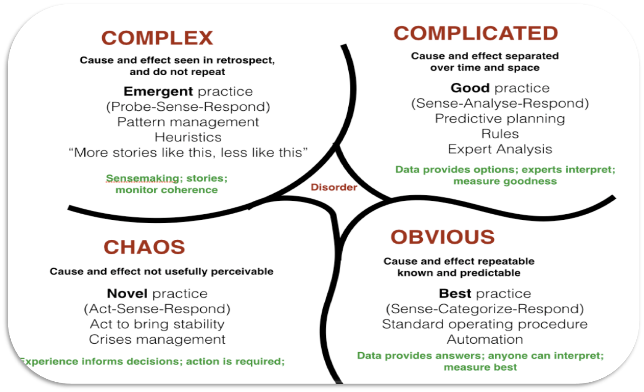
Strategic Consulting Models in the Cynefin Framework
Process Model
Expert Model
Emergent Model
Doctor-Patient Model
The Cynefin framework is a conceptual framework used to aid decision-making. Created in 1999 by Dave Snowden when he worked for IBM Global Services, it has been described as a "sense-making device". Cynefin is a Welsh word for habitat.
Proposed Prototype – Jefferson DMgt Strategic Consulting Course

Slide 19
What Is a Right Tool?
Tool/ Method Characteristic
Qualitative
Quantitative
Strategic
System Level
Tactical
http://bit.ly/2mr4RNx
Notes:
“Situational Awareness is a model that is primarily used in aviation in human factors research that can encompass both the cognitive and the systems roots of such errors. In essence Situational Awareness model is a shared understanding of what’s going on and what is likely to happen next. It is a critical concept that involves complex and dynamic systems where safety is a priority.” Research shows that 88% of the problems involving human errors could be attributed to problems with Situational Awareness. Similar to pilots in dynamic flight environments, TkFm operators make complicated operational decisions while facing demands and distractions from the environment. Endsley’s situational awareness model (shown above) proposes three levels of situational awareness and the task/system and individual/cognitive factors that affect this. Level 1 involves perception of information and cues from the environment. Level 2 involves comprehension of the situation and the way an individual combines, interprets, stores and retains information. Level 3 is the ability to forecast future events and dynamics and its highest level of understanding of the situation.
Therefore, Situational Awareness incorporates the cognitive approach (individual perception, decision making, and information processing) and the systems approach (task/systems influences on individual including system properties such as complexity of data presented, automation, stress and workload issues, interface design).

Slide 20
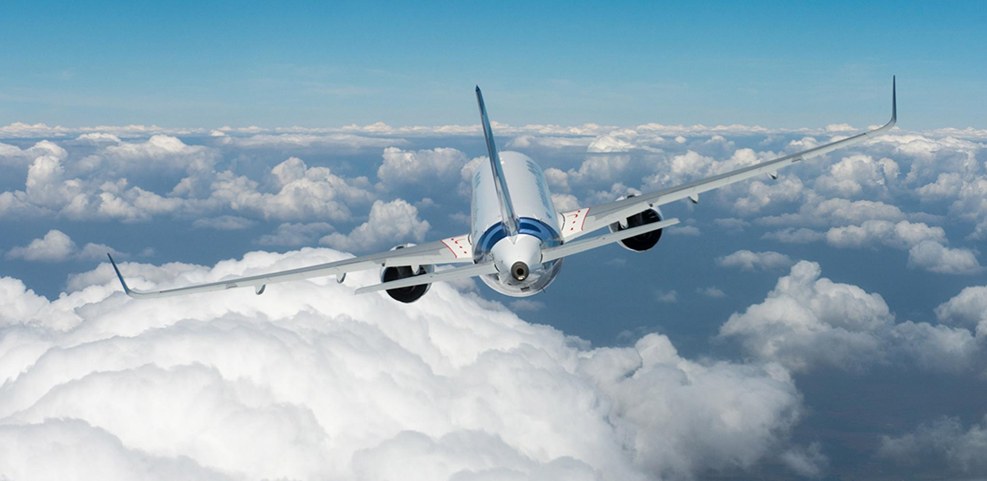
What Really Happens When There’s Turbulence
Your airplane is shaking and trembling and even careening to one side. Your cup of water is dangerously close to spilling.
Put quite simply, turbulence is just “rough air.” The Federal Aviation Administration (FAA) has four levels of turbulence: light, moderate, severe, and extreme.
Light turbulence, often called light chop, feels like rhythmic bumpiness. You won’t have trouble walking around the cabin, and you can expect to see flight attendants out with the service cart.
Moderate turbulence has increased bumpiness and will feel more erratic. You might also feel strain from your seat belt. Anticipating this level of turbulence, pilots will turn on the seat belt sign alerting passengers to return to their seats,” Gonzales explains.
Severe turbulence is rare and comes with short bursts of weightlessness and more strain on your seatbelt. During Extreme turbulence, the rarest form of rough air, you will experience violent jolts, and objects in the cabin can get tossed around.”
https://youtu.be/5wQ9nAlO12E
https://www.youtube.com/watch?v=PI4TiedPiPQ

Slide 21
Four Levels of Turbulence in the Cynefin Framework
Severe
Turbulence
Moderate Turbulence
Extreme
Turbulence
Light
Turbulence
Proposed Prototype – Jefferson DMgt Strategic Consulting Course

Slide 22

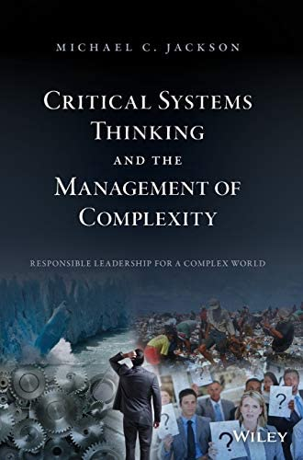
Complex System (Professor M. C. Jackson)
It is the number of parts and the ways in which they interact that define the complexity of a given system.
A large number of elements;
Many interactions among the elements;
Attributes of the elements are not predetermined;
Interaction among elements is loosely organized and are probabilistic in their behavior;
The 'system' evolves over time;
‘Sub-systems' are purposeful and generate their own goals;
The 'system' is subject to behavioral influences;
The 'system' is largely open to the environment.

Slide 23

Complexity
Complexity is more a way of thinking about the world than a new way of working with mathematical models...…It can help all of us address the challenges and opportunities we face in a new epoch of human history.
Using the Cynefin framework can help executives sense which context they are in so that they can not only make better decisions but also avoid the problems that arise when their preferred management style causes them to make mistakes.
http://bit.ly/1t1Q2ct

Slide 24

Complexity and Emergence
Complexity: the myriad of possible ways that the variables in the internal and external environments of the system can interact.
  The complex whole: may exhibit properties that are not readily understood by understanding parts of the system. Complexity is manifested at the level of the system itself.
  The concept of emergence: what distinguishes a complex context from a complicated one is that some behaviors and patterns emerge in complex situations as a result of the pattern of relationships between the elements that creates a condition.
    https://medium.com/age-of-awareness/facing-complexity-means-befriending-uncertainty-and-ambiguity-46b7f576570

Slide 25
Management Manifestation of Complexity
It is not clear which activities are relevant;
Is not apparent how or to what extent these activities are interdependent; and
The environment to a decision maker appears ill-structured, dynamic, and uncertain.

Slide 26
Examples of Organizational COMPLEXITY
When an earthquake strikes, social infrastructure goes into a state of shock, and the first job of the authorities is to get things back up and running.
The same holds true when a blue-chip company riding a prolonged wave of competitive advantage suddenly runs smack into disruptive technology that is creating discontinuity in in its traditional markets. Stock price crumbles, analysts call, partners defect, employees resign, competitors gloat, customers hedge, and investors demand action. It is time for triage.
      Moore, Geoffrey, A. (2000). Living on the Fault Line, Managing for Shareholders Value in the Age of Internet. New York: Harper Business. Page 188.

Slide 27
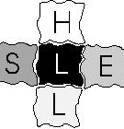
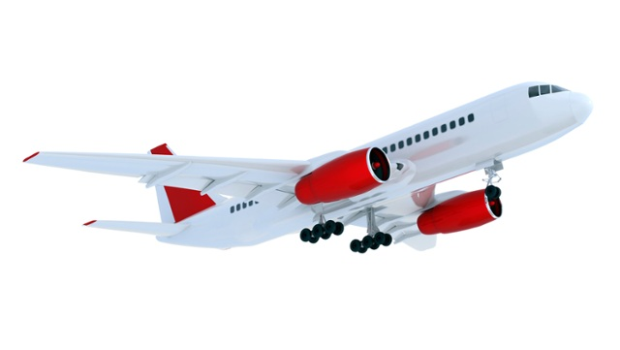
“S H E L L” model
The concept (the name being derived from the initial letters of its components, Software, Hardware, Environment, Liveware) was first developed by Edwards in 1972, with a modified diagram to illustrate the model developed by Hawkins in 1975.
Software - the rules, procedures, written documents etc., which are part of the standard operating procedures.
Hardware - the Air Traffic Control suites, their configuration, controls and surfaces, displays and functional systems.
Environment - the situation in which the L-H-S system must function, the social and economic climate as well as the natural environment.
Liveware - the human beings - the controller with other controllers, flight crews, engineers and maintenance personnel, management and administration people - within in the system.

Slide 28
Complex Adaptive and Complex Evolving Systems: Difference
The idea of complex evolving systems grew out of the somewhat simpler concept of “complex adaptive systems.”
The difference is that the evolving systems not only adapt and survive, they also learn better adaptations over time as a form of “meta-adaptation.”

Slide 29


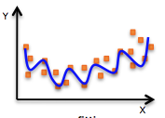

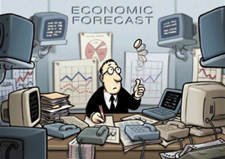
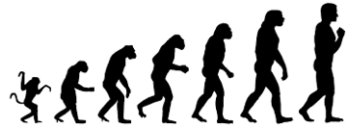
Complexity Theory
Non-linear
Interactive Elements
Whole > Parts
Evolution is Irreversible
Hindsight Does Not Lead
To Foresight
Cannot Forecast

Slide 30




Counterintuitive behavior
Counterintuitive behavior means that actions intended to produce a desired outcome may generate opposite results. It has been said that the path to hell is paved with good intentions. Things can get worse before getting better, or vice versa. One can win or lose for the wrong reason.”
Example: Downsizing! And Qantas flight 72 from Singapore to Perth: “Instinctively, I release my pressure on the sidestick. Out of my subconscious, a survival technique from a previous life emerges: Neutralize! I'm not in control so I must neutralize controls. I never imagined I'd use this part of my military experience”
Jamshid Gharajedaghi

Slide 31

Resilience
Resilience (n): The capacity to recover quickly from difficulties; toughness.
Both the ability to tap into a well of inner strength and a process of adapting in the face of adversity.
Ensuring resilience in the face of disruptions:
the ability to successfully adapt and respond positively to difficulties or other adverse conditions.”

Slide 32
Resilience and Robustness
Resilience may be confused with robustness, but they are not the same.
“Resilience is more about how we go beyond that and how we continuously adapt to changing situations for which we may not necessarily have procedures.
“Robustness is more about how we respond to challenges when there are ways that were trained and skills and resources that were provided,” according to Shawn Pruchnicki, assistant professor at the Center for Aviation Studies at The Ohio State University.
In the aviation realm, it is when we are faced with unexpected events for which we do not have the likes of specific checklists that we can demonstrate our level of resilience.

Slide 33

Resilience
In the social realm, resilience is the process and outcome of successfully adapting to difficult or challenging life experiences, especially through mental, emotional, and behavioral flexibility and adjustment to external and internal demands.

Slide 34
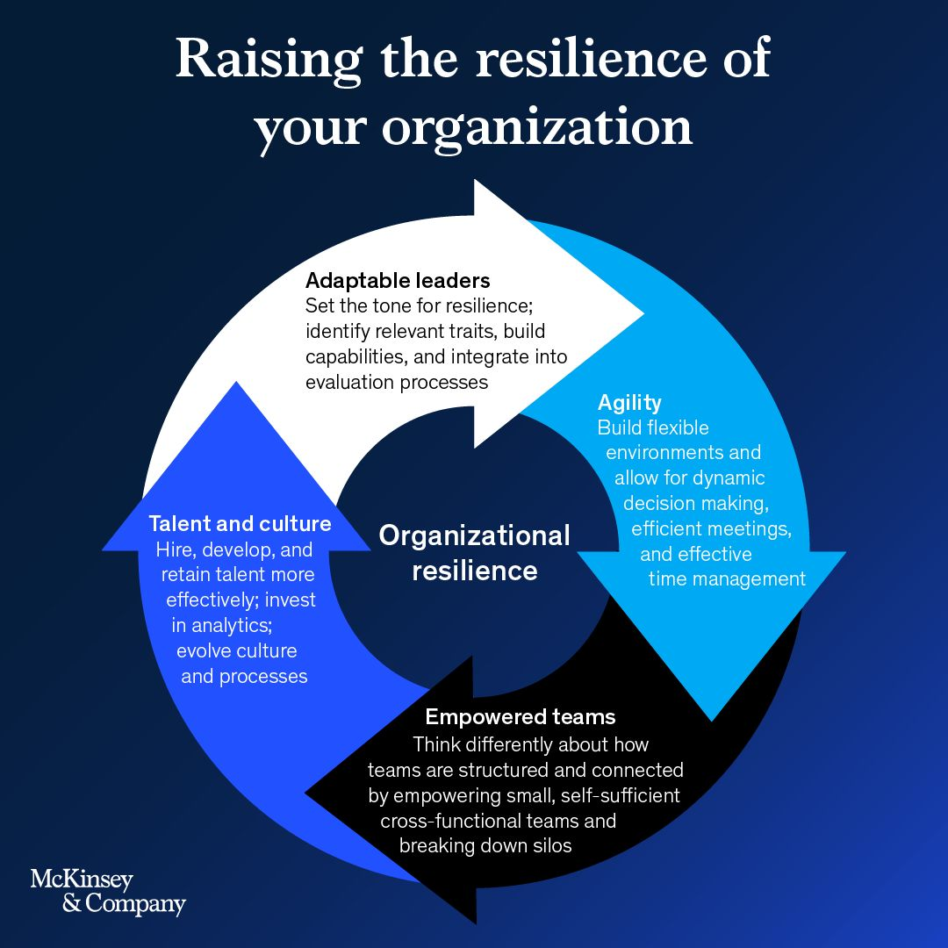

Slide 35
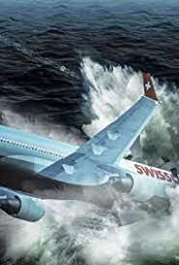
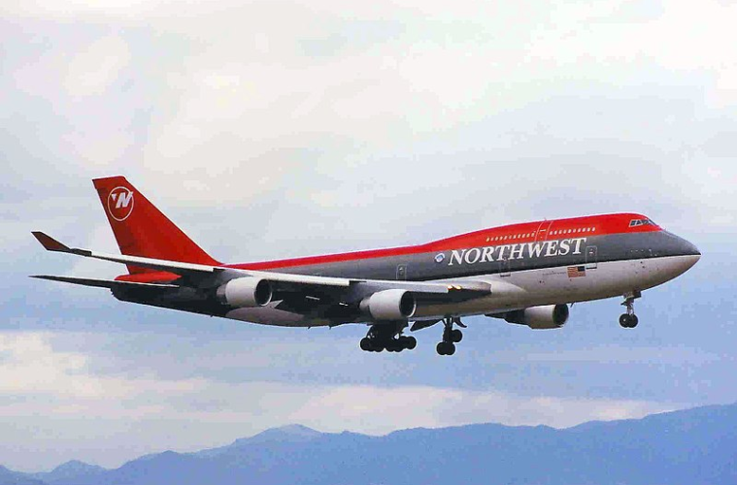
Example of Resilience
Miracle on Northwest Airlines Flight 85 – How 4 pilots saved 404 lives.
Explaining the term is easy; putting the concept into practice is challenging.
https://flightsafety.org/asw-article/defining-resilience/

Slide 36
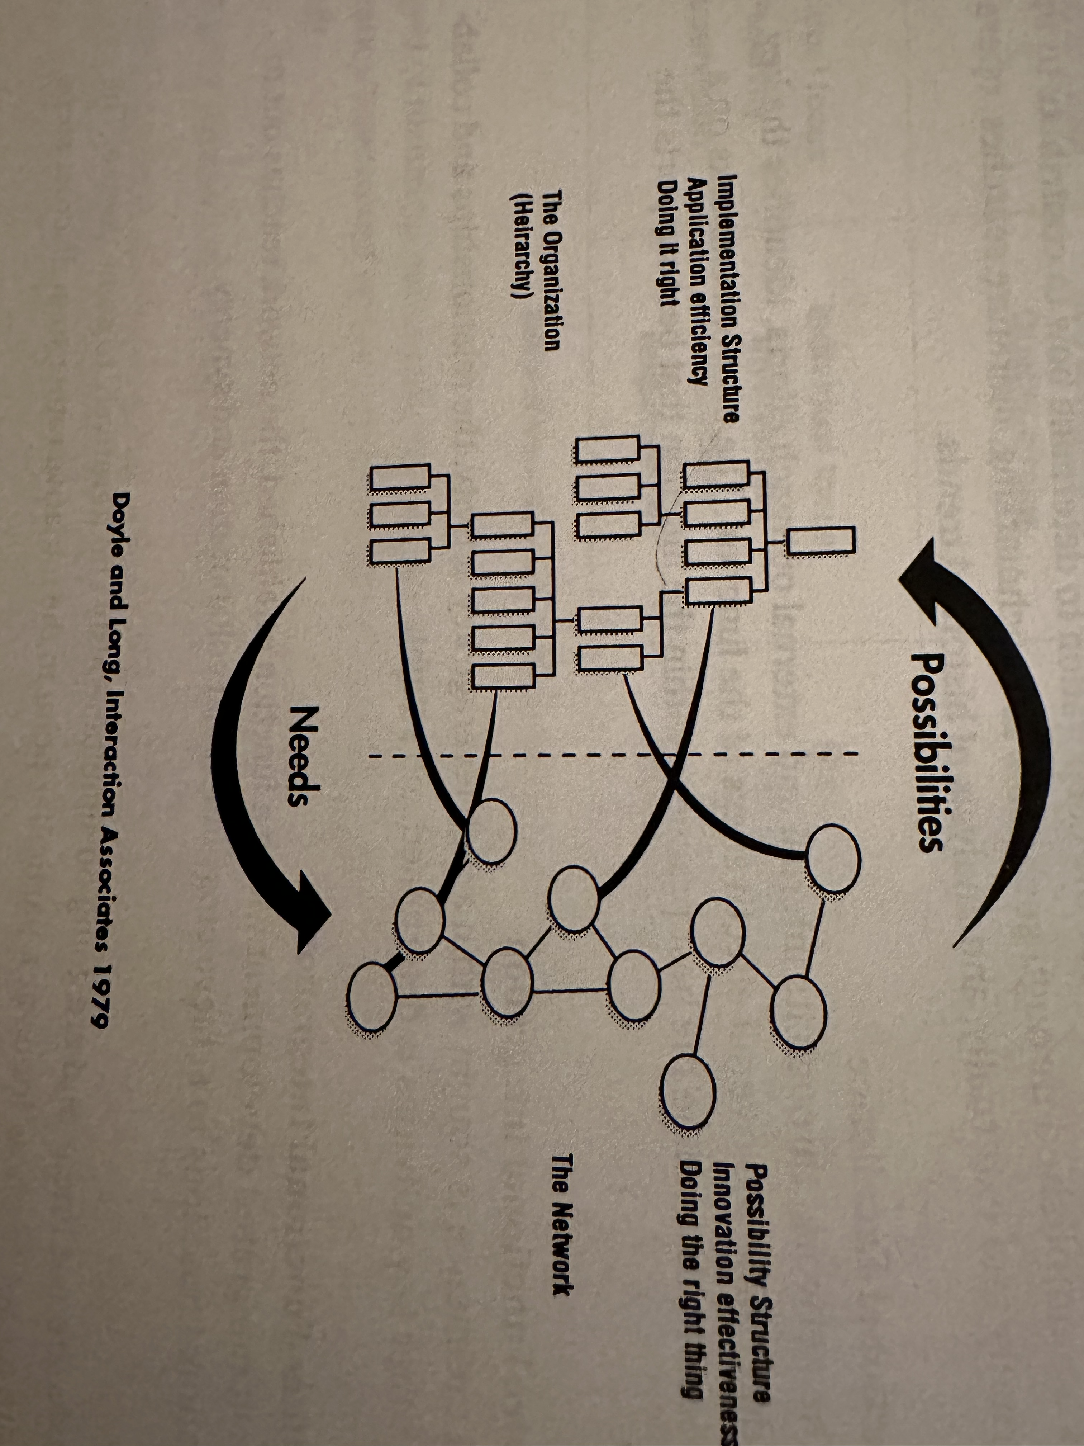
POSSIBILITY-SEEKING & IMPLEMENTATION STRUCTURE

Slide 37
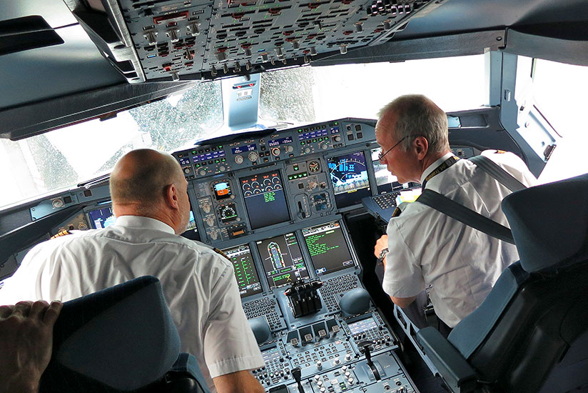
Agile Thinking
Agile thinking is the ability to actively switch your thinking according to what's needed across different contexts. It is an effective and efficient way of managing uncertainty and turbulent
How do environmental turbulence and complexity affect the appropriate formal design of organizations?.Nov 4, 2021

Slide 38
Aviation as a Complex Adaptive System
To reduce errors of judgment and improve decision-making skills, a Decision-making model has been tailored for the system to fit different flying conditions. It provides a logical decision-making process, even when decisions must be made under pressure. The DECIDE model, according to Krause (1996), stands for:
D-Detect: The pilot detects the fact that a change has occurred that requires attention.
E-Estimate: The pilot estimates the significance of the change to the flight.
C-Choose: The pilot chooses a safe outcome for the flight.
I-Identify: The pilot identifies plausible actions in response to the change.
D-Do: The pilot acts on the best options.
E-Evaluate: The pilot evaluates the effect of the action on the change and on the progress of the flight.

Slide 39
Detecting and Correcting Errors
Black Boxes: Although great effort goes into raising the competency level of all those who work within the system, mistakes dooccur. In order for the aviation industry to learn and improve, it must and does have a way of identifying errors. A “black box” is aboard every commercial aircraft. It consists of flight data and cockpit voice recorders.
Determining what caused deviations from expectations is the responsibility of the National Transportation Safety Board (NTSB). Its main function is diagnosis and prescription—to investigate accidents, identify their causes, and recommend improvements. In order to achieve a high standard of excellence, the NTSB is a professional body with its own investigators and methodology.
Accidents and Lessons Learned It is important to understand how these different components of the commercial aviation system function and interact with one another and with the rest of the environment. Such interactions are best illustrated by examples of how major accidents produce “lessons learned.”

Slide 40
Scanning and Surveilance
Providing decision makers with the ability to anticipate threats and opportunities. This function performs scanning and surveillance of the internal and external environments for significant trends or changes. Statistical procedures are used to identify such trends or changes in critical indicators before organizational performance is affected.

Slide 41

Thank you
Questions and Discussion

