Slide 1
PromOTing Social Participation for Young Individuals Following Concussion
Occupational Therapy
Presented by: Umara Iftikhar, OTS; Ann Claire Macalintal,OTS;
Madeline Rea, OTS; and Allizey Shields, OTS
Faculty Advisor: Rebecca Sinko, OTD, OTR/L
Presented in Partial Fulfillment of the Master of Science in Occupational Therapy degree at Thomas Jefferson University

Slide 2
Session Objectives
Understand the relevance of anxiety and depression amongst young individuals following the onset of a concussion or post-concussive symptoms.
Recognize the distinct value of occupational therapy in promoting social skills to enhance relationships and mitigate feelings of isolation for persons with concussive symptoms.
Develop evidence-based interventions within the scope of occupational therapy for young individuals experiencing anxiety and depression following diagnosis of a concussion.

Slide 3
Presentation Objectives
Background Information
Clinical Problem and Rationale
PICO Question
Methods of Research
Evidence
Results, Themes, and Implications
Acknowledgements and References

Slide 4
Background Information, Clinical Problem, and Rationale

Slide 5
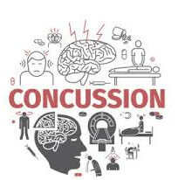
Concussion Defined
A concussion is often caused by a sudden direct blow or bump to the head; often related to sport or recreational activity; MVA; work-related injury, fall, or fighting
(Pheifer, n.d.; Wright, n.d.)

Slide 6
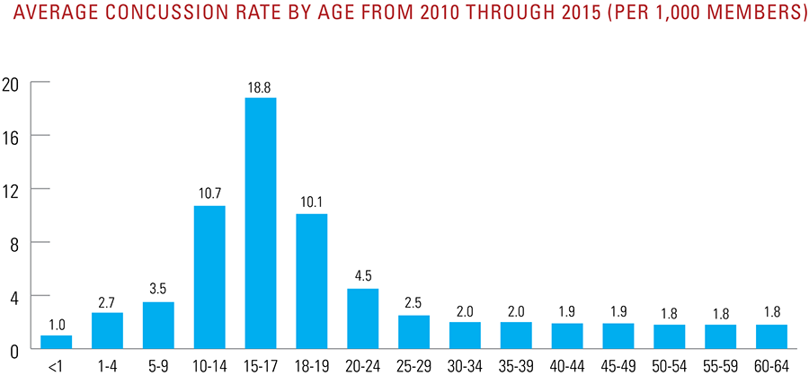
(BCBS, 2016)

Slide 7
Concussion Symptoms
Headache
Sluggishness / fatigue
Dizziness
Difficulty concentrating
Excessive fatigue
Forgetfulness
Confusion
Slowed Response
Clumsiness
Problems related to sleep
Sensitivity to light / noise
Depression, anxiety, irritability, or behavioral changes
(Wright, n.d)
Notes:
Some of the many symptoms of concussions are listed here, symptoms can include blurred vision dizziness,Forgetfulness, Sensitivity to light and noise, Headaches, fatigue, nausea and vomiting, as well as depression, anxiety and other behavioral changes. These symptoms can be debilitating and cause a lack of engagement in meaningful occupations for the individual.

Slide 8
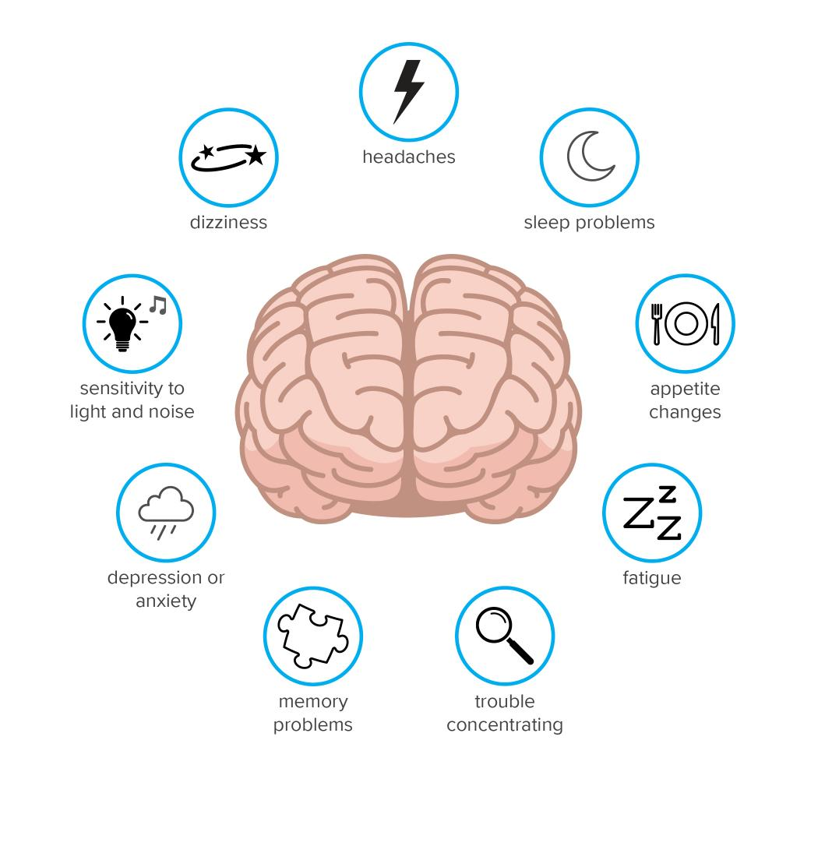
Post-Concussion Syndrome
Defined
Post-concussion syndrome (PCS) is when symptoms after a head injury persists for a period of time ranging from week to months, and sometimes years.
https://www.medicalnewstoday.com/articles/326227 (Pheifer, n.d.; Wright, n.d., Gauvin-Lepage et al., 2020))

Slide 9
ICD 10 Criteria for Post-Concussive Syndrome
Headache
Memory complaints
Blurred Vision
Difficulty concentrating
General malaise
Emotional excitement / Stress
Noise intolerance
Emotional lability
Insomnia
Easily provoked
Reduced tolerance to alcohol
Preoccupation of above symptoms may cause permanent brain damage
(Quinn et al., 2019)

Slide 10
Depression and Anxiety Defined
Depression is a common yet serious mood disorder that can affect many aspects of daily living.There are multiple forms of depression that may develop under unique situations.
Anxiety is a psychiatric disorder that is often characterized by intense, excessive, and constant worry and fear. These feelings can be difficult to control and affect everyday functioning.
(2021 icd-10-cm Diagnosis Code f41.9. 10. (n.d)., Mayo Clinic (2018), U.S. Department of Health and Human Services. (n.d.)

Slide 11
DSM-V Anxiety
DSM-V Depression
Excessive worry
Loss of interests
Restlessness
Feeling sad / empty / hopeless / worthless
Fatigue / Sleep disturbance
Insomnia or Hypersomnia
Difficulty Concentrating
Recurrent thoughts of death or suicide
Irritable / Tense
Inability to concentrate or make decisions
Impairment in social, occupational, or other life functioning areas
(American Psychiatric Association, 2013)
Notes:
In order to be diagnosed with depression or anxiety, an individual must meet specific criteria according to the DSM-V. Symptoms of anxiety can include restlessness, excessive worry, fatigue, and sleep disturbance. The DSM-V states that symptoms of depression can include fatigue, loss of interest or pleasure inactivities, recurrent thoughts of death or suicide, and feeling sad/empty/hopeless/or worthless. The DSM-V lists that both anxiety and depression can cause an impairment in social, occupational, and or other life functioning areas. It is important to note that symptoms of anxiety must not occur due to the effects of drugs or medications and is not the result of another psychological disorder such as panic disorder, obsessive-compulsive disorder, posttraumatic stress disorder, etc.
https://www.ncbi.nlm.nih.gov/books/NBK519704/table/ch3.t15/
https://chsciowa.org/sites/chsciowa.org/files/resource/files/7_-_depression_dsm-5_checklist.pdf

Slide 12
Clinical Problem
19.5%
14%
5.5%
Adolescents diagnosed with a concussion
Report one concussion
Report more than one concussion
Post-concussion symptoms can cause elevated levels of depression, anxiety, loneliness, and isolation
This can affect the quality of social relationships and friendships for young individuals
(DiBattista et al., 2014; Veliez et al., 2017)

Slide 13
Relevance to Occupational Therapy Practice
According to the OTPF 4, social participation...
“involves social interaction with others (family, friends, intimate partners, peers, and community members) and that support social interdependence”.
Persons who experience a concussion may have psychological symptoms that hinder their meaningful interactions with others.
Occupational therapy practitioners can play a role in promoting social skills to resume meaningful relationships.
(AOTA, 2020b)

Slide 14
Rationale for OT
OT’s should seek to formulate interventions that promote social engagement amongst this population.

Slide 15
PICO Question
Amongst individuals, ages 13-25, experiencing symptoms of anxiety and depression following concussion, what interventions
within the scope of Occupational Therapy will increase social participation?
P(1) Individuals (ages 13-25)
with a Concussion
P(2) Experiencing symptoms of anxiety and depression
Identify interventions within the scope of Occupational Therapy
Increased social participation

Slide 16
Methods of Literature Search

Slide 17
Methods
Databases Searched
Search Terms Used
Database limitations
Inclusion and exclusion criteria
Prisma Flow Diagram
Critical Review Process

Slide 18
Databases Searched
PUBMED
CINAHL
PSYCInfo
Used to retrieve biomedical and life sciences literature
Used to retrieve nursing and allied health literature
Used to retrieve psychological and psychiatric literature

Slide 19
Search Terms Used
P(1): concussion
Brain Injuries, mild traumatic brian injury, post-concussion syndrome, head injury, TBI, brain concussion, traumatic brain injuries, concussion, mild head injuries
P(2): anxiety & depression
Anxiety, depression, psychological effects, generalized anxiety disorder, social anxiety, mental health, psychosocial factors, well being, emotional states, adaptation psychological, models, psychological
I: OT interventions
psychosocial intervention, psychosocial functioning, psychosocial health, occupational therapy, occupational therapy practice, occupational therapy service, occupational therapy interventions, communication skills training, social skills training, mental health education, psychological techniques
O: social participation
Social participation, social involvement, social behavior, social adjustment, socialization, quality of life, psychological well being, satisfaction, personal satisfaction, communication, communication skills, social skills, social interaction

Slide 20
LIMITATIONS
Within the past 10 years (2011-2021)
Articles in English language
Peer reviewed articles
Full-text access

Slide 21
INCLUSION
Interventions within the scope of OT practice
Dx of concussion, post-concussion syndrome, mild TBI
Experiencing symptoms of anxiety and/or depression according to the DSM-V
Age range of 13-25 years old
EXCLUSION
Pharmacologic interventions
Interventions for caregivers
Hx of MH disorder prior to concussion
Dx of moderate-severe TBI or ABI
Primary focus of assessments and evaluation tools
Meta-analysis or systematic reviews
Culture-specific interventions that are not translatable
Exclusion

Slide 22
PRISMA Flow Diagram
Identification
Records identified from: Databases (n= 614)
Records removed before screening:
Duplicate records removed (n = 93)
Screening
Records screened - title
(n = 521 )
Records excluded (n = 270 )
Records screened - abstract
(n = 251 )
Records excluded (n = 173 )
Records sought for retrieval
(n = 78)
Records not retrieved (n = 0 )
Reports assessed for eligibility
(n = 78)
Reports excluded:
Reason 1 (n = 23 )
Reason 2 (n = 18 )
Reason 3 (n = 31 )
Included
Studies included in review
(n =10 )

Slide 23
Critical Review Process
Full text articles reviewed: 10
Quantitative Review forms: 7
Qualitative Review forms: 2
Mixed Methods: 1
Peer cross checking
Thematic coding
Synthesis and analysis of all articles

Slide 24
AOTA’s Level of Evidence
Level of Evidence | Description
Level I | Systematic reviews, meta-analysis, randomized control trials
Level II | Two groups, nonrandomized studies (cohort; case-control)
Level III | One group, nonrandomized (before and after; pre-test and post-test, quasi-experimental)
Level IV | Descriptive studies that include analysis of outcomes (single-subject design; case series)
Level V | Case reports and expert opinions that include narrative literature reviews and consensus statement
(Tomlin & Borgetto, 2011)

Slide 25
Articles Reviewed Level of Evidence
Level of Evidence | # of Articles | Articles
Level I | 5 | Hanks et al., 2021; Hoek et al., 2021; Rytter et al., 2019; Suffoletto et al., 2013; Wise et al., 2012;
Level II | 1 | Di Battista et al., 2014
Level III | 3 | Bay & Chan, 2019; Gauvain-LePage et al., 2020; Donnelly et al., 2019
Level IV | 1 | Sasse et al., 2014
Level V | 0

Slide 26
Results of the Literature

Slide 27
Study Characteristics
Sample
Size
Diagnoses
Participant
Age
Average n= 318
Range n = 11-1,563
Majority of studies < 100
Mild Traumatic Brain Injury
Post-Concussive Symptoms / Syndrome
Concussion
12-70
*(our study aimed to focus on 13-25)

Slide 28
Geographic Locations
Canada
Germany
United States
Australia

Slide 29
Primary Outcome Measures used across studies (N=10)
Measurements on Concussion and Psychological Symptoms
Rivermead Post-Concussion Questionnaire (RSQ) Post-concussion symptom inventory Beck Depression Inventory and Beck Youth Inventory The Headache Impact Test Major Depressive Inventory Brief Symptom Inventory-18
Rivermead post-concussion symptom questionnaire. Shirley Ryan AbilityLab. (n.d.)

Slide 30
Secondary Outcome Measures used across studies (N=10)
Health-related quality-of-life questionnaire | Multidimensional Fatigue Inventory | Coping Inventory for Stressful Situations
Freiburg questionnaire of coping with illness | Profile of mood states (POMS) | Quality of life after brain injury (QOLIBRI)
Community Integration Measure | Short Form 36 Health Survey | Medical Outcomes Study
36-Item short form Survey (SF-36). Physiopedia. (n.d.).

Slide 31
Overall Research Findings
Example outcome measures
Screen for Anxiety Related Disorders State-Trait Anxiety Inventory
Child Depression Inventory
Peer Network and Dyadic Loneliness Scale (PNDLS)
The Differential Loneliness Scale for Non-Student Populations
PedsQL
Psychosocial assessments after mTBI for depression and anxiety should be done through the patient not caregiver/proxy.
Symptoms of depression should be treated in addition to concussion symptoms to improve QOL in patients with mild TBI.
(DiBattista et al., 2014)

Slide 32
Themes

Slide 33
PICO Question Revisited
Amongst individuals, ages 13-25, experiencing symptoms of anxiety and depression following concussion, what interventions
within the scope of Occupational Therapy will increase social participation?

Slide 34
Themes
3. Use of Technology- Based Interventions
1. Aerobic Exercise and Physical Activity
2. Emotional Well-Being Strategies
Notes:
After peer reviewing and thematic analysis; Three overarching themes were identified across studies:
1. Aerobic exercise and physical activity for concussive symptom relief
2. Emotional well-being strategies (such as mindfulness)
3. And Technology-based interventions; however we have found mixed results on this intervention

Slide 35
AOTA’s Strength of the Evidence
Strength | Description
Strong | Two or more level I studies The available evidence usually includes consistent results from well-designed, well-conducted studies. The findings are strong
Moderate | At least one level I high-quality study or multiple moderate quality studies (Level II, Level III, etc) The available evidence is sufficient to determine the effects on health outcomes, but confidence in the estimate is constrained The number, size, or quality of the individual studies or inconsistency of the findings across individual studies
Low | Small number of low-level studies, flaws in the studies, etc The available evidence is insufficient to assess effects on health and other outcomes of relevance to occupational therapy Evidence is sufficient
(AOTA, 2020a)

Slide 36
Theme 1:
Aerobic Exercise and Physical Activity
Interventions for individuals with mild TBI experiencing depression and anxiety

Slide 37
Theme 1: Aerobic Exercise & Physical Activity
Level of Evidence | Citation | Intervention | Significance of Results
Level III | Donnelley et al., 2021 | “LoveYourBrain Yoga” 6-week yoga and psychoeducation program for groups of individuals with a TBI and caregivers | Statistical Significance: improvements in QOL (B 9.70, 95% CI: 8.51, 10.90) Resilience (B 1.30, 95% CI: 0.60, 2.06) Well-being (B 1.49, 95% CI: 1.14, 1.84) Cognition (B 1.48, 95% CI: 0.78, 2.18) Clinical Relevance: Yoga program with psychoeducation Improve QOL in individuals with TBI
Level III | Gauvin-Lepage et al., 2020 | “ARI; Aerobic Rehabilitation Intervention” Aerobic activity Coordination/sport-specific activity Mental imagery Education about diagnosis course, progression, & coping strategies Home program | Statistical Significance:improvements in QOL (P = 0.04) Less anger (P = 0.02) Less fatigue PCS (P = 0.09) Clinical Relevance: Active rehabilitation intervention can Reduce post-concussion symptoms. Increase quality of life Increase energy level Increase balance Decrease anger.

Slide 38
Theme 1: Aerobic Exercise & Physical Activity contd.
Level of Evidence | Citation | Intervention | Significance of Results
Level I | Rytter et al., 2019 | “S-REHAB” 22-week program Individual and group-based neuropsychological treatment Exercise therapy Physiotherapeutic coaching Compared to standard treatment the usual treatment offered by the public municipality services (STAND). | Statistical Significance: Reduction in symptoms compared to the STAND Post-treatment: ES = 0.28 Improvement of headache Post-treatment: ES = 0.38 Improvement of social functioning Post-treatment ES = 0.31 Clinical Relevance: Emphasis on use of an Interdisciplinary team approach
Level I | Wise et al., 2012 | “Follow-Up Phone Call” 10 week 1x/wk exercise sessions And a home aerobic exercise 4x/wk Bimonthly phone calls for 6 months post intervention to encourage exercise adherence | Statistical Significance: (N/A) Clinical Relevance: 90 minutes of exercise a week can improve: Mood Mental health QOL

Slide 39
Theme 1 Summary
Aerobic exercise and physical activity (n=4)
Yoga programs and aerobic exercise interventions
Displayed improvement in quality of life, mood, and energy levels
Reduction in post-concussive symptoms
4/4 with statistical significance and clinical relevance
AOTA’s Strength of Evidence: Strong
(Donnelley et al., 2021; Gauvin-Lepage et al., 2020; Rytter et al., 2019; Wise et al.2012)

Slide 40
Theme 2:
Emotional Well-Being Strategies
Interventions for individuals with mild TBI experiencing depression and anxiety

Slide 41
Theme 2: Emotional Well-Being Strategies
Level of Evidence | Citation | Intervention | Significance of Results
Level III | Bay & Chan, 2018 | “Mindfulness Group Therapy” Intervention group: Positive focused mindfulness group therapy (PFM-GT) Control Health promotion group; active control group therapy (AC-GT) | Statistical Significance: PFM-GT resulted in improved change in: chronic stress, depressive symptoms, and TBI symptoms; (p < 0.05) Clinical Relevance: Mindfulness-based group intervention for individuals with chronic difficulties after TBI is feasible and effective.
Level I | Hanks et al., 2012 | “Mentoring Group” Intervention group: Mentoring group Spoke with trained mentor via phone Emotional support, QOL, community integration Control group: no mentoring group | Statistical Significance: Compared to control, peer mentoring program improved: Feeling of being in control P=.04 Lower alcohol use P=.01 Avoidance coping (P=.03), QOL (P=.04) Clinical Relevance: Mentoring can be an effective way to benefit mood and healthy coping after TBI, and prevent maladaptive behaviors

Slide 42
Theme 2: Emotional Well-Being Stratgies contd.
Level of Evidence | Citation | Intervention | Significance of Results
Level IV | Sasse et al., 2014 | “Coping Strategies” Aim to investigate coping strategies Identify TBI characteristics that can predict maladaptive coping strategies Researchers assessed behaviors via the Freiburg Questionnaire of Coping with Illness (FQCI) HRQoL by the Quality of Life after Brain Injury (QOLIBRI) scale Short Form-36 Health Survey (SF-36) | Statistical Significance: Individuals following TBI may pursue 2 types of coping strategies: “Trivialization/Resignation” (maladaptive) “Action/Distraction” (adaptive): p < 0.05 Clinical Relevance: Trivialisation/Resignation strategy was negatively correlated with health related quality of life. Action/Distraction strategy were positive for managing anxiety, depression, recovery, cognitive status, mood states and trauma Use of adaptive strategies should correspondingly be fostered.

Slide 43
Theme 2: Summary
Strategies to improve emotional well-being; (n=3)
Intervention Examples
Mindfulness therapy (in-person and telephone)
Peer mentoring
Individual/group discussions
Adaptive coping strategies
3/3 reporting statistical significance
AOTA’s Strength of Evidence: Moderate
(Bay & Chan, 2018; Hanks et al., 2012; Sasse et al., 2014)

Slide 44
Theme 3:
Use of Technology- Based Interventions
Interventions for individuals with mild TBI experiencing depression and anxiety

Slide 45
Theme 3: Technology Use
Level of Evidence | Citation | Intervention | Significance of Results
Level I | Hoek et al., 2021 | “Video Discharge Plan” Intervention: Discharge information provided via verbal, written, and video instructions Control: verbal and written only | Clinical Relevance: Difference in mean total RPCS score between the 2 groups was 0.2 at 1 week and 0.3 at 3 months after. Intervention deemed ineffective.
Level I | Suffoletto et al., 2013 | “Text Message Follow-Up” Intervention: Patients texted study hotline and answered 3 questions over 14 days Control: Follow-up report with doctor | Clinical Relevance: Text messaging–based education and support had fewer and less severe postconcussive symptoms than controls but none of the differences reached statistical significance
Level I | Wise et al., 2012 | “Follow-Up Phone Call” Intervention: patients were called bimonthly for 6 months by two trainers: Encouraged exercise adherence Discussed strategies to maintain social and environmental support | Clinical Relevance: Exercising at least 90 minutes a week is associated with Improved mood, QOL, and mental health. Limitations of study determine that telephone contact could have played a role in patients' mood and data, rather than through maintenance of exercise.

Slide 46
Theme 3: Summary
Caution for technology use; (n=4)
2 articles without statistical significance or positive intervention results:
Ineffective interventions using technology (SMS or video instructions) as the delivery method
1 article with positive results:
Positive results when contacting patients over the phone to encourage adherence to intervention program
AOTA’s Strength of Evidence: Strong
(Hoek et al., 2021; Suffoletto et al., 2013; Wise et al., 2012)

Slide 47
PICO Question Revisited
Amongst individuals, ages 13-25, experiencing symptoms of anxiety and depression following concussion, what interventions
within the scope of Occupational Therapy will increase social participation?

Slide 48
PICO Question Answered
Occupational Therapists can play an important role in the treatment of managing psychological symptoms following concussion to promote social participation.
Interventions should focus on:
Group therapy / Peer mentoring
Coping skills training
Mindfulness-based strategies
Exercise based interventions
Promotion of physical activity

Slide 49
Research Strengths
Research Limitations
- - - - - - - - - - - - - - - - - - - - - - - - - - - - - - - - - - - - - - -
Randomized control trials
Up-to-date literature
Validity and reliability of outcome measures
Statistical Significance
Small sample sizes limits generalizability
Attrition
Lack of detail on interventions
Confounding variables
Unclear terminology: “standard care”
Bias: lack of blinding & number of self reporting

Slide 50
Project Strengths
Project Limitations
- - - - - - - - - - - - - - - - - - - - - - - - - - - - - - - - - - - - - - -
Emerging Patterns
Cohesive teamwork
Search Terms
Peer review process
Strong mentorship and guidance
Available resources
Focusing only on mild TBI
Focusing only on ages 13-25
Limited time

Slide 51
Implications for
Practice, Education, and Research

Slide 52
Implication to occupational therapy practice
Using a holistic occupation-based and client-centered approach for addressing psychological and concussion symptoms have shown to improve QOL and mood, promoting engagement in meaningful social relationships.
Interventions
Manage anxiety & depression | Manage concussion symptoms
Mindfulness strategies Coping strategies Peer support | Aerobic exercise Physical activity

Slide 53
Implications on education
OT curriculum would benefit from:
Addressing how to create home exercise programs to support activity amongst patients with mTBI experiencing anxiety and depression
Providing resources for students experiencing anxiety and depressive symptoms following mTBI

Slide 54
Implications on research
Future studies can:
Utilize larger and more diverse samples of the population
Develop peer support programs for young individuals
Address young adult/adolescent populations following mTBI
Provide thorough details of interventions and data collection procedures to ensure trustworthiness
Focus research studies on peer social interactions following mTBI

Slide 55
Take Home Messages
In order to mitigate social withdrawal of young individuals experiencing anxiety and depression as a result of a concussion, occupational therapists should be leaders and program developers in creating client-centered and occupation-based interventions to promote meaningful social interactions with friends, family, peers, and other persons in the community.

Slide 56
Acknowledgements & References

Slide 57
Acknowledgements
Rebecca Sinko OTD, OTR/L
E. Adel Herge OTD, OTR/L, FAOTA
Paul Hunter, DMD, MLIS
Gary Kaplan, MS
Gregory Laynor, MLS, PhD
Larissa Gordon, MS, MEd, MA
Family, friends, and classmates

Slide 58
Questions or Comments?
PLEASE CONTACT:
Umara: umara.iftikhar@students.jefferson.edu
Ann Claire: ann.claire.macalintal@students.jefferson.edu
Madeline: madeline.rea@students.jefferson.edu
Allizey: allizey.shields@students.jefferson.edu

Slide 59
References
American Occupational Therapy Association [AOTA]. (2020a). Guidelines for systematic reviews. American Journal of Occupational Therapy. https://ajot.submit2aota.org/journals/ajot/forms/systematic_reviews.pdf
American Occupational Therapy Association [AOTA]. (2020b). Occupational therapy practice framework: Domain and process (4th ed.). American Journal of Occupational Therapy, 74(Suppl. 2), Article 7412410010. https://doi.org/10.5014/ajot.2020.74S2001
American Psychiatric Association. (2013). Diagnostic and statistical manual of mental disorders (5th ed.). Arlington, VA: Author
Bay, E., & Chan, R. R. (2019). Mindfulness-Based Versus Health Promotion Group Therapy After Traumatic Brain Injury. Journal of
Psychosocial Nursing and Mental Health Services., 57(1), 26–33. https://doi.org/10.3928/02793695-20180924-03
BlueCross BlueShield [BCBS]. (2016, September 27). The steep rise in concussion diagnoses in the U.S. Blue Cross Blue Shield. https://www.bcbs.com/the-health-of-america/reports/the-steep-rise-concussion-diagnoses-the-us.
Di Battista, A., Godfrey, C., Soo, C., Catroppa, C., Anderson, V. (2014) Depression and Health Related Quality of Life in Adolescent Survivors of a Traumatic Brain Injury: A Pilot Study. PLoS ONE 9(7): e101842. doi:10.1371/journal.pone.0101842
Donnelly, K. Z., Baker, K., Pierce, R., St. Ivany, A. R., Barr, P. J., & Bruce, M. L. (2021). A retrospective study on the acceptability,
feasibility, and effectiveness of LoveYourBrain Yoga for people with traumatic brain injury and caregivers. Disability and Rehabilitation., 43(12), 1764–1775. A retrospective study on the acceptability, feasibility, and effectiveness of LoveYourBrain Yoga for people with traumatic brain injury and caregivers
Gauvin-Lepage, J., Friedman, D., Grilli, L., Sufrategui, M., De Matteo, C., Iverson, G. L., & Gagnon, I. (2020). Effectiveness of an
Exercise-Based Active Rehabilitation Intervention for Youth Who Are Slow to Recover After Concussion. Clinical Journal of Sport Medicine., 30(5), 423–432. https://doi.org/10.1097/JSM.0000000000000634

Slide 60
References
Hanks, R. A., Rapport, L. J., Wertheimer, J., & Koviak, C. (2012). Randomized controlled trial of peer mentoring for individuals with
traumatic brain injury and their significant others. Archives of Physical Medicine and Rehabilitation, 93(8), 1297–1304. https://doi.org/10.1016/j.apmr.2012.04.027
Hoek, A. E., Joosten, M., Dippel, D. W., Van Beeck, E. F., van den Hengel, L., Dijkstra, B., ... & Rood, P. P. (2021). Effect of Video Discharge Instructions for Patients With Mild Traumatic Brain Injury in the Emergency Department: A Randomized Controlled Trial. Annals of Emergency Medicine Journal of the American College of Emergency Physicians., 77(3), 327–337. https://doi.org/S0196-0644(20)31354-8
Mayo Foundation for Medical Education and Research. (2018, May 4). Anxiety disorders. Mayo Clinic. https://www.mayoclinic.org/diseases-conditions/anxiety/symptoms-causes/syc-20350961.
Pheifer, T. (n.d.). Post-Concussion Syndrome: Symptoms, Treatments, Tests, Recovery, and More. Retrieved from
https://www.webmd.com/brain/post-concussion-syndrome
Quinn, D. K., Mayer, A. R., Master, C. L., & Fann, J. R. (2018). Prolonged Postconcussive Symptoms. The American journal of psychiatry, 175(2), 103–111. https://doi.org/10.1176/appi.ajp.2017.17020235
Rivermead post-concussion symptom questionnaire. Shirley Ryan AbilityLab. (n.d.). https://www.sralab.org/rehabilitation-measures/rivermead-post-concussion-symptom-questionnaire.
Rytter, H. M., Westenbaek, K., Henriksen, H., Christiansen, P., & Humle, F. (2019). Specialized interdisciplinary rehabilitation reduces persistent post-concussive symptoms: a randomized clinical trial. Brain Injury : BI., 33(3), 266–281. https://doi.org/10.1080/02699052.2018.1552022
Sasse, N., Gibbons, H., Wilson, L., Martinez, R., Sehmisch, S., von Wild, K., & von Steinbüchel, N. (2014). Coping strategies in individuals after traumatic brain injury: associations with health-related quality of life. Disability and Rehabilitation., 36(25), 2152–2160. https://doi.org/10.3109/09638288.2014.893029

Slide 61
References
Suffoletto, B., Wagner, A. K., Arenth, P. M., Calabria, J., Kingsley, E., Kristan, J., & Callaway, C. W. (2013). Mobile phone text messaging
to assess symptoms after mild traumatic brain injury and provide self-care support: a pilot study. Journal of Head Trauma Rehabilitation., 28(4), 302–312. https://doi.org/10.1097/HTR.0b013e3182847468
Tomlin, G., Borgetto, B., & Tomlin, G. (2011). Research Pyramid: a new evidence-based practice model for occupational therapy. The American Journal of Occupational Therapy : Official Publication of the American Occupational Therapy Association, 65(2), 189–196. https://doi.org/10.5014/ajot.2011.000828
U.S. Department of Health and Human Services. (n.d.). Nimh " depression. National Institute of Mental Health. https://www.nimh.nih.gov/health/topics/depression.
Wise, E. K., Hoffman, J. M., Powell, J. M., Bombardier, C. H., & Bell, K. R. (2012). Benefits of Exercise Maintenance After Traumatic Brain Injury. Archives of Physical Medicine and Rehabilitation., 93, 1319–1323. https://doi.org/10.1016/j.apmr.2012.05.009
Wright, S. (n.d.). Concussion: Symptoms, Causes, Diagnosis, Treatments, & Recovery. Retrieved from
https://www.webmd.com/brain/concussion-traumatic-brain-injury-symptoms-causes-treatments
Veliz, P., McCabe, S. E., Eckner, J. T., & Schulenberg, J. E. (2017). Prevalence of concussion among us adolescents and correlated factors. JAMA, 318(12), 1180–1182. https://doi.org/10.1001/jama.2017.9087
36-Item short form Survey (SF-36). Physiopedia. (n.d.). https://www.physio-pedia.com/36-Item_Short_Form_Survey_(SF-36).
2021 icd-10-cm Diagnosis Code f41.9. 10. (n.d.). https://www.icd10data.com/ICD10CM/Codes/F01-F99/F40-F48/F41-/F41.9#:~:text=2021%20ICD%2D10%2DCM%20Diagnosis,9%3A%20Anxiety%20disorder%2C%20unspecified.

