Slide 1
Let’s Get Spiritual!
How integrating spirituality into the OT process impacts well-being for those experiencing a life-altering diagnosis
Taneisha Esplin Jolley, Jeffrey Gold, MS, Nicholas Luca, & Antôn Nguyễn
Faculty Mentor: Eileen Adel Herge OTD, OTR/L, FAOTA
Completed in partial fulfillment of a Master of Science Degree Thomas Jefferson University

Slide 2
Session Objectives
Upon completion of this presentation participants will be able to:
Define spirituality as it applies to the scope of occupational therapy practice for individuals experiencing life-altering diagnoses and conditions
Describe current evidence that supports incorporating clients’ spirituality into the occupational therapy process to ensure a holistic approach to practice
Apply spiritual-based interventions in order to achieve positive outcomes for individuals experiencing life-altering diagnoses and conditions

Slide 3
Defining Spirituality
“The aspect of humanity that refers to the way individuals seek and express meaning and purpose and the way they experience their connectedness to the moment, to self, to others, to nature, and to the significant or sacred¹”.
Beliefs and practices that give a person transcendent meaning in life².
Affects the inner need for self-improvement, the decisions one makes, and depends on one’s needs and personality³.
1. AOTA, 2014
2. Pulchaski & Romer, 2000
3. Misiorek & Janus, 2019

Slide 4
Relevance to Occupational Therapy
Spirituality is an important dimension for consideration within occupational therapy practice and within the concept of holism, and it should be treated and evaluated as a part of therapy¹ .
When attempting to find and describe factors affecting occupational performance and engagement, spirituality is a part of the contemporary paradigm of occupational therapy⁴.
The spiritual dimension of a person may have an effect on an individual’s human needs, purpose, well-being, as well as quality of life⁴.
1. AOTA, 2014
4. Jones et al., 2016

Slide 5
Barriers to Incorporating Spirituality into OT Practice
Professionals define spirituality differently and subjectively
Defining spirituality as opposed to religion/religious beliefs
There is a need for profound discussion about the ‘what’, ‘how’ and ‘why’ within the relationship between spirituality, occupation and occupational therapy⁵.
5. Wilding, 2002

Slide 6
Barriers to Incorporating Spirituality into OT Practice
Medical model⁶
Treat what we can ‘see’
Lack of student preparation, clear definitions, and assessment options⁶
Debate on scope of practice⁶
6. Humbert, 2016

Slide 7
Spirituality and Patient populations
“Illness and other life-altering events often lead people to question the meaning and purpose of life… The population health community has begun to understand the critical role that religion or spirituality can play in quality care⁷”
7. Cobb, et al., 2012

Slide 8
Defining Life-Altering Diagnosis
PTSD
Amputation
Cancer
HIV/AIDS
https://www.healthline.com/health/grief-cycle-chronic-illness

Slide 9
Secondary Effects of Life-Altering Diagnoses
Psychological Distress
Guilt⁸
“You’d do anything when it’s all spiraling out of control, to do something to help. To just get an hour when you’re not feeling ill.⁸”
Depression⁹
Anxiety^{10, 11, 12}
8. Cooper, 2015
9. Wilson et al., 2017
10. Atreya et al., 2018
11. Azad Marzabadi & Zadeh, 2014; 12. Boland et al., 2019

Slide 10
Life-altering diagnoses and spirituality
Higher levels of quality of life are associated with positive spiritual coping among war trauma survivors¹³
Daily spiritual experiences significantly affected the well-being of end-of-life cancer patients and contributed to psychological health¹⁴
Spirituality was positively associated with the feeling that life has improved in patients with HIV/AIDS¹⁵
13. Fadilipasic et al., 2017
14. Bovero et al., 2019
15. Szaflarski et al., 2006

Slide 11
Problem Statement
Individuals with life-altering diagnoses may suffer from secondary psychological distress. Spirituality and spiritual interventions have been shown to decrease symptoms.

Slide 12
PICO question
How does incorporating spirituality within the OT process impact well-being/QOL for individuals who have experienced life-altering conditions or diagnoses?

Slide 13
SYSTEMATIC
PROCESS

Slide 14
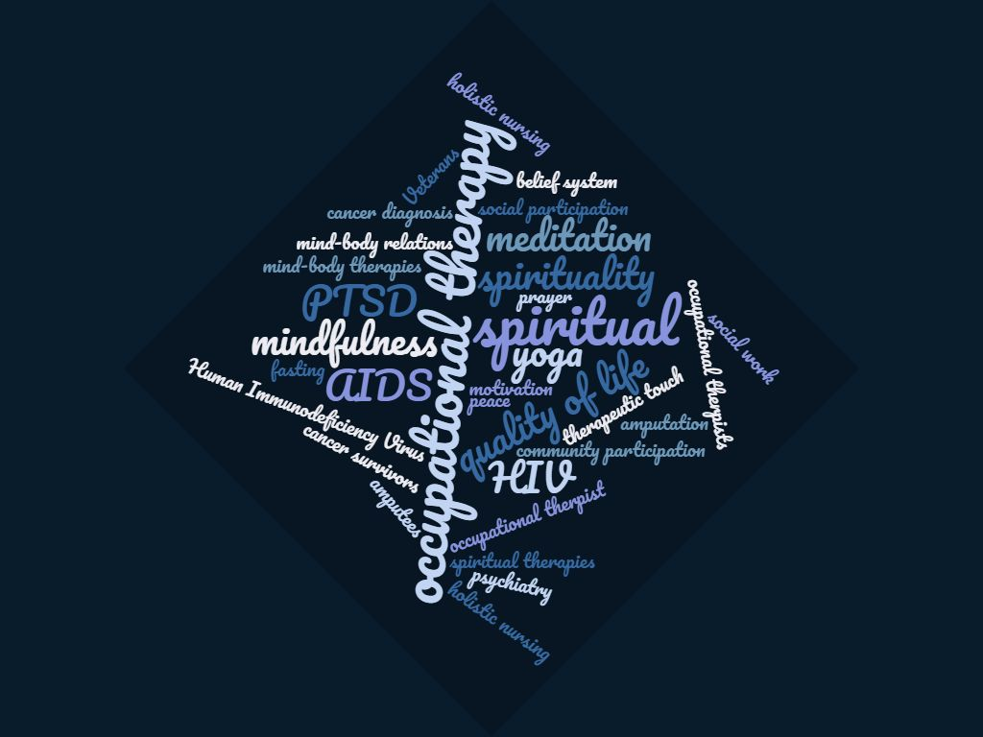
Methods
Databases Used
Pubmed
CINAHL
Scopus
PsycINFO by OVID
Limits
2010-2020
English language only

Slide 15
Search Terms
P | I-1 | I-2 | O
HIV Human Immunodeficiency Virus AIDS Acquired Immunodeficiency Disorder veterans PTSD stress disorders, traumatic cancer survivors cancer diagnosis | occupational therapy evaluation prayer belief system meditation mindfulness yoga fasting peace faith spiritual spirituality mind-body relations therapeutic touch holistic nursing spiritual therapies | psychiatry social work occupational therapy occupational therapist occupational therapists holistic nursing | quality of life motivation social participation community participation

Slide 16
Criteria
inclusion
exclusion
Life-altering conditions/ diagnoses (Chronic and/or acute)
Within OT scope of practice
Evaluation process
Interventions within the scope of OT practice
Adults (18≤)
OT graduate student preparation (in incorporating spirituality/ spiritual interventions)
Professional development
Systematic reviews
Meta-Analyses
Books/book chapters
Dissertations
Epidemiological studies
Scoping review
Drugs/medications
Chronic pain

Slide 17
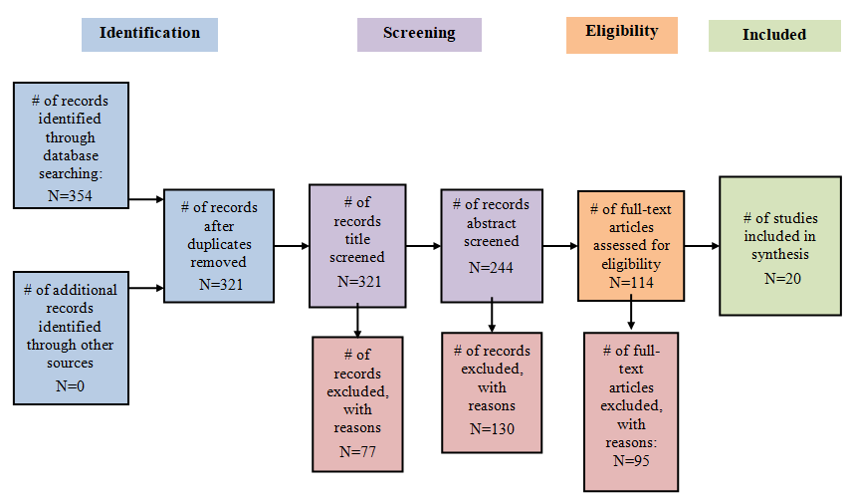
Prisma Flow
N=27

Slide 18
STUDY
CHARACTERISTICS

Slide 19
Levels of Evidence: Quantitative (n=11/20)
Randomized Controlled Trials
I
Azad Marzabadi & Zadeh, 2014¹¹
Nakamura et al., 2017¹⁶
Rosen et al., 2018¹⁷
Bormann et al., 2018¹⁸
Kang et al., 2018¹⁹
Mennin et al., 2015²⁰
Wilson et al., 2017⁹
Two groups, nonrandomized studies
II
One group nonrandomized (e.g., before and after, pretest and posttest)
III
Buttner et al., 2016²¹
Manne et al., 2015²²
McCarthy et al., 2017²³
Case-Control or Cohort Study
IV
Fadilpasic et al., 2017¹³
adapted from 24. (University of New Mexico, n.d.)

Slide 20
Levels of Evidence: Qualitative (n=6/20)
Descriptive studies
III
Boland et al., 2019¹²
Cooper, 2014⁸
Single case studies
IV
McCall et al., 2015²⁵
Mishra et al., 2018²⁶
Siemon et al., 2013²⁷
Sleight, 2017²⁸
Mixed Methods (N=3/20)
III
Atreya et al., 2018¹⁰
Gaddy, 2018²⁹
Justice & Brems, 2019³⁰
adapted from 31. Daly et al. 2007

Slide 21
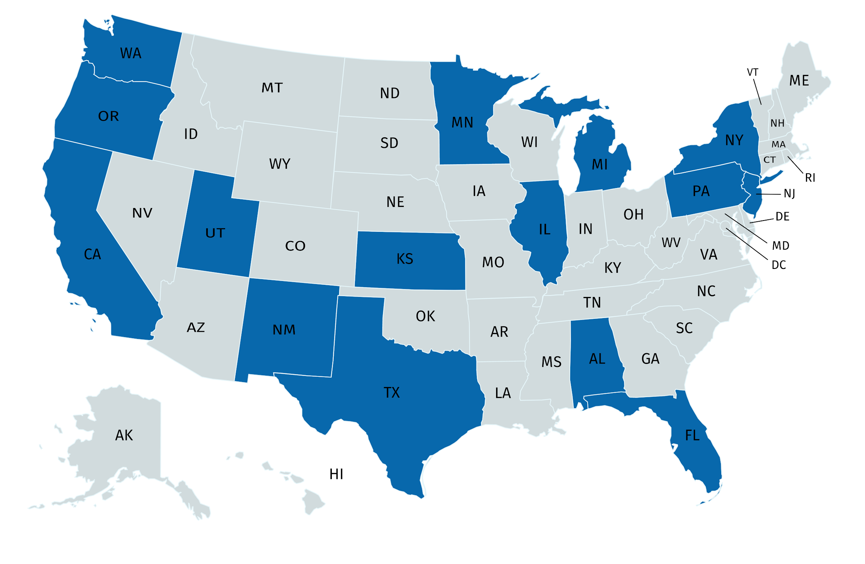
Where did the studies come from?
Birmingham, AL
SF, LA, and SD, CA
New Haven, CT
Miami, FL
Chicago, IL
Leavenworth, KS
Ann Arbor, MI
Minneapolis, MN
New Jersey
New York
Albuquerque, NM
Hillsboro, OR
Philadelphia, PA
Dallas, TX
Salt Lake City, UT
Seattle, WA
mapchart.net

Slide 22
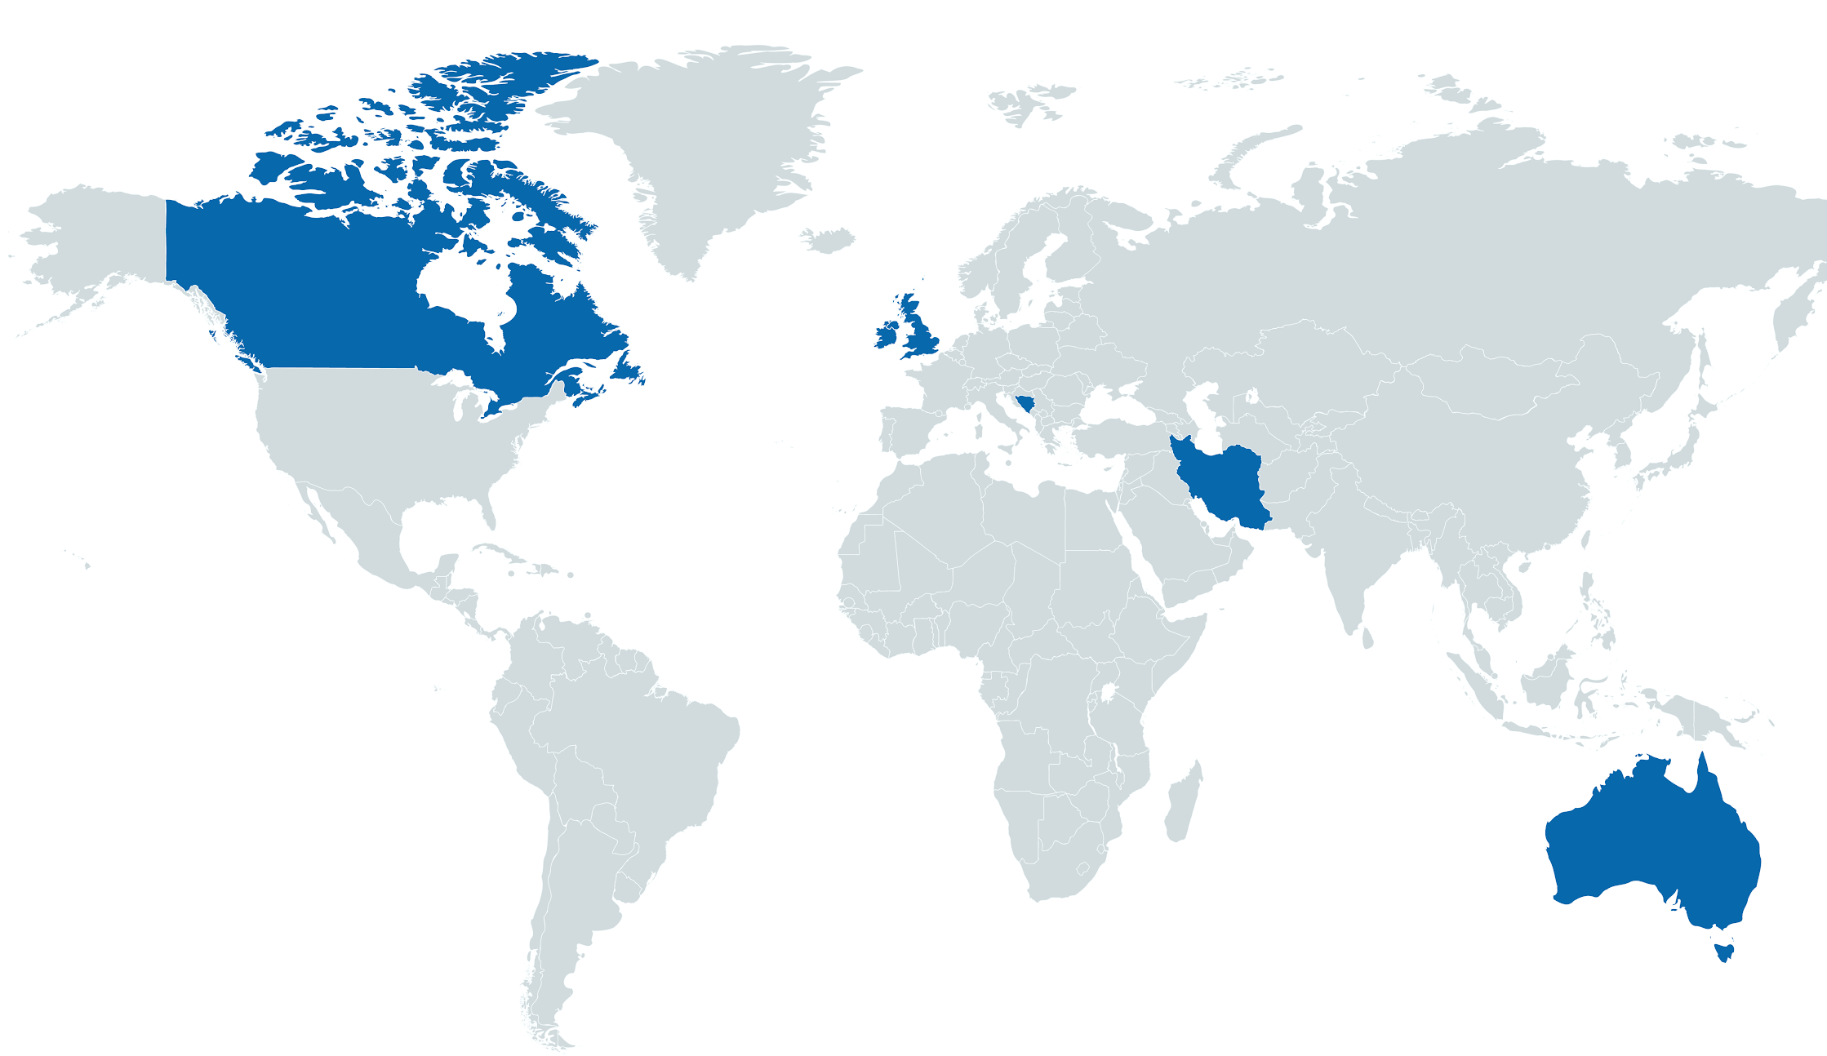
Where else did the studies come from?
Australia
Bosnia and Herzegovina
Canada
England
Iran
Ireland
mapchart.net

Slide 23
What about the participants?
age (years)
conditions
participants (n)
range (18-88)
life-altering
mean = 81
range (4-353)
sum = 1,626
Notes:
Anton
What about the participants? Starting with the age, our sample size included participants ranging 18-88 years, effectively covering the entire adult lifespan. Next are the number of participants, with a total 1,626 participants, an avg of 81 per study and a range of 4 to 353 for our largest quantitative study. Lastly, are the conditions, as we’ve stated, were life-altering, to be covered next

Slide 24
Life-Altering Conditions
Cancer
PTSD
Bone marrow
Bowel
Breast
Cervical
Colorectal
Endometrial/uterine
Fallopian tube
Gynecological
Leiomyosarcoma
Leukemia
Melanoma
Myeloma
Ovarian
Prostate
Skin
Testicular
Vulvar
Individual Studies
Veterans & Victims
Veterans
Generalized Anxiety Disorder
HIV
SCI
Afghanistan
Gulf War
Iraq
Viet Nam
Bosnia War
Iraq-Iran War

Slide 25
Quality of Life
Psychological Distress
PTSD
Mindfulness
Outcome Measures
Emotions
Coping
Spirituality
Sleep

Slide 26
Outcome Measures
Quality of Life | WHOQOL-BREF Four categories measuring physical health, psychological health, social relationships, and environmental health
Psychological Distress | PHQ-9 Subscale of Patient Health Questionnaire addressing depression
Mindfulness | FFMQ-SF Assessed skills such as observing, describing, acting with awareness, nonreactivity, and non-judgment
Spirituality | FACIT-12-SP Two subscales assessing 1) meaning and peace and 2) faith

Slide 27
THEMES

Slide 28
Strength of Evidence ³²
Strong | Two or more Level I studies The available evidence usually includes consistent results from well-designed, well-conducted studies, with strong findings
Moderate | At least one Level 1 high-quality study or multiple moderate-quality studies (Level II and Level III) The available evidence is sufficient to determine the effects on health outcomes, but confidence is constrained
Low | Few studies, flaws in available studies Insufficient evidence to assess impact on health and outcomes
32. AOTA, 2020

Slide 29
Themes
Occupational Engagement
Connectedness
Coping

Slide 30
Theme 1: Occupational Engagement and Spiritual Well-Being (n=4)
Moderate Evidence: Level III (2), Level IV (2)
Volunteer work, serving others, and social participation led to increased measures in quality of life (QOL)^{27, 28}
Spiritual and religious activities such as going to church, prayer, and connection through worship increased feelings of fulfillment, meaning and purpose^{27, 28}
Setting goals and routines, group relaxation programs, and self-management programs helped individuals ‘take their lives back’^{8, 12}

Slide 31
Theme 1: Occupational Engagement and Spiritual Well-Being (n=4)
Author | Population | Interventions/Occupation | Results
Level III: Qualitative
Boland et al., 2019¹² | Cancer Patients | Group self-management program Setting goals and routines | QOL Positive attitude
Cooper, 2014⁸ | Cancer Patients | Group relaxation sessions | QOL Participation in meaningful activities and roles
Level IV: Qualitative
Siemon et al., 2013²⁷ | Women Living with HIV | Spiritual and religious activity Prayer Going to church/Spiritual institutions Volunteering Connecting Caring for others | QOL Spiritual well-being Social engagement Motivation Coping strategies
Sleight, 2017²⁸ | Latina Breast Cancer Survivors

Slide 32
Theme 1: Occupational Engagement and Spiritual Well-Being (n=4)
There is Moderate Level of Evidence supporting a connection between occupational engagement, spiritual well-being, and quality of life for individuals living with a life-altering diagnosis
Interventions
Going to Church/Spiritual Institutions
Prayer
Volunteering
Setting Goals
Self-management program
Relaxation groups
Outcomes
QOL
Spiritual Well-Being
Positive Attitude
Motivation
Meaningful Activities and Roles
Social Engagement

Slide 33
Theme 2: Connectedness (n=12)
Strong Evidence: Level 1 (3), Level II (3), Level III (5), Level IV (1)
Emotion-Regulation Therapy
Mantram Repetition
Mind-Body Bridging
Mindfulness
Transcendental Meditation
Yoga

Slide 34
Theme 2: Connectedness (n=12)
Authors | Population | Intervention | Results
Level I: Quantitative
Azad Marzabadi & Zadeh, 2014¹¹ | War Victims with PTSD | 8 weeks of Mindfulness Training | Statistically significant QOL
Nakamura et al., 2017¹⁶ | Veterans with PTSD | 3 weeks of Mind-Body Bridging Program | Statistically significant PTSD symptoms Clinically significant Mindfulness skills Depression scores
Rosen et al., 2018¹⁷ | Women with Breast Cancer | 8 weeks of Mindfulness Training | Clinically significant Mindfulness skills QOL

Slide 35
Theme 2: Connectedness (n=12)
Authors | Population | Intervention | Results
Level II: Quantitative
Bormann et al., 2018¹⁸ | Veterans with PTSD | 6 weeks of Mantram Repetition | Statistically significant PTSD symptoms
Kang et al., 2018¹⁹ | Veterans with PTSD | 8 weeks of Transcendental Meditation | Statistically significant PTSD symptoms Mindfulness skills
Mennin et al., 2015²⁰ | Individuals with GAD and Depression | 20 Weeks of Emotion Regulation Therapy | Statistically significant QOL Depression symptoms Anxiety symptoms

Slide 36
Theme 2: Connectedness (n=12)
Authors | Population | Intervention | Results
Level III: Quantitative
Buttner et al., 2016²¹ | Veterans with PTSD | 8 week Mantram Repetition Program | Statistically significant QOL Mindfulness skills Spirituality Clinically significant Program development
McCarthy et al., 2017²³ | Veterans with PTSD | 8 weeks of Trauma-sensitive Yoga Program | Statistically significant QOL PTSD Symptoms Depression Clinically significant Program development

Slide 37
Theme 2: Connectedness (n=12)
Authors | Population | Intervention | Results
Level III: Mixed Methods
Atreya et al., 2018¹⁰ | Patients with Colorectal Cancer and their Caregivers | 8 week audio-based Mindfulness Program | Statistical significant Psychological distress Mindfulness skills Spirituality
Gaddy, 2018²⁹ | Veterans at MH Facility | 4 weeks of Integrative Medicine | Clinical significant QOL
Justice & Brems, 2019³⁰ | Veterans with PTSD | 10-weeks of Trauma-Informed Yoga | Clinical significant QOL
Level IV: Qualitative
McCall et al., 2015²⁵ | Adult Cancer Patients | Yoga | Clinically significant Connection to body, breathe, emotions, and mental formations

Slide 38
Theme 2: Connectedness (n=12)
There is strong evidence showing that at different levels of the therapeutic process, connectedness to different factors within and surrounding the client increased quality of life to clients experiencing life-altering conditions
Emotion-Regulation Therapy
Mantram Repetition (2)
Mind-Body Bridging
Mindfulness (2)
Transcendental Meditation
Yoga (4)

Slide 39
Theme 3: Coping³³ (n = 12)
Strong Evidence: Level 1 (2), Level II (3), Level III (4), Level IV (3)
Management of emotional and physical health symptom severity to increase QoL and spiritual well-being ^{23, 33}
Strategies:
Goal Setting/Routines^{8, 12}
Self-Acceptance¹¹
Taking Back Control8, 10, 12, 17, 18, 19, 20, 21, 25
Social Support^{8, 10, 11, 12, 22, 29}
33. Coping, n.d.

Slide 40
Theme 3: Coping (n = 12)
Authors | Population | Intervention | Results
Level I: Quantitative
Azad Marzabadi & Zadeh 2014¹¹ | War Victims with PTSD | Mindfulness Training | Clinically significant QOL
Rosen et al., 2018¹⁷ | Women with Breast Cancer | Mindfulness App | Statistically significant QOL
Level II: Quantitative
Bormann et al., 2015¹⁸ | Veterans with PTSD | Mantram Repetition | Statistically significant symptoms

Slide 41
Theme 3: Coping (n = 12)
Authors | Population | Intervention | Results
Level II: Quantitative
Kang et al., 2018¹⁹ | Veterans with PTSD | Transcendental Meditation | Statistically significant depressive symptoms
Mennin et al., 2015²⁰ | Individuals with Generalized Anxiety Disorder and Depression | Emotional Regulations Therapy | Statistically significant symptoms
Level III: Mixed Methods
Atreya et al., 2018¹⁰ | Colorectal Cancer Patients | Audio-Based Mindfulness | Statistically significant physical and mental symptoms

Slide 42
Theme 3: Coping (n = 12)
Authors | Population | Intervention | Results
Level III: Quantitative
Buttner et al., 2015²¹ | Veterans with PTSD | Mantram Repetition Program | Clinically significant symptom severity
Level III: Qualitative
Siemon et al., 2013²⁷ | Women over 50 with HIV | Spiritual and Religious Activity: Prayer Worship Going to church Volunteering Caring for others | Social support dealing with HIV
Sleight, 2017²⁸ | Low-Income Latina Breast Cancer Survivors |  | Clinically significant influences on well-being religious and spiritual activity service to others regular routine

Slide 43
Theme 3: Coping (n = 12)
Authors | Population | Intervention | Results
Level IV: Qualitative
Boland et al., 2019¹² | Cancer Survivors | OptiMal Program | self-management skills
Cooper, J., 2014⁸ | Adults with Cancer Diagnosis | Relaxation Program | taking back control
McCall et al., 2015²⁵ | Adults Cancer Patients | Yoga | Clinically significant personal empowerment

Slide 44
Theme 3: Coping (n = 12)
There is strong evidence that positive coping increases QOL and spiritual well-being
Interventions
Control
Mindfulness
Meditation
Yoga
Mantram Repetition

Slide 45
Summary of Findings
Identified Themes | Level of evidence³²
Occupational Engagement | Moderate
Connectedness | Strong
Coping | Strong

Slide 46
PICO question
How does incorporating spirituality within the OT process impact well-being/QOL for individuals who have experienced life-altering conditions or diagnoses?

Slide 47
Answer To pico question
There are many spiritually-based evaluations which help to identify the need an individual may have for spiritually-based interventions
Spiritually-based interventions for our population (PTSD, cancer, HIV, SCI, GAD) increased quality of life by utilizing these spiritual-based themes:
Occupational Engagement
Connectedness
Coping

Slide 48
STRENGTHS
&
LIMITATIONS

Slide 49
Strengths |  | Limitations
Large geographical study Clients reported positive outcomes and satisfaction with interventions Majority of studies were clinically and/or statistically significant Studies used standardized assessments |  | Only cross-sectional studies performed Small sample size Populations missing Primary use of patient reports limits strength of evidence Minimal follow-up or record of maintenance of goals Individuals with PTSD were limited to veterans and victims of war

Slide 50
IMPLICATIONS

Slide 51
Implications for Research and education
Research A need for: Longitudinal studies Larger sample size Increased diversity and representation in the literature Literature represented in OT practice | Education A need for: Adequate training Shared knowledge regarding role of spirituality within the scope of OT

Slide 52
Implications for OT practice
Occupational Engagement Volunteering Caring for Others Prayer/Worship Church/Spiritual Institution | Connectedness Interventions ERT Mantram Repetition Mind-Body Bridging Mindfulness TM Yoga | Coping Strategies Social Support Goal Setting Self-Acceptance Taking Back Control

Slide 53
Conclusion
Individualized treatment plans, beginning with evaluation through intervention and discharge should consider these spiritually-based ideas
The spiritual dimension of a person may have an effect on an individual’s needs, purpose, well-being, as well as quality of life, falling within the scope of OT practice
There is a moderate to strong relationship between spiritual-based interventions and increased quality of life

Slide 54
Appreciation & Acknowledgement
We would like to thank:
Gary Kaplan, MS, AHIP
Paul Hunter, MLIS
Maclain Capron
Rebecca Sinko, OTD, OTR/L
A special thank you to our faculty mentor:
Eileen Adel Herge, OTD, OTR/L, FAOTA

Slide 55
Outcome Measures
Quality of Life | Distress | PTSD | Mindfulness
CARES, FACT-G, FACT-B, MANSA, MOS-SF36, NCCN Distress Thermometer, NIH PROMIS, PAWB, PROMIS-29, PROMIS-Alcohol Use, QOLI, SDS, SF-12, SF-36, SSR, WHOQOL-BREF | BDI-II, CES-D, CFQ, DASS, GSI-BSI-18, MASQ, MFI, PHQ-15 (somatic), PHQ-9 (depressive), PSWQ, STAI-7 | CAPS, Mississippi Scale for PTSD, PCL, PTGI, SCL | AASP, EQ, FFMQ-SF , MAAS, SBC, SCS-SF
Spirituality | Emotions | Coping | Sleep
"Are You at Peace?", FACIT-12 Sp, Religious Problem-Solving Scale, Religiousness Scale | AIM, Block and Block, DERS, EEP, ERQ, PANAS | AAQ-II, Brief Religious Coping Scale, COPE | MOS-SS, PSQI

Slide 56
Contact info
Presenter Name | Contact Information
Taneisha Esplin Jolley | taneisha.esplin@gmail.com
Jeffrey Gold, MS | gold092@gmail.com
Nicholas Luca | nickjluca@gmail.com
Antôn Nguyễn | hellothisisanton@gmail.com

Slide 57
References
American Occupational Therapy Association. (2014). Occupational therapy practice framework: Domain &amp; process (3rd ed.). American Journal of Occupational Therapy, 68, S1-S48. doi:10.5014/ajot.2014.682006
Puchalski, C., & Romer, A. L. (2000). Taking a spiritual history allows clinicians to understand patients more fully. Journal of Palliative Medicine, 3(1), 129–137. https://doi.org/10.1089/jpm.2000.3.12
Misiorek, A., & Janus, E. (2019). Spirituality in occupational therapy practice according to new graduates. OTJR : Occupation, Participation and Health, 39(4), 197–203. doi:10.1177/153944921880827808278
Jones, J., Topping, A., Wattis, J., Smith, J. (2016). A concept analysis of spirituality in occupational therapy practice. Journal for the Study of Spirituality, 6(1), 38-57. doi:10.1080/20440243.2016.1158455
Wilding, C. (2002). Where angels fear to tread: Is spirituality relevant to occupational therapy practice? Australian Occupational Therapy Journal, 49, 44-47.
Humbert, T. K. (2016). Spirituality and Occupational Therapy: A Model For Practice and Research. Bethesda, MD: AOTA Press, The American Occupational Therapy Association
Cobb, M., Puchalski, C. M., & Rumbold, B. (2012). Oxford Textbook of Spirituality in Healthcare. Oxford University Press. https://doi.org/10.1093/med/9780199571390.001.0001
Cooper, J. (2014). What is the cancer patient's own experience of participating in an occupational therapy-led relaxation programme? Progress in Palliative Care, 22(4), 206-211. doi:10.1179/1743291X13Y.0000000081
Wilson, C. S., Forchheimer, M., Heinemann, A. W., Warren, A. M., & McCullumsmith, C. (2017). Assessment of the relationship of spiritual well-being to depression and quality of life for persons with spinal cord injury. Disability and Rehabilitation, 39(5), 491-496. doi:10.3109/09638288.2016.1152600
Atreya, C. E., Kubo, A., Borno, H. T., Rosenthal, B., Campanella, M., Rettger, J. P., . . . Dhruva, A. (2018). Being present: A single-arm feasibility study of audio-based mindfulness meditation for colorectal cancer patients and caregivers. PloS One, 13(7), e0199423. doi:10.1371/journal.pone.0199423
Azad Marzabadi, E., & Hashemi Zadeh, S. M. (2014). The effectiveness of mindfulness training in improving the quality of life of the war victims with post traumatic stress disorder (PTSD). Iranian Journal of Psychiatry, 9(4), 228-236.

Slide 58
References
Boland, L., Bennett, K., Cuffe, S., Gleeson, N., Grant, C., Kennedy, J., & Connolly, D. (2019). Cancer survivors' experience of OptiMal, a 6-week, occupation-based, self-management intervention. British Journal of Occupational Therapy, 82(2), 90-100. doi:10.1177/0308022618804704
Fadilpašić, S., Maleč, D., & Džubur-Kulenović, A. (2017). Relationship of religiousness and religious coping with quality of life among war trauma survivors. Psychiatria Danubina, 29(3), 291-301. doi:10.24869/psyd.2017.291
Bovero et al., (2019). The spirituality in end-of-life cancer patients, in relation to anxiety, depression, coping strategies and the daily spiritual experiences: A cross-sectional study. Journal of Religion and Health, 58(6), 2144–2160. doi:10.1007/s10943-019-00849-z
Szaflarski, M., Ritchey, P. N., Leonard, A. C., Mrus, J. M., Peterman, A. H., Ellison, C. G., … Tsevat, J. (2006). Modeling the effects of spirituality/religion on patients’ perceptions of living with HIV/AIDS. Journal of General Internal Medicine, 21, Suppl 5, S28-38. doi:10.1111/j.1525-1497.2006.00646.x
Nakamura, Y., Lipschitz, D. L., Donaldson, G. W., Kida, Y., Williams, S. L., Landward, R., . . . Tuteja, A. K. (2017). Investigating clinical benefits of a novel sleep-focused mind-body program on gulf war illness symptoms: A randomized controlled trial. Psychosomatic Medicine, 79(6), 706-718. doi:10.1097/PSY.0000000000000469
Rosen, K. D., Paniagua, S. M., Kazanis, W., Jones, S., & Potter, J. S. (2018). Quality of life among women diagnosed with breast cancer: A randomized waitlist controlled trial of commercially available mobile app-delivered mindfulness training. Psycho-Oncology, 27(8), 2023-2030. doi:10.1002/pon.4764
Bormann, J. E., Thorp, S. R., Smith, E., Glickman, M., Beck, D., Plumb, D., . . . Elwy, A. R. (2018). Individual treatment of posttraumatic stress disorder using mantram repetition: A randomized clinical trial. The American Journal of Psychiatry, 175(10), 979-988. doi:10.1176/appi.ajp.2018.17060611
Kang, S. S., Erbes, C. R., Lamberty, G. J., Thuras, P., Sponheim, S. R., Polusny, M. A., . . . Lim, K. O. (2018). Transcendental meditation for veterans with post-traumatic stress disorder. Psychological Trauma : Theory, Research, Practice and Policy, 10(6), 675-680. doi:10.1037/tra0000346
Mennin, D. S., Fresco, D. M., Ritter, M., & Heimberg, R. G. (2015). An open trial of emotion regulation therapy for generalized anxiety disorder and co-occurring depression. Depression and Anxiety, 32(8), 614-623. doi:10.1002/da.22377
Buttner, M. M., Bormann, J. E., Weingart, K., Andrews, T., Ferguson, M., & Afari, N. (2016). Multi-site evaluation of a complementary, spiritually-based intervention for veterans: The mantram repetition program. Complementary Therapies in Clinical Practice, 22, 74-79. doi:S1744-3881(15)30028-1

Slide 59
References
Manne, S. L., Myers-Virtue, S., Kashy, D., Ozga, M., Kissane, D., Heckman, C., . . . Rosenblum, N. (2015). Resilience, positive coping, and quality of life among women newly diagnosed with gynecological cancers. Cancer Nursing, 38(5), 375-382. doi:10.1097/NCC.0000000000000215
McCarthy, L., Fuller, J., Davidson, G., Crump, A., Positano, S., & Alderman, C. (2017). Assessment of yoga as an adjuvant treatment for combat-related posttraumatic stress disorder. Australasian Psychiatry : Bulletin of Royal Australian and New Zealand College of Psychiatrists, 25(4), 354-357. doi:10.1177/1039856217695870
University of New Mexico. (n.d.). Evidence pyramid-levels of evidence. University Libraries. http://www.unm.edu/~unmvclib/cascade/handouts/PICOTpyramidofevidence.pdf
McCall, M., Thorne, S., Ward, A., & Heneghan, C. (2015). Yoga in adult cancer: An exploratory, qualitative analysis of the patient experience. BMC Complementary & Alternative Medicine, 15(1), 1-9. doi:10.1186/s12906-015-0738-9
Mishra, S. I., Rishel Brakey, H., Kano, M., Nedjat-Haiem, F. R., & Sussman, A. L. (2018). Health related quality of life during cancer treatment: Perspectives of young adult (23-39 years) cancer survivors and primary informal caregivers. European Journal of Oncology Nursing : The Official Journal of European Oncology Nursing Society, 32, 48-54. doi:S1462-3889(17)30259-4
Siemon, J. S., Blenkhorn, L., Wilkins, S., O’Brien, K. K., & Solomon, P. E. (2013). A grounded theory of social participation among older women living with HIV / une théorie ancrée pour analyser la participation sociale chez les femmes âgées atteintes du VIH. Canadian Journal of Occupational Therapy, 80(4), 241-250. doi:10.1177/0008417413501153
Sleight, A. G. (2017). Occupational engagement in low-income latina breast cancer survivors. American Journal of Occupational Therapy, 71(2), 1-8. doi:10.5014/ajot.2017.023739
Gaddy, M.A. (2018). Implementation of an integrative medicine treatment program at a Veterans Health Administration residential mental health facility. Psychological Services. 15(4), 503-509. http://dx.doi.org/10.1037/ser0000189
Justice, L., & Brems, C. (2019). Bridging body and mind: Case series of a 10-week trauma-informed yoga protocol for veterans. International Journal of Yoga Therapy, 29(1), 65-79. doi:10.17761/D-17-2019-00029

Slide 60
References
Daly et al. (2007). A hierarchy of evidence for assessing qualitative health research. Journal of Clinical Epidemiology, 60, 43-49.
American Occupational Therapy Association. (2020). Guidelines for systematic reviews [PDF file]. https://ajot.submit2aota.org/journals/ajot/forms/systematic_reviews.pdf
Coping. (n.d.) In The Free Dictionary by farlex Medical-Dictionary. Retrieved from https://medical-dictionary.thefreedictionary.com/copings

