Slide 1
Trauma-Informed Care in a School Setting: Occupational Therapy Interventions to Promote Emotional Regulation
Sarah Blaise, OTS, Sara Cohen, OTS,
Shannon Kelly, OTS & Maria Marcum, OTS
Department of Occupational Therapy
Thomas Jefferson University
Presented in partial fulfillment of the Master of Science in Occupational Therapy degree
at Thomas Jefferson University

Slide 2
Objectives
By the end of this presentation, the audience will:
Define trauma and note its prevalence among school-aged children
Describe principles of Trauma-Informed Care and its importance in a school setting.
Describe current research to determine best practice using a Trauma-Informed Care (TIC) approach in schools for OT practitioners

Slide 3
First Things First: Safety
https://www.zerotothree.org/resources/2896-getting-started-with-mindfulness-a-toolkit-for-early-childhood-organizations

Slide 4
Trauma and Its Impact

Slide 5
What is Trauma?
Trauma refers to experiences that cause intense physical and psychological stress reactions that has lasting adverse effects on an individual’s physical, social, emotional, or spiritual well being
Such events involve a sense of fear, helplessness, and horror.
Children may experience trauma from abuse (physical, sexual, emotional), neglect (physical, medical, emotional, educational), natural disasters, illness, and violence (school, community, domestic) etc.
(SAMHSA, 2014)
(Van der Kolk, 1989)

Slide 6
Prevalence
Physical abuse
Sexual abuse
Emotional abuse
Physical neglect
Emotional neglect
Witnessing domestic violence
Substance Abuse in the household
Mental Illness in the household
Incarcerated household member
Witnessing violence
Experiencing racial discrimination
Feeling unsafe in their neighborhoods
Being bullied
Living in foster care
1 in 5 students will have 2+ 1 in 10 students will have 3+
40% of Philadelphians have experienced 4+
(CDC, 2013)
(Cronholm et. al, 2015)
(Perenchik & Weiss, 2015)

Slide 7
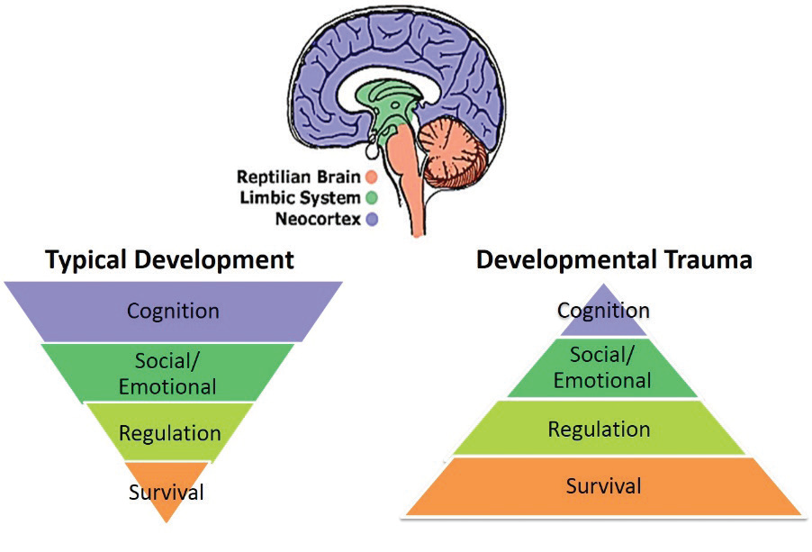
Impact on Functioning
Trauma and Development
Impacts areas:
Emotionally
Physically
Cognitively
Behaviorally
Socially
Developmentally
Image Adapted from Holt & Jordan, Ohio Dept. of Education
(Ohio Department of Education, 2019)

Slide 8
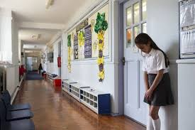
Trauma Impact in School
• Impaired executive function
• Difficulty envisioning a future
• Impaired attention and arousal regulation
• Negative attention seeking
• Poor attendance and homework completion, lower grades
• Staff or teacher not understanding the reason for negative behaviors
“What is wrong with them?” vs. “What happened to them?”
(Petrenchik & Weiss, 2015)
(Bloom & Harrison, 2011)

Slide 9
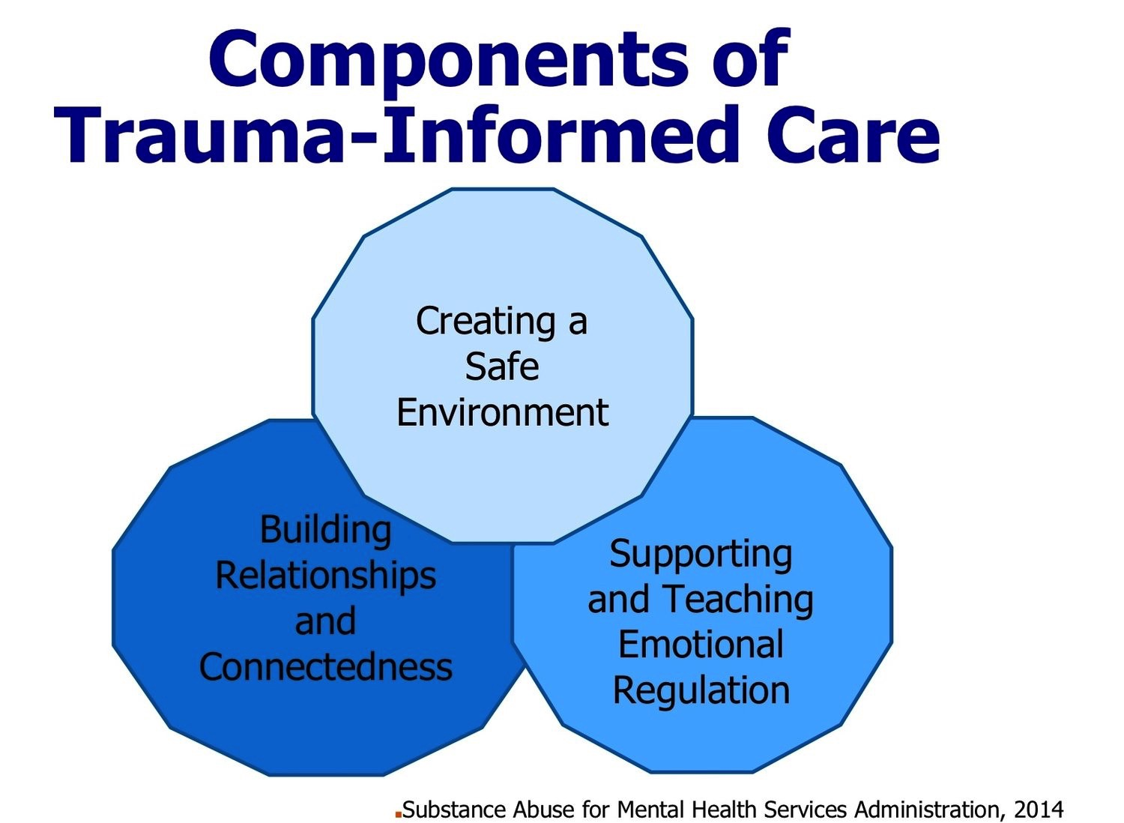
What is Trauma-Informed Care (TIC)?
Strengths-based service delivery approach
Focus on impact of trauma
Emphasizes safety
Rebuilding a sense of control and empowerment
Consumer participation is key!
(SAMHSA, 2014)

Slide 10
What does Trauma-Informed Care Look Like?
A new “universal precaution”
Therapeutic use of self principles that align with TIC
Understanding our own ACEs and effects and practicing self-care
Recognize how “fight-or-flight” can present in students
Seek to minimize perceived threats/triggers +maximize safety
Develop emotional management + cognitive skills
Encourage Activities that are self-soothing
Mindfulness, meditation, yoga, prayer, etc.
What We Need to Do
(Bloom & Harrison, 2011)

Slide 11
Connection to Occupational Therapy & Children in Schools

Slide 12
Occupational Therapy’s Specialty in Schools
Occupations:
ADLs
IADLs
Rest and Sleep
Education
Work
Play
Leisure
Social Participation
(AOTA, 2014)
school-based-therapy-slp-ot-pt-jobs.jpg

Slide 13
Occupational Therapy’s Role in Supporting Children in Schools
Participation
Interprofessional education
Environmental modification
Strengths based approach
(Petrenchik & Weiss, 2015) (AOTA, 2016)

Slide 14
Connection to Occupational Therapy
Trauma Informed Care within the school setting is utilized to form a positive climate in which students feel physically and emotionally safe so they can focus on learning
Children participating in traditional school occupations can be supported through occupational therapy services to increase participation in school based tasks by utilizing:
Mental functions
Motor Skills
Process skills
Social interaction skills
Physical & social environmental aspects
(Post, Grybush, Elmadani, & Lockhart, 2020)
(AOTA, 2014)

Slide 15
Rationale for Investigation
Vulnerable children are significantly more likely to experience emotional and psychological stress due to their consistent higher exposure of risk factors that impact well-being
Vulnerable children have demonstrated challenges coping with life stressors by internalizing issues which as been shown to manifest symptoms of anger, depression, hopelessness, low-self esteem, loneliness, and suicidal-ideation
(Olowokere & Okanlawon, 2014)

Slide 16
Problem Statement
School aged children may have experienced trauma that can negatively impact their participation, emotional regulation and success in school

Slide 17
Clinical PICO Question
What trauma informed occupational therapy interventions improve emotional regulation and participation in school-based tasks for students?

Slide 18
Methods

Slide 19
Methods to Formulate Clinical Question
Databases used:

Slide 20
Search Terms
P: Schools, School, Elementary School, Middle School, High School, Primary School, Secondary School, Student, Students, Minority Students
P: Historical Trauma, Psychological Trauma, Adverse Childhood Experiences, Childhood Adversity, Stress and Trauma Related Disorders, Trauma, Emotional Trauma, Complex PTSD, injuries
I: Occupational Therapy, Occupational Therapist, Coping Skills, Resilience Building, Relaxation Techniques, Trauma Informed Approaches, Coping Behavior, Resilience, Relaxation, Non-Reactivity, Psychological Resilience, Stress and Coping Measures, Mindfulness-Based Interventions
O: Emotional Regulation, Self-Control, Behavioral Regulation, School Participation, Classroom Participation, Behavioral Inhibition, Classroom Behavior, Emotional Intelligence, Hardiness, Coping, Psychological Stress, Behavioral Intention, Classroom Discipline, Classroom Behavior Modification

Slide 21
Methods
Inclusion Criteria:
Patient characteristics: ages 5-18 years old
All forms of trauma
All levels of evidence
Exclusion Criteria:
Non-human subjects
Pharmacology
Genetic analysis
Systematic Reviews
Religion-based interventions
Community-based interventions
Limits:
Date of publication: within the last 10 years
Languages: English

Slide 22
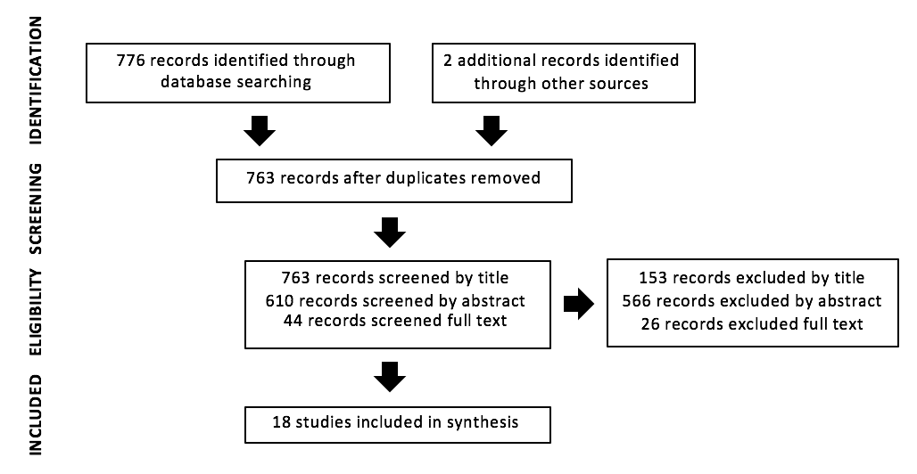
PRISMA Flowchart

Slide 23
Synthesis of Articles
Critically Reviewed
Qualitative review form and guidelines
Qualitative Research
Quantitative review form and guidelines.
Quantitative Research
Cross Checking
Member Checking
(Letts et al.,2014)
(Law et al.,2014)

Slide 24
Results

Slide 25
Quantitative Levels of Evidence
(Sackett, Rosenberg, Muir Gray, Haynes, & Richardson, 1996)

Slide 26
Levels of Evidence Quantitative (n=12)
Level of Evidence | Number of Articles | Citation of Articles
Level I | 3 | Dray et al., 2017 Volanen et al., 2020 White, 2012
Level III | 9 | Eva & Thayer, 2017 Huang et al., 2019 Mendelson et al., 2015 Olowokere & Okanlawon, 2014 Srija & Sugi, 2019 Terjestam, Bengtsson & Jansson, 2016 Viafora, Mathiesen & Unsworth, 2015 Wagner et al, 2019 Wisner & Norton, 2013

Slide 27
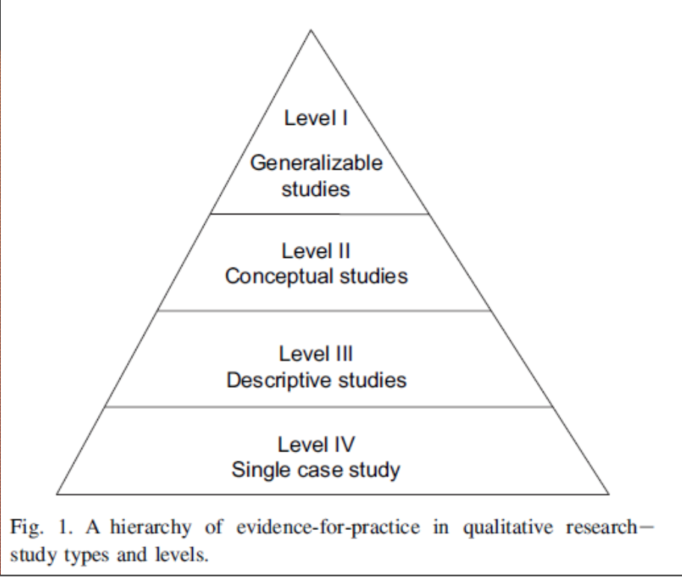
Qualitative Levels of Evidence
(Daly et al., 2007)

Slide 28
Levels of Evidence- Qualitative (n= 6)
Level of Evidence | Number of Articles (N=6) | Article Citation
Level I | 1 | Garcia, Pintor & Lindgren, 2010
Level II | 3 | Correia da Silva & Sant’ Ana, 2017 Post, Grybush, Elmadani & Lockhart, 2020 Wisner & Starzec, 2016
Level III | 1 | Wang & Hagins, 2016
Level IV | 1 | Finn, Warner, Price & Spinazzola, 2018

Slide 29
Age Distribution
Sample Sizes ranged from 1-3519 participants.
Age Range | Number of Articles | Authors
Elementary School Aged (K-5th grade) | 6 | Correia da Silva & Sant’ Ana, 2017 Finn, Warner, Price & Spinazzola, 2018 Post, Grybush, Elmadani & Lockhart, 2020 Srija & Sugi, 2019 Wagner et al., 2019 White, 2012
Middle School Aged (6th-8th grade) | 8 | Dray et al., 2017; Garcia, Pintor & Lindgren, 2010; Mendelson et al., 2015; Srija & Sugi, 2019; Terjestam, Bengtsson & Jansson, 2016; Viafora, Mathiesen & Unsworth, 2015; Volanen et al., 2020; Wang & Hagins, 2016
High School Aged (9th-12th grade) | 8 | Dray et al., 2017; Eva & Thayer, 2017; Garcia, Pintor & Lindgren, 2010; Huang et al., 2019; Olowokere & Okanlawon, 2014; Wang & Hagins, 2016; Wisner & Norton, 2013; Wisner & Starzec, 2016

Slide 30
Interventions Implemented By
Interventionist | Number of Articles | Articles
Teacher | 7 | Correia da Silva & Sant’ Ana, 2017 Dray et al., 2017 Huang et al., 2019 Mendelson et al., 2015 Post, Grybush, Elmadani & Lockhart, 2020 Terjestam, Bengtsson & Jansson, 2016 Wang & Hagins, 2016
Researcher | 7 | Eva & Thayer, 2017 Garcia, Pintor & Lindgren, 2010 Olowokere & Okanlawon, 2014 Volanen et al., 2020 White, 2012 Wisner & Norton, 2013 Wisner & Starzec, 2016
Occupational Therapist | 2 | Srija & Sugi, 2019 Wagner et al., 2019
Mindfulness Instructor | 1 | Viafora, Mathiesen & Unsworth, 2015
Therapist (non-specified) | 1 | Finn, Warner, Price & Spinazzola, 2018

Slide 31
Outcome Measures
Mindfulness | Resilience | Behavior | Coping | Self- Perception | Emotions
Mindful Attention Awareness Scale Self-Description Questionnaire, Mindful attention awareness scale for adolescents (MAAS-A) Healthy Self-Regulation subscale of the Mindful Thinking and Action Scale for Adolescents | Resilience & Youth Development Module of the California Healthy Kids Survey Resilience Scale (RS14) | Sutter–Eyberg Student Behavior Inventory-Revised (SESBI-R) Eyberg Child Behavior Inventory (ECBI) Behavior Rating Inventory of Executive Function 2(BRIEF2)—Teacher and Parent Screening Forms The Behavioral and Emotional Rating Scale: Teacher Rating Scale (BERS–2=Teacher Rating Scale) | The Schoolagers’ Coping Strategies Inventory Coping with bullying scale for children (CBSC) | Perceived Stress Scale and Single-Item Self-Esteem Scale Global Self-Worth subscale of Self-Perception Profile for Children Strengths and Difficulties Questionnaire (SDQ) | Beck Depressive Inventory (RBDI) The Feel Bad Scale The Behavioral and Emotional Rating Scale: Teacher Rating Scale (BERS–2=Teacher Rating Scale)
Qualitative articles collected data using participant observation, document reviews, focus groups and interviews

Slide 32
Intervention Themes
Theme | Description | Authors
Mindfulness-based Interventions (n=10) | Purposeful awareness and attention to the present moment, acknowledging emotions and feelings but not dwelling on them | Eva & Thayer, 2017 Huang et al., 2019 Terjestam, Bengtsson & Jansson, 2016 Viafora, Mathiesen & Unsworth, 2015 Volanen et al., 2020 Wagner et al., 2019 Wang & Hagins, 2016 White, 2012 Wisner & Norton, 2013 Wisner & Starzec, 2016
Resilience Training (n=9) | To promote resistance and recovery despite adverse experiences | Correia da Silva & Sant’ Ana, 2017 Dray et al., 2017 Finn, Warner, Price & Spinazzola, 2018 Huang et al., 2019 Olowokere & Okanlawon, 2014 Post, Grybush, Elmadani & Lockhart, 2020 Srija & Sugi, 2019 Volanen et al., 2020

Slide 33
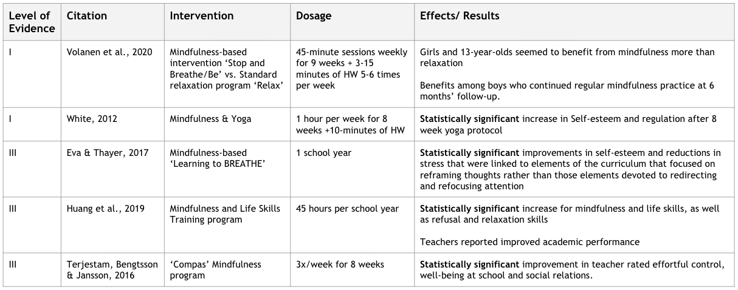
Theme 1: Mindfulness-Based Interventions (n=10)

Slide 34
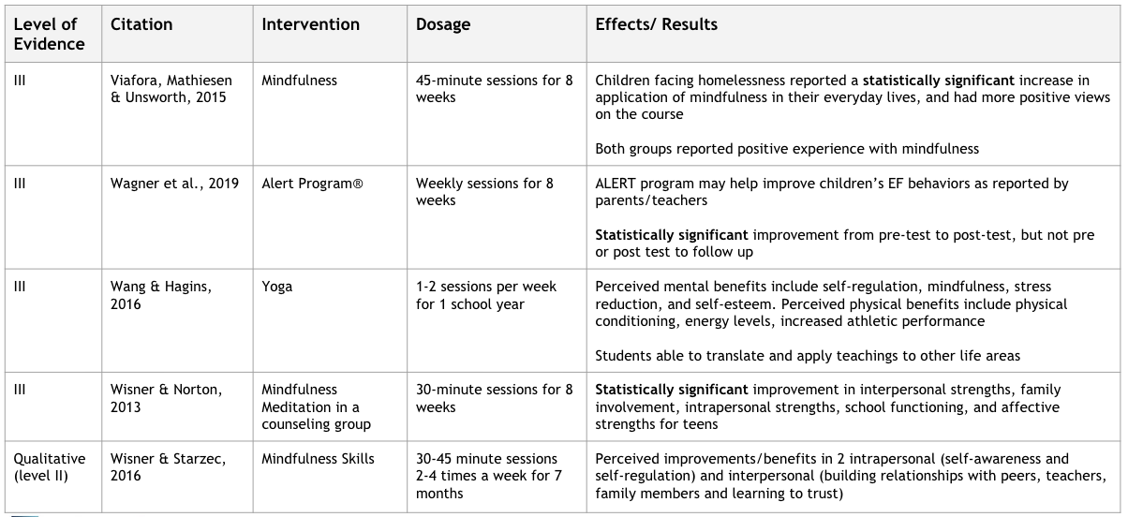
Theme 1: Mindfulness-Based Interventions (n=10)

Slide 35
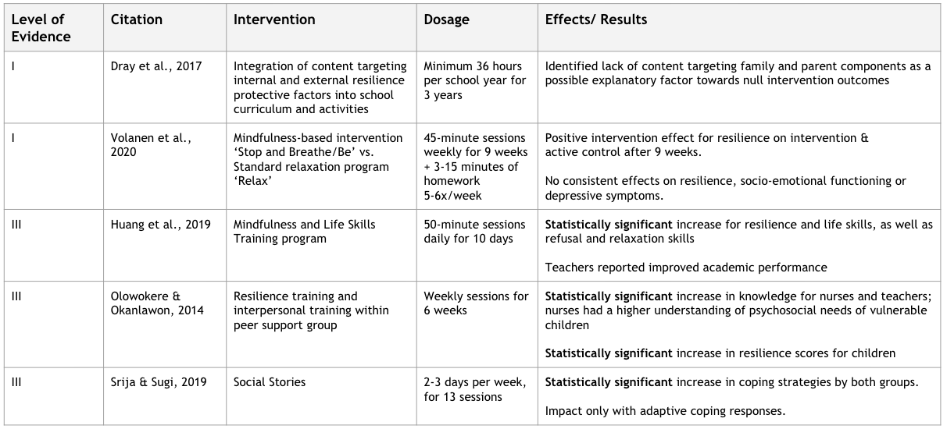
Theme 2: Resilience Training (n=9)

Slide 36
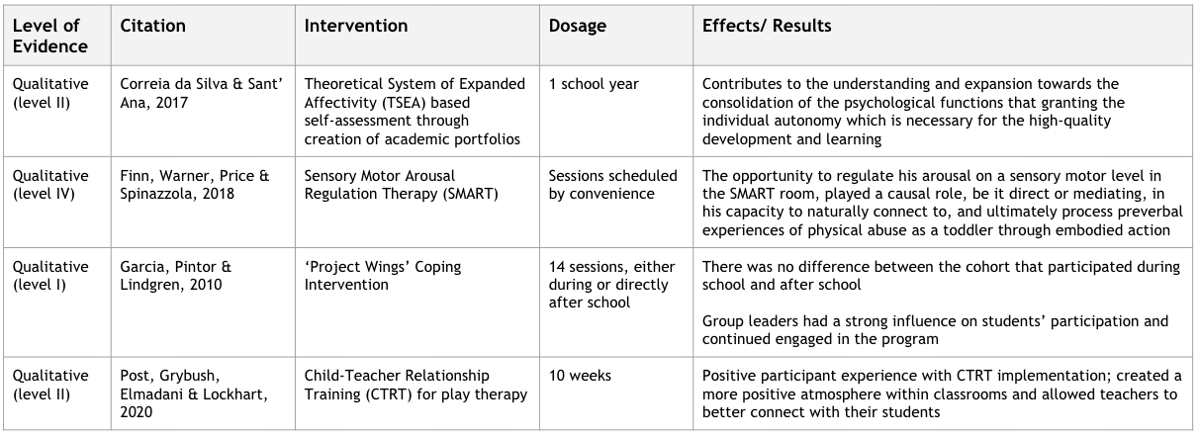
Theme 2: Resilience Training (n=9)

Slide 37
Strength of Evidence
Strong: Two or more Level I studies; The available evidence usually includes consistent results from well-designed, well-conducted studies.
Moderate: At least one Level I high-quality study or multiple moderate-quality studies (Level II, Level III, etc.)
Mindfulness-Based Interventions
Resilience Training
Low: Small number of low-level studies, flaws in the studies, etc.
(Sackett et al., 1996)

Slide 38
Strengths and Limitations of Studies/ Articles Reviews
Strengths | Limitations
Previous data to support the need and benefit of these studies Found large RCTs “the gold standard” Valid and reliable outcome measures Consistency in those delivering services Buy in from staff and students Embedded into school day routines | Small/ homogenous sample Multiple studies lacking a control group; insubstantial rigor Bias for success/concerns with blinding Lack of long term follow up

Slide 39
Implications for Occupational Therapy Practice

Slide 40
Clinical PICO Question
What trauma-informed occupational therapy interventions improve emotional regulation and participation in school-based tasks for students?
There is moderate evidence to support occupational therapy interventions focusing on mindfulness and resilience training to improve emotional regulation, self-esteem, academic achievement and school participation for children who have experienced or are at increased risk for experiencing trauma as well as a universal precaution for all children.

Slide 41
Implications
Occupational Therapy Practice | Educators | Research
Advocate to reduce stigma and increase awareness of childhood trauma Facilitate the development of safe school environments Supports group-based interventions for both mindfulness and resilience training; resilience training interventions extended throughout a school year were more successful and mindfulness-based interventions averaged 45-minute sessions for 8 weeks | Encourage embedding trauma-informed care principles into OT school curriculum Educate OT practitioners in school settings on signs and symptoms of trauma Implementation of continuing education courses for school based OTs focused on trauma informed care in schools | Improve research level of studies to include higher level I and II studies Increase study rigor Examine the long-term effects of interventions, and the connection to developmental milestones

Slide 42
Acknowledgements
E. Adel Herge, OTD, OTR/L, FAOTA
Gary Kaplan, MSLIS, AHIP
Paul Hunter, DMD, MLIS
Gregory Laynor, MLS, PhD
Larissa Gordon, MS, MEd, MA
Maclain Capron
Rebecca Sinko, OTD, OTR/L
Our classmates, the BS/MS 2020 Cohort
Our families, significant others, friends and support systems

Slide 43
Thank you!
Notes:
42-45 minutes total
approx. 10 minutes each
11.5 sb
9.45 mm
9.45 sk
8.5 sc

Slide 44
References
American Occupational Therapy Association [AOTA]. (2014). Occupational therapy practice framework: Domain and process (3rd ed). American Journal of Occupational Therapy, 68, s1-s48. http://dx.doi.org/10.5014/ajot.2014.682006
American Occupational Therapy Association [AOTA]. (2016). Occupational Therapy’s Role with School Settings. Retrieved from https://www.aota.org/~/media/Corporate/Files/AboutOT/Professionals/WhatIsOT/CY/Fact-Sheets/School%20Settings%20fact%20sheet.pdf
American Psychiatric Association. (2013). Diagnostic and statistical manual of mental disorders (5th ed.). Washington, DC: Author
Bloom,S.L., & Harrison, L.C. (2011, September 18). Trauma and Hyperarousal [PowerPoint Slides]. National Network to Eliminate Disparities in Behavioral Health. nned.net/docs-general?Webinar_1_SLB_HANDOUT.pdf
Centers for Disease Control and Prevention [CDC]. (2013). About the CDC-Kaiser ACE Study. Retrieved from https://www.cdc.gov/violenceprevention/childabuseandneglect/acestudy/about.html
Correia da Silva, N. & Sant’ Ana, H.L. (2017). Developing psychic self-regulation in children through self-assessment portfolios in school interaction. Paidéia, 27(1), 475-483. doi:10.1590/1982-432727s1201713
Cronholm, P.F., Forke, C.M., Wade, R., Bair-Merritt, M.H., Davis, M., Harkins-Schwarz, M., ... Fein, J. (2015). Adverse childhood experiences: Expanding the concept of adversity. American Journal of Preventive Medicine, 49(3), 354-361. doi: 10.1016/j.amepre.2015.02.001
Dray, J., Bowman, J., Campbell, E., Freund, M., Hodder, R., Wolfenden, L., Richards, J., Leane, C., Green, S., Lecathelinais, C., Oldmeadow, C., Attia, J., Gillham, K. (2017). Effectiveness of a pragmatic school-based intervention targeting student resilience protective factors in reducing mental health problems in adolescents. Journal of Adolesc., 57, 74-89. http://dx.doi.org/10.1016/j.adolescence.2017.03.009
Eva, A.L. & Thayer, N.M. (2017). Learning to BREATHE: A pilot study of a mindfulness-based intervention to support marginalized youth. Journal of Evidence-Based Complementary & Alternative Medicine, 22(4), 580-591. doi:10.1177/2156587217696928
Finn, H., Warner, E., Price, M. & Spinazzola, J. (2018). The boy who was hit in the face: Somatic regulation and processing of preverbal complex trauma. Journ Child Adol Trauma, 11, 277-288. doi 10.1007/s40653-017-0165-9
Garcia, C., Pintor, J. K., & Lindgren, S. (2010). Feasibility and acceptability of a school-based coping intervention for Latina adolescents. The Journal of School Nursing, 26(1), 42-52.
Letts, L., Wilkins, S., Law, M, Stewart, D., Bosch, J. & Westmorland, M. (2014). Qualitative review form and guidelines. In Law, M. & MacDermid, J. (Eds). Evidence-based rehabilitation: A guide to practice, Third edition. (pp.357-374). Thorofare, NJ: Slack Incorporated.
Law, M., Stewart, D., Pollock, N.,, Letts, L & Bosch, J. (2014). Quantitative review form and guidelines. In Law, M. & MacDermid, J. (Eds). Evidence-based rehabilitation: A guide to practice, Third edition. (pp.375-389). Thorofare, NJ: Slack Incorporated.
Huang, C. C., Chen, Y., Greene, L., Cheung, S., & Wei, Y. (2019). Resilience and emotional and behavioral problems of adolescents in China: Effects of a short-term and intensive mindfulness and life skills training. Children and Youth Services Review, 100, 291-297.
Mendelson, T., Tandon, S. D., O'Brennan, L., Leaf, P. J., & Ialongo, N. S. (2015). Brief report: Moving prevention into schools: The impact of a trauma-informed school-based intervention. Journal of Adolescence, 43, 142-147.
Notes:
Citation for level of evidence table:
Haynes, R. B., Muir Gray, J. A., Richardson, W. S., Rosenberg, W. M. & Sackett, D.L. (1996). Evidence-based medicine: What it is and what it isn’t. British Medical Journal, 312, 71–72.

Slide 45
References
Ohio Department of Education. (2019, July 1). The impact of trauma on students. http://education.ohio.gov/Topics/Student-Supports/PBIS-Resources/Trauma-Informed-Schools/The-Impact-of-Trauma-on-Students
Olowokere, A. E., & Okanlawon, F. A. (2014). The effects of school-based psychological intervention on resilience and health outcomes among vulnerable children. The Journal of School Nursing, 30(3), 206-215. doi:10.1177/1059840513501557
Petrenchik, T. & Weiss, D. (2015). Childhood trauma: Occupational therapy’s role in mental health promotion, prevention, and intervention with children and youth. Retrieved from https://www.aota.org/Practice/Children-Youth/Mental%20Health/School-Mental-Health.aspx
Post, P. B., Grybush, A. L., Elmadani, A., & Lockhart, C. E. (2020). Fostering resilience in classrooms through child-teacher relationship training. International Journal of Play Therapy, 29(1), 9-19. doi:10.1037/pla0000107
Ryan, K., Lane, S. J., & Powers, D. (2017). A multidisciplinary model for treating complex trauma in early childhood. International Journal of Play Therapy, 26(2), 111-123. doi:10.1037/pla0000044
Srija, S. S., & Sugi, S. (2019). Effectiveness of social stories in coping with bullying among children with childhood psychiatry conditions. The Indian Journal of Occupational Therapy, 51(2), 1-3. Retrieved from https://jefferson-illiad-oclc-org.proxy1.lib.tju.edu/illiad/illiad.dll?Action=10&Form=75&Value=119219
Substance Abuse and Mental Health Services Administration. (2014).Trauma-Informed Care in Behavioral Health Services. Treatment Improvement Protocol (TIP) Series 57. Rockville, MD: Substance Abuse and Mental Health Services Administration.
Terjestam, Y., Bengtsson, H., & Jansson, A. (2016). Cultivating awareness at school. Effects on effortful control, peer relationships and well-being at school in grades 5, 7, and 8. School Psychology International, 37(5), 456-469. doi:10.1177/0143034316658321
The Trauma Informed Care Project (2020, February 11). What is TIC?. http://www.traumainformedcareproject.org
Van der Kolk, B. A. (1989). The compulsion to repeat the trauma: Re-enactment, re-victimization, and masochism. Psychiatric Clinics of North America, 12, 389–411.
Viafora, D. P., Mathiesen, S. G., & Unsworth, S. J. (2015). Teaching mindfulness to middle school students and homeless youth in school classrooms. Journal of Child and Family Studies, 24(1), 1179-1191. doi:10.1007/s10826-014-9926-3
Volanen, S., Lassander, M., Hankonen, N., Santalahti, P., Hintsanen, M., Simonsen, N., … Suominen, S. (2020). Healthy Learning Mind- Effectiveness of a mindfulness program on mental health compared to a relaxation program and teaching as usual in schools: A cluster-randomized controlled trial. Journal of Affective Disorders, 260, 660-669. Doi:10.1016/j.jad.2019.08.087
Wagner, B., Olson, H.C., Symons, M., Mazzucchelli, T.G., Jirikowic, Latimer, J., … Cross, D. (2019). Improving self-regulation and executive functioning in primary school children in a remote Australian Aboriginal community: A pilot study of the Alert Program. Australian Journal of Education, 63(1), 98-115. Doi: 10.1177/0004944119826206
Wang, D., & Hagins, M. (2016). Perceived benefits of yoga among urban school students: A qualitative analysis. Evidence-Based Complementary and Alternative Medicine (1), 1-7. Doi: 10.1155/2016/8725654
White, L.S. (2012). Reducing stress in school-age girls through mindful yoga. Journal of Pediatric Health Care, 26(1), 45-56. Doi: 10.1016/j.pedhc.2011.01.002
Wisner, B.L, & Norton, C.L. (2013). Capitalizing on behavioral and emotional strengths of alternative high school students through group counseling to promote mindfulness skills. The Journal for Specialists in Group Work, 38(3), 207-224.
Wisner, B.L. & Starzec, J.J. (2016). The process of personal transformation for adolescents practicing mindfulness skills in an alternative school setting. Child Adolescent Social Work Journal, 33, 245-257. Doi: 10/.1007/s10560-015-0418-0

